Slide 1
Managing with Measures Information Systems for Tracking and Reporting of Strategy Effectiveness Measures Screen shots from live demonstration delivered at the Conservation Measures Summit in Palo Alto, California on May 5, 2010
Dan Salzer
Conservation Science
The Nature Conservancy

Slide 2
Main Topics
Key Measures Questions
From TNC Measures Business Plan
Measures Information Systems
Desktop:
Web:
Next Steps

Slide 3
Key Measures Questions
What results are we trying to achieve?
What actions will achieve results?
Are we making progress implementing actions and achieving desired results?
Notes:
Need to have clear, measureable, time-bound statements of desired results
Theory of change – what are our key assumptions that link our actions to our desired results
Reporting on progress needs to be public, open access

Slide 4
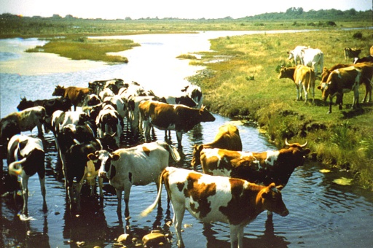
SMART Objectives
Before: Reduce impacts from cattle grazing
Indicator: ???
After: Between 2010 and 2015, maintain cattle-free conditions within 100 ft along 50 miles of the Willow River
Indicator: Miles of river without cattle grazing within 100 ft of river
Notes:
Specify short-term and long-term results
Short-term results (e.g., funding secured, changes in policy)
Long-term results (e.g., threats abated & biodiversity targets improved)

Slide 5
Key Measures Questions
What results are we trying to achieve?
What actions will achieve results?
Are we making progress implementing actions and achieving desired results?
What results are we trying to achieve?
What actions will achieve results?
Actions with adequate detail
Actions linked to desired results
Are we making progress implementing actions and achieving desired results?
Notes:
Theory of change – what are our key assumptions that link our actions to our desired results

Slide 6
Key Measures Questions
What results are we trying to achieve?
What actions will achieve results?
Are we making progress implementing actions and achieving desired results?
Implementation progress ratings
“Percent complete” for all desired results
0% = No progress
100% = Desired results fully achieved
Indicator measurements
Notes:
3 Reporting Metrics for SEM information

Slide 7
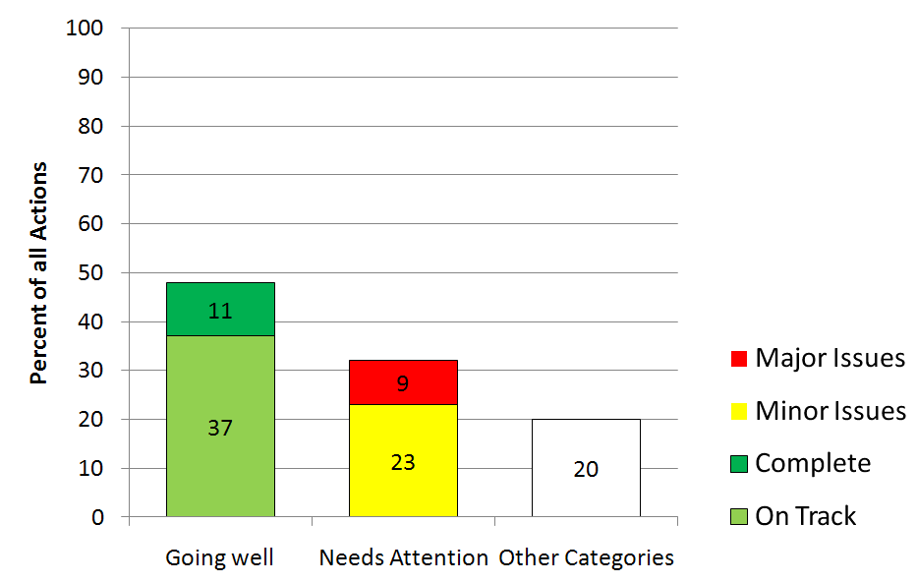
Implementation Progress
Environmental Flow Policy March 2009 Implementation Progress Ratings for 70 Work Plan Activities
Actual Data from March 2009 Report – see next slide for example of tracking details
48% “On-Track” or “Completed”
Same implementation progress rating tracking exists for measures indicators

Slide 8
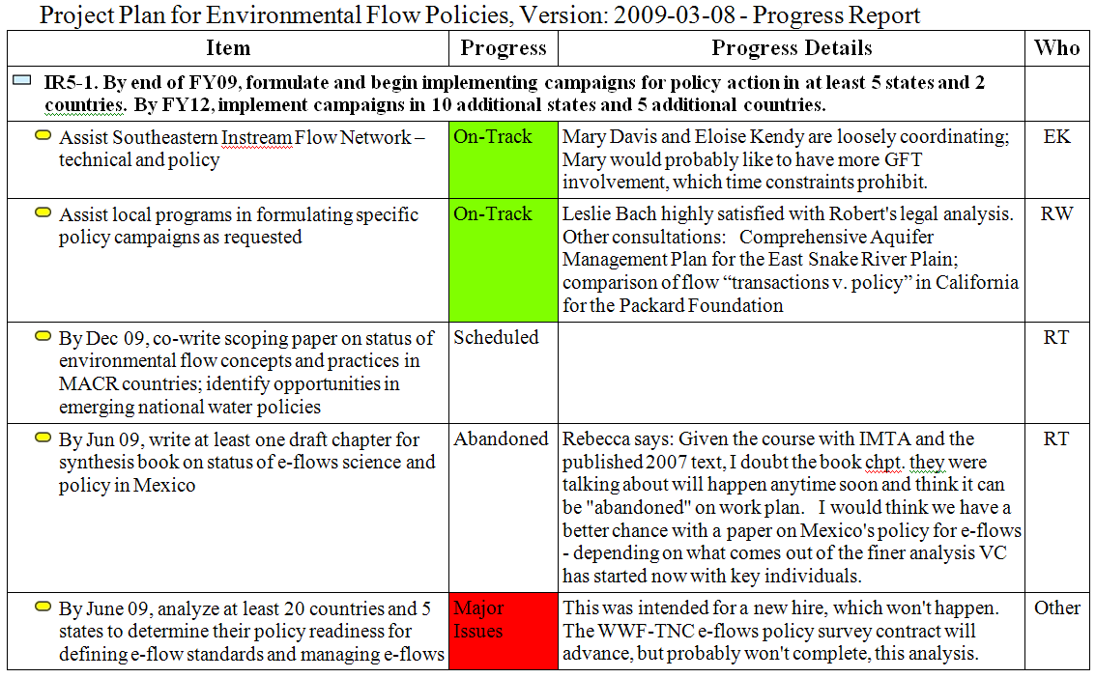
Strategy Implementation – Taking Actions
Example of underlying data in previous slide

Slide 9
Key Measures Questions
What results are we trying to achieve?
What actions will achieve results?
Are we making progress implementing actions and achieving desired results?
Implementation progress ratings
“Percent complete” for all desired results
0% = No progress
100% = Desired results fully achieved
Indicator measurements

Slide 10
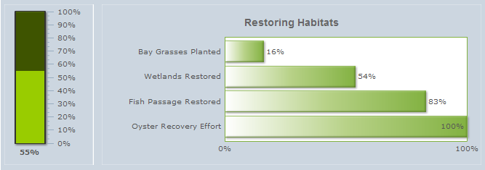
Chesapeake Bay Example
Objective for Wetlands: Restore 25,000 acres of wetlands in the watershed portions of Maryland, Pennsylvania, Virginia and the District of Columbia by 2010.
http://www.chesapeakebay.net/status_restoration.aspx

Slide 11
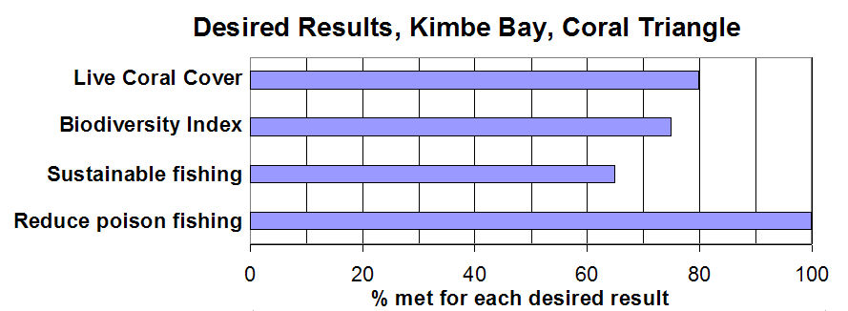
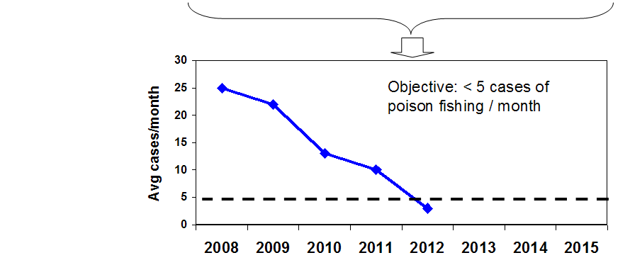
2012 - Percent Complete Report for Kimbe Bay, Coral Triangle
% complete for each desired result
Objective: By 2015, reduce incidence of poison-fishing to less than 5 cases per month in the Kimbe Bay Marine Protected Area.
Shows trend in underlying measures indicator values

Slide 12
Measures Information Management
Desktop Software
Web Access
http://miradi.org
http://conpro.tnc.org

Slide 13
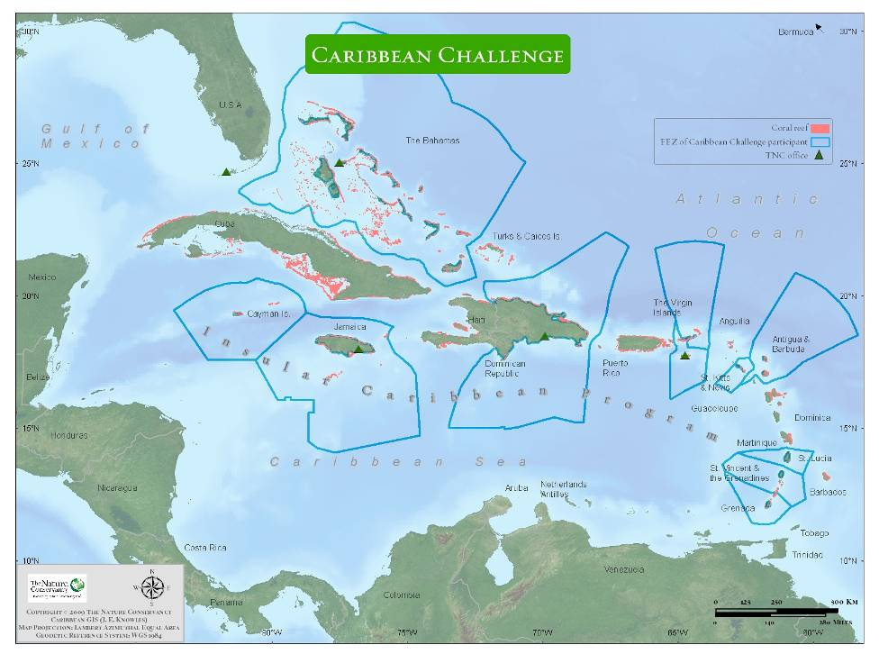

Slide 14
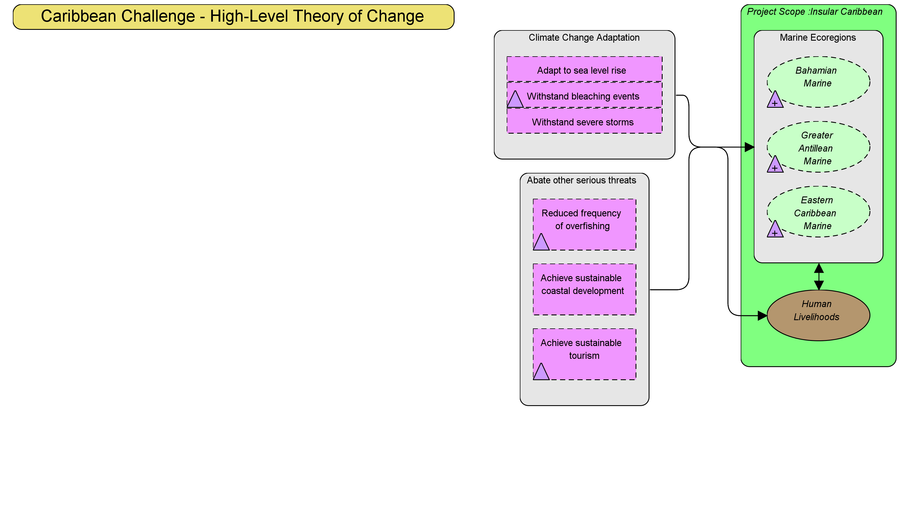
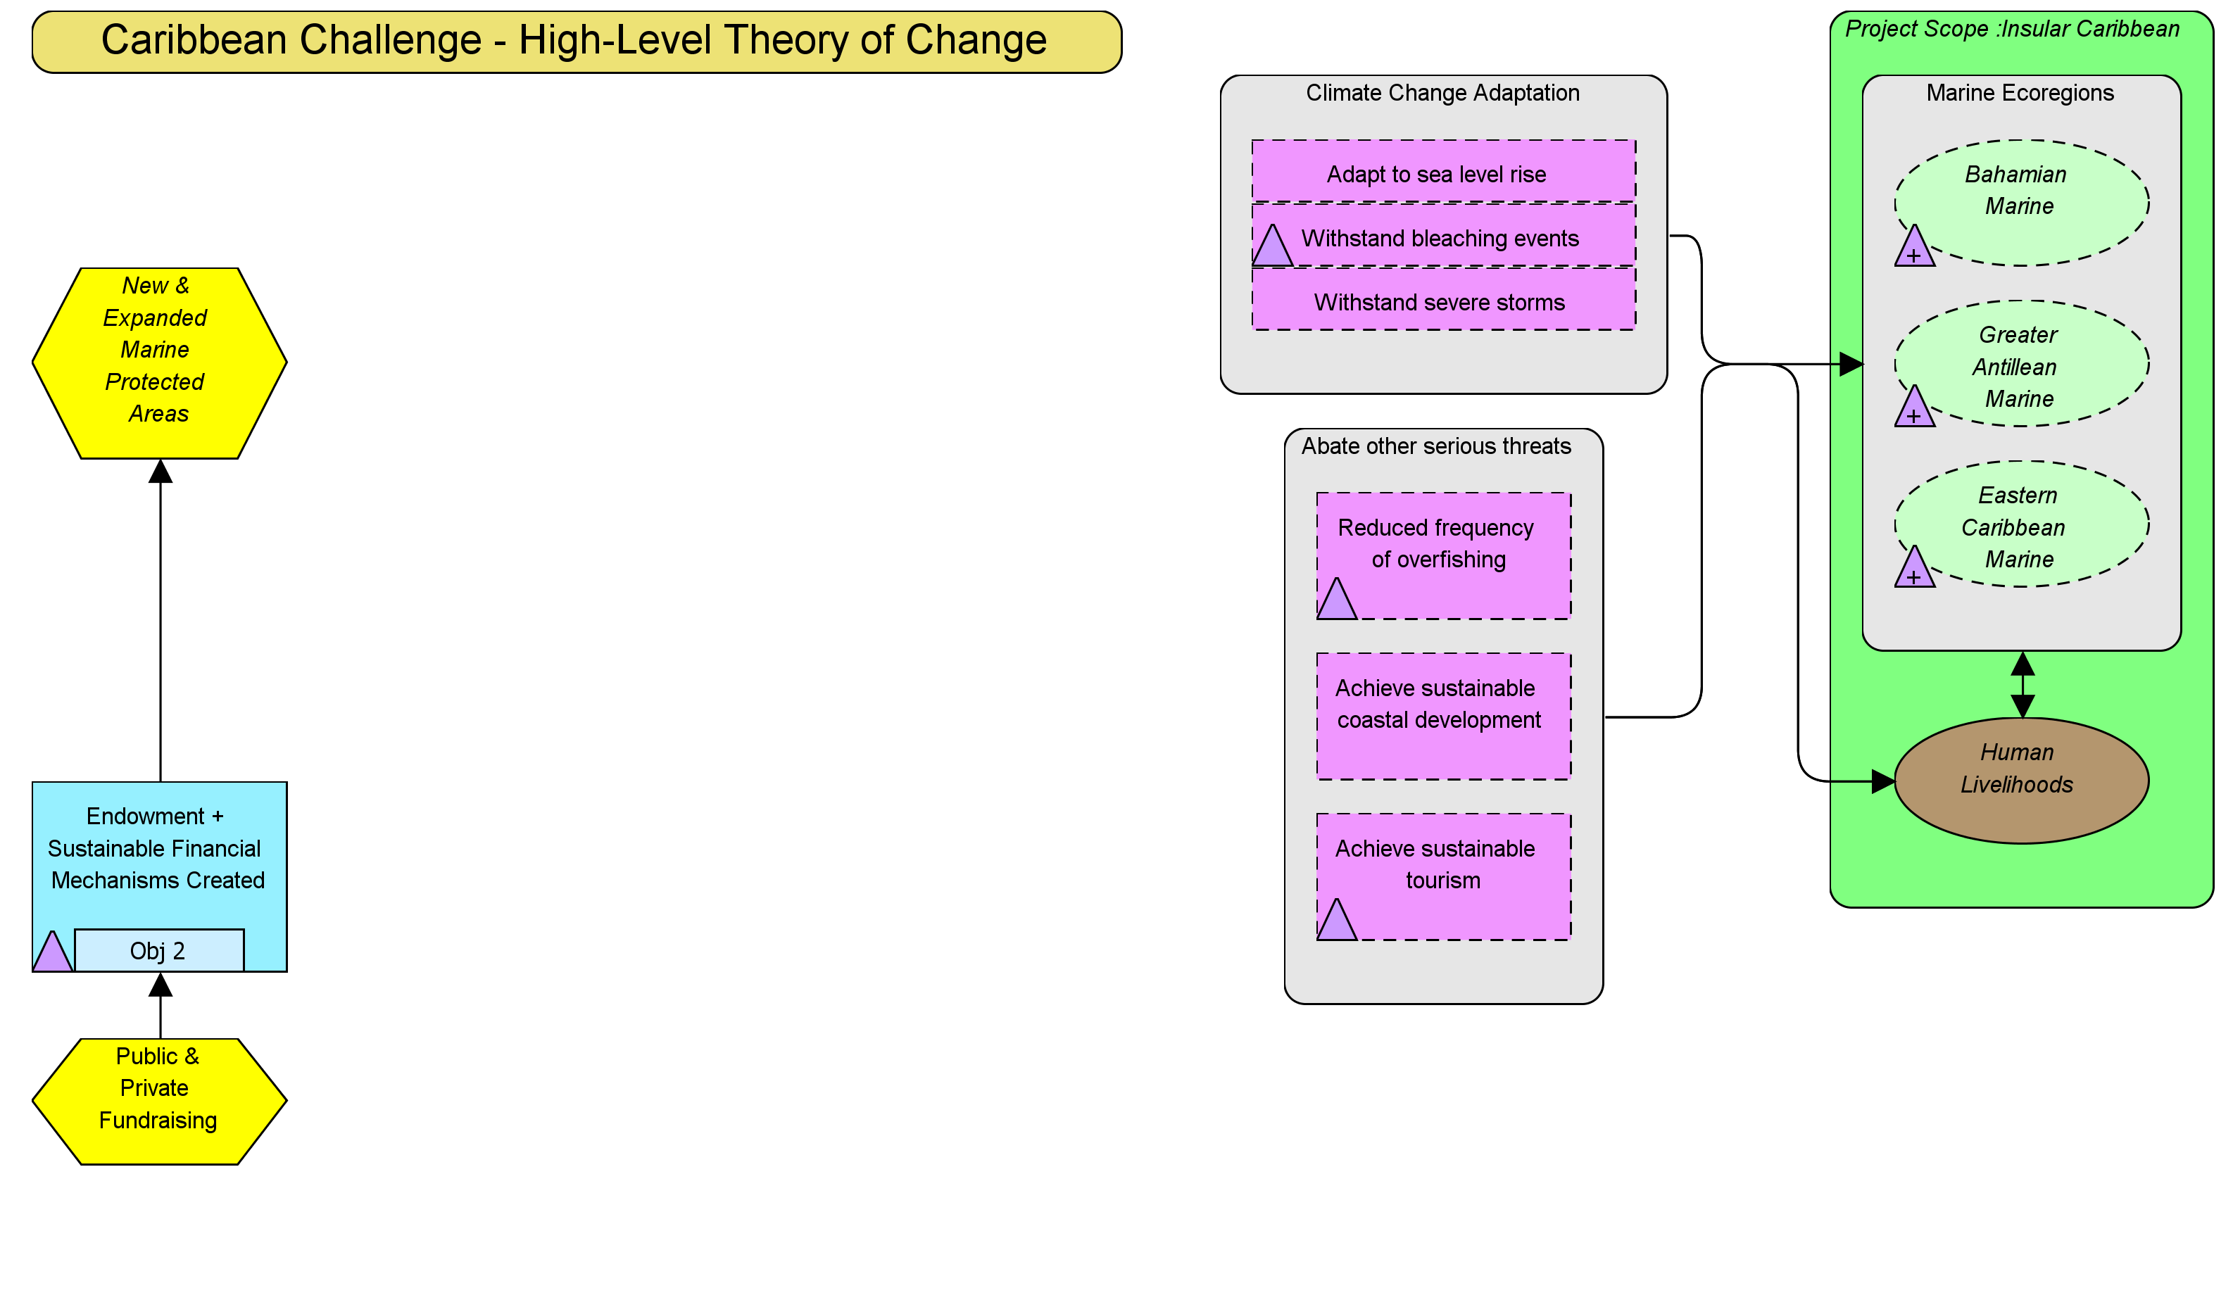
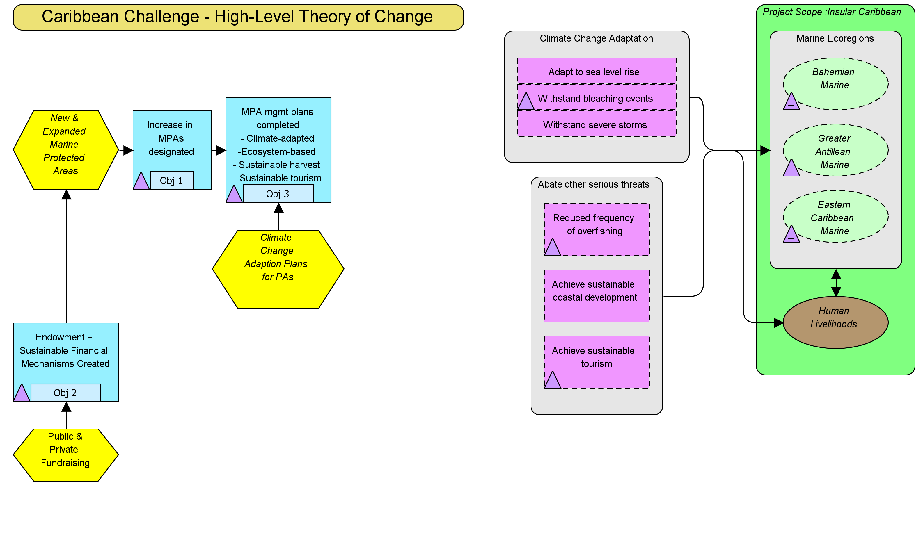
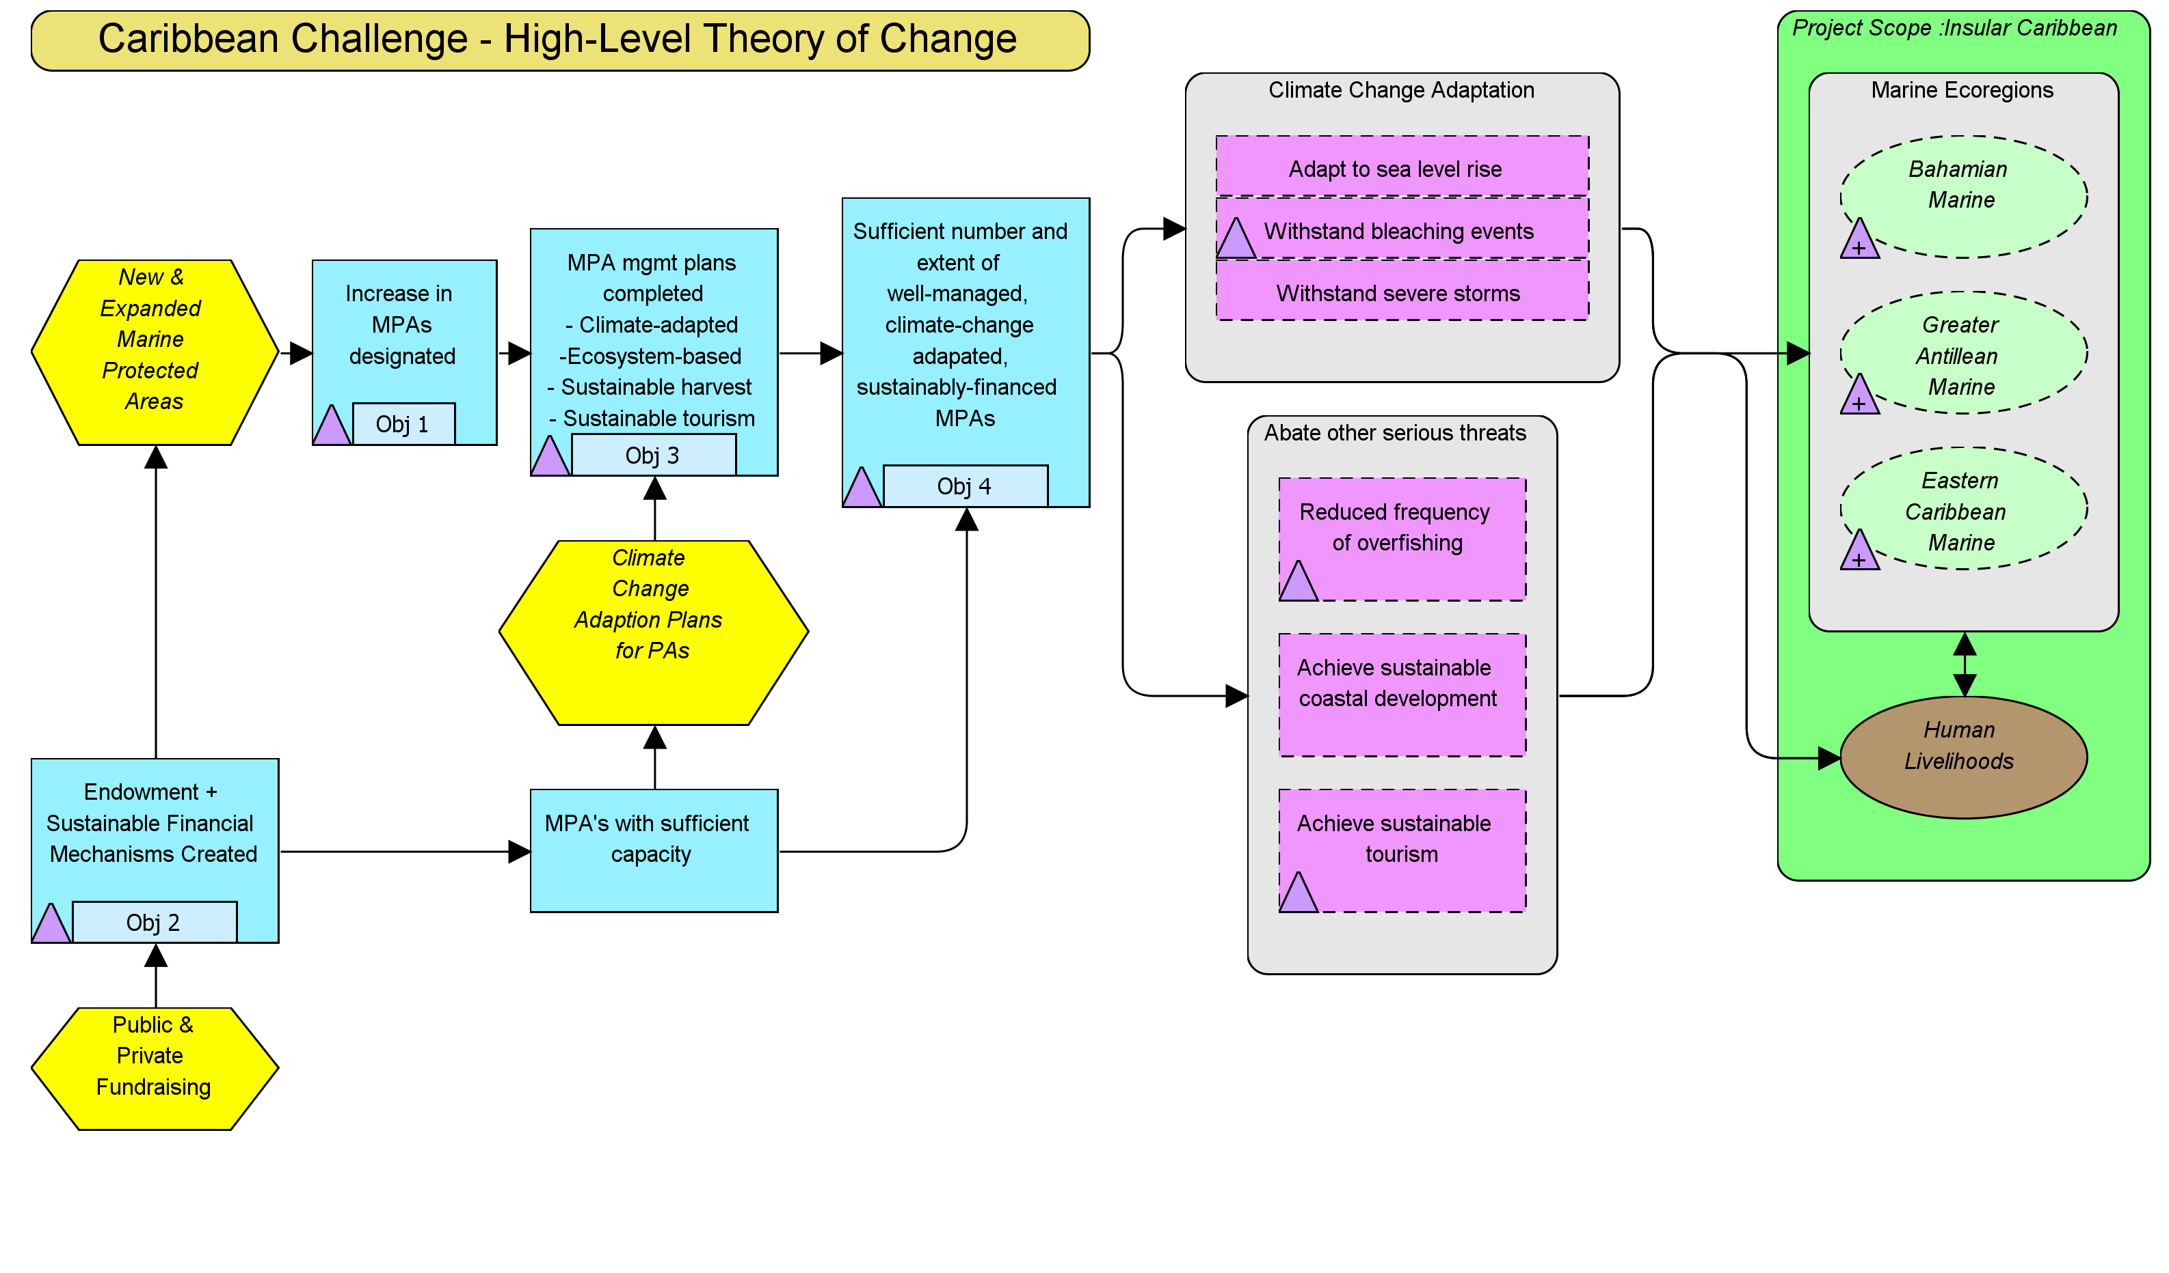
Miradi – Plan, Track, Report

Slide 15
Objectives & Indicators
Objective 3: Management plans approved for 20 new or expanded MPAs by 2015, and management plans updated for 10 existing MPAs by 2013
Indicator: # of management plans completed or updated
Objective 1: 20 million acres coastal-marine habitat protected within expanded MPA networks by 2020.
Indicator: Acres of coastal-marine habitat in MPAs
Objective 2: By 2014, $40 million Caribbean Biodiversity Fund capitalized as regional endowment.
Indicator: Funds Raised
Objective 4: Management effectiveness benchmarks for selected PAs achieved by 2015
Indicator: Management Effectiveness Scores
Need measureable desired results for targets and threat reduction factors

Slide 16
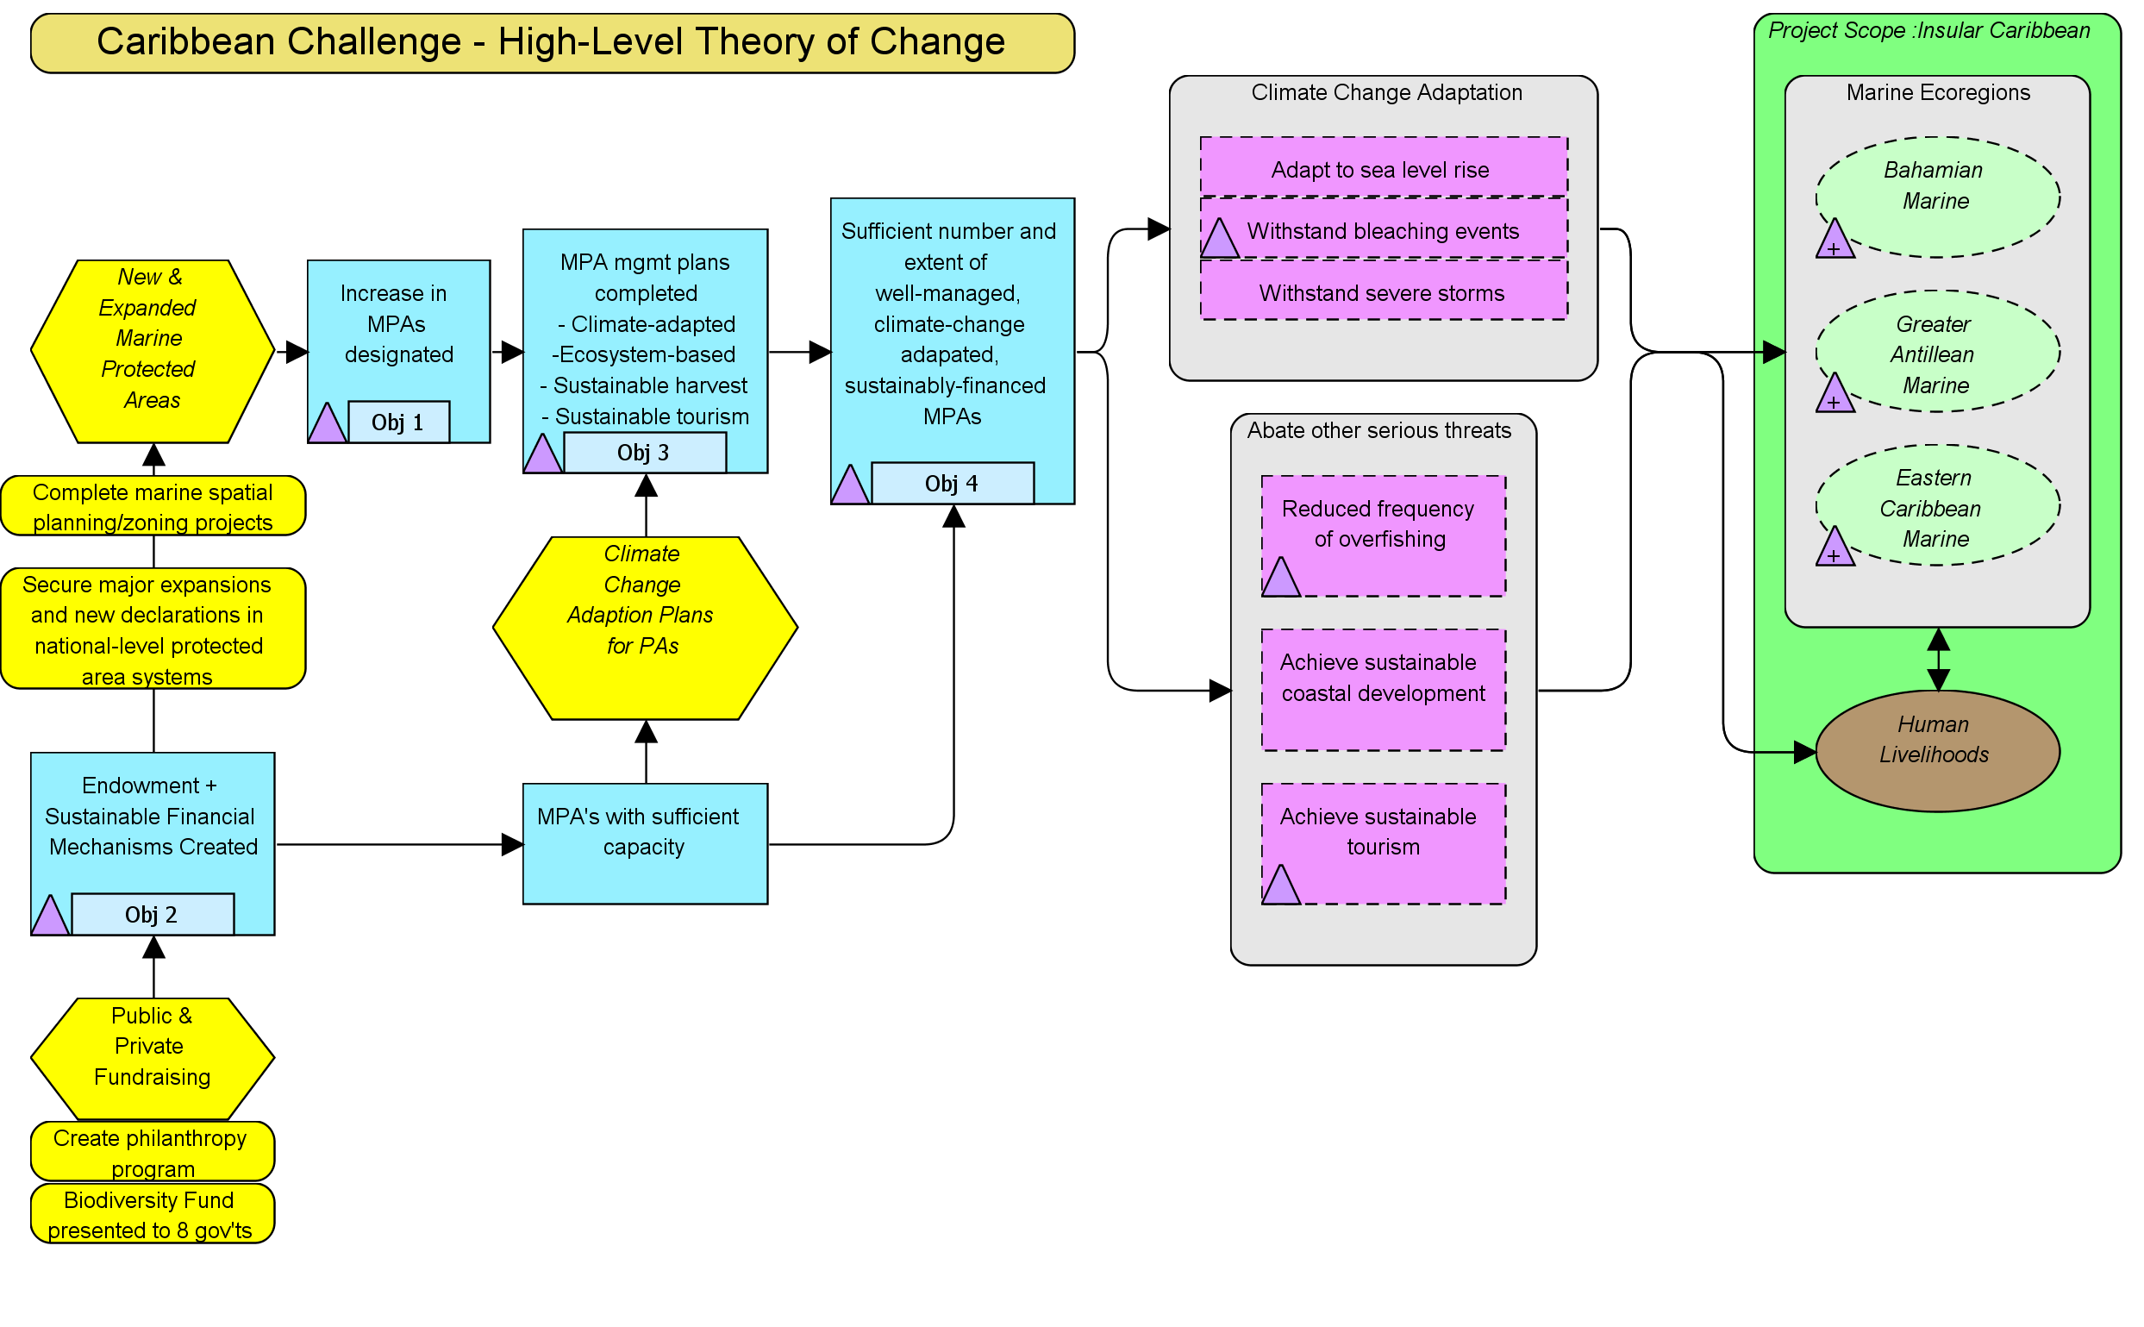
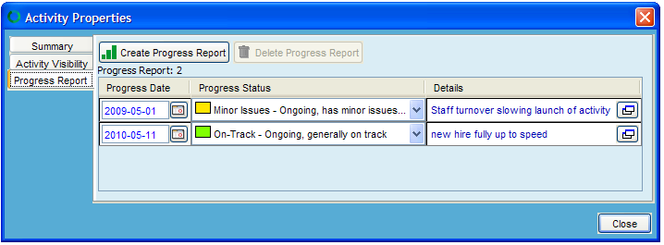
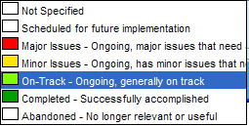
Implementation Progress Measurements
Create new Progress Report rows by clicking on this button
Use Calendar widget to enter dates
Click to open text editor to add comments
Use pull-down menu to assign progress rating
Double-click activity to open dialog box

Slide 17
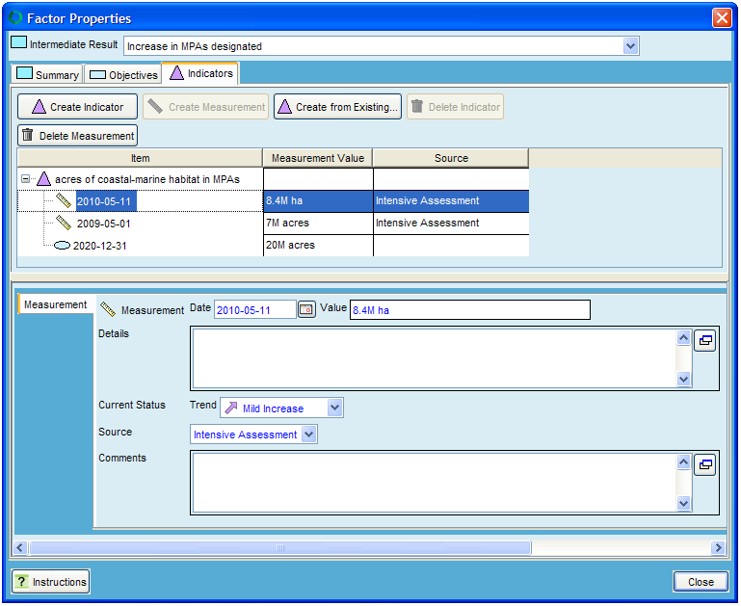
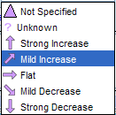
Indicator Measurements
Create new indicator measurement rows by clicking on this button
Enter Indicator measurement
Double-click Indicator icon to open dialog box
Use pull-down menu to assign trend
Use pull-down menu to assign source of data

Slide 18
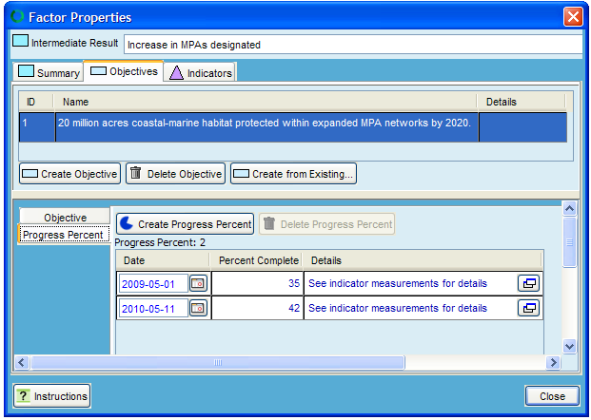
% Complete Measurements
Create new Percent Complete rows by clicking on this button
Enter Percent Complete value
Double-click Objective icon to open dialog box

Slide 19
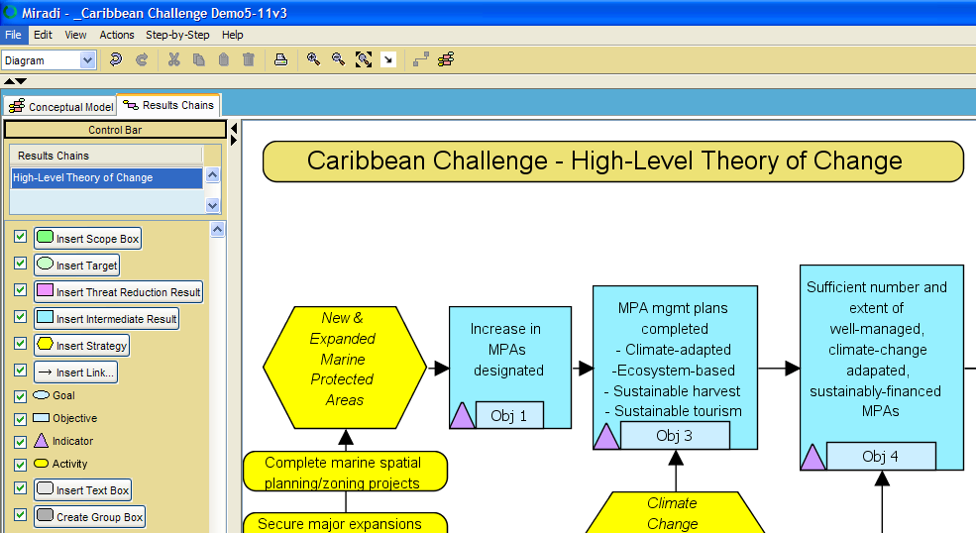
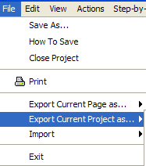
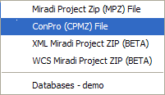
Export to ConPro format

Slide 20
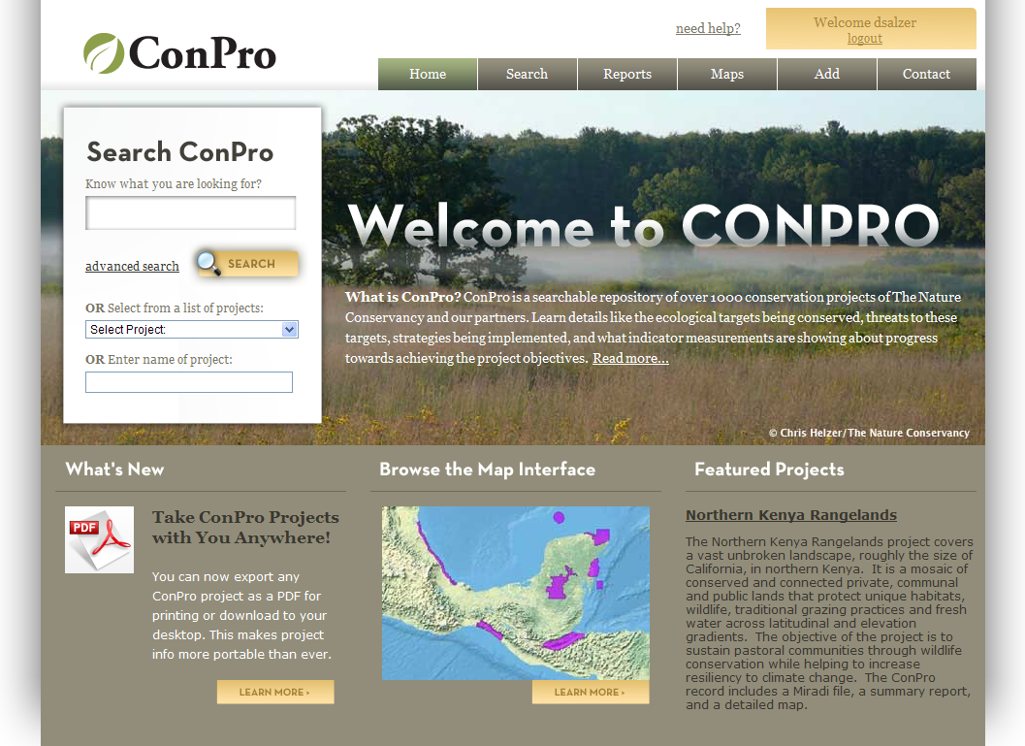

Slide 21
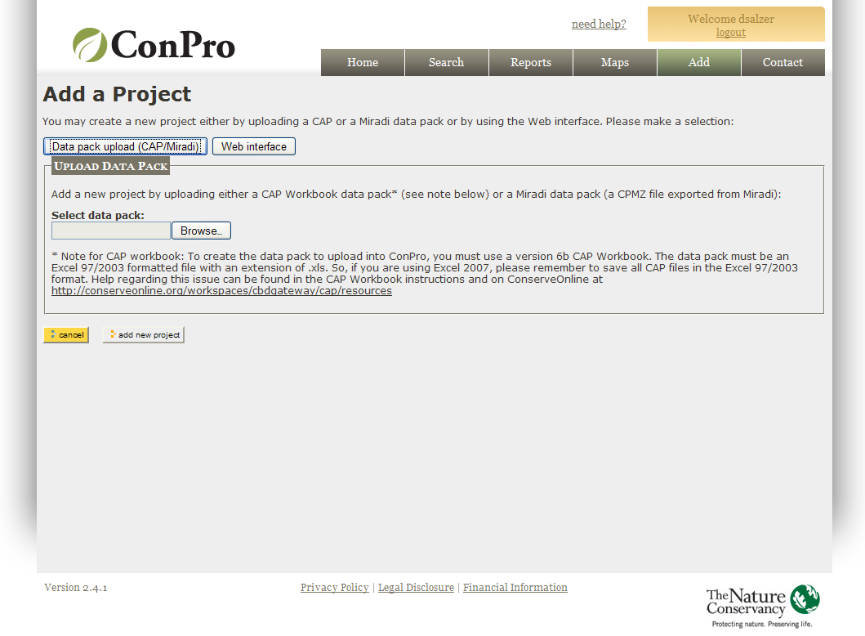
Import Miradi project to ConPro

Slide 22
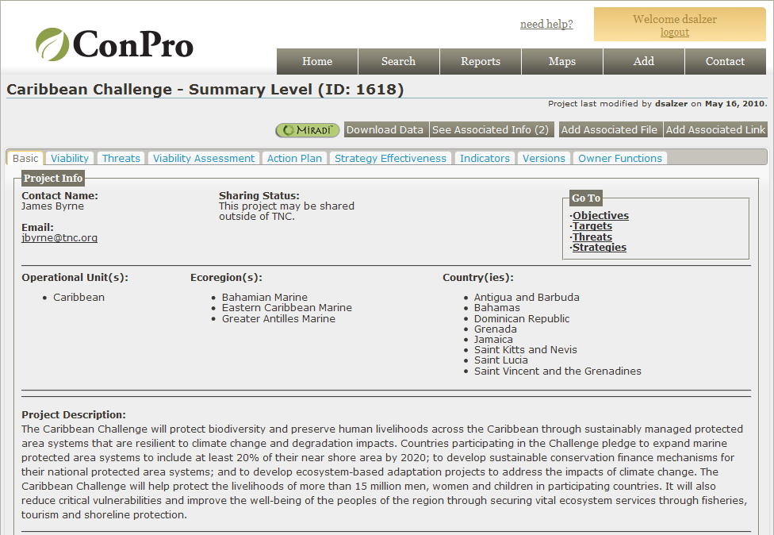
Basic Tab with General Project Information

Slide 23
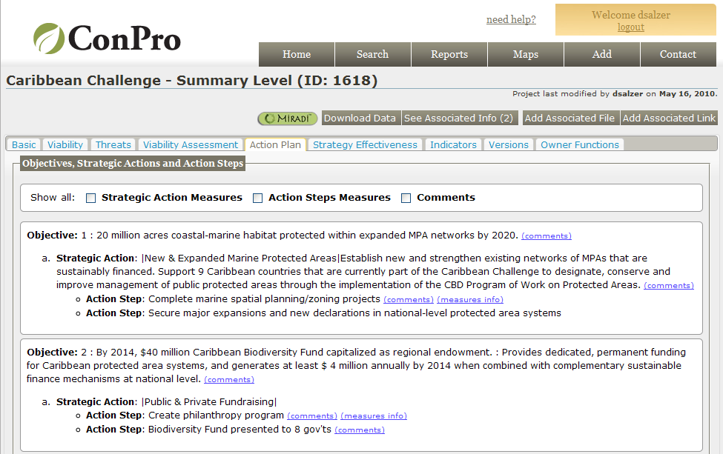
Objectives & Action Plan

Slide 24
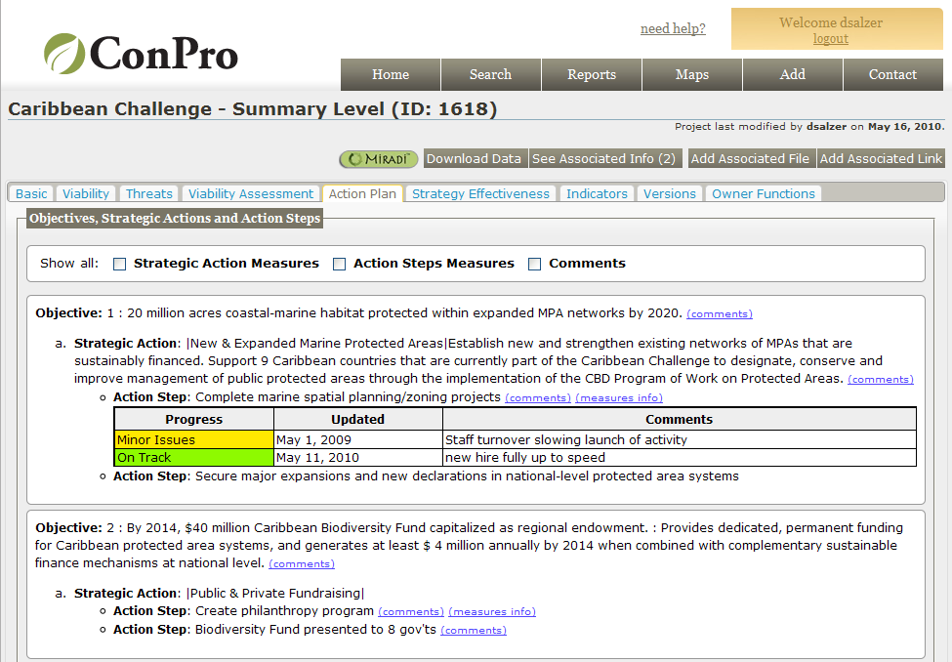
Implementation Measurements

Slide 25
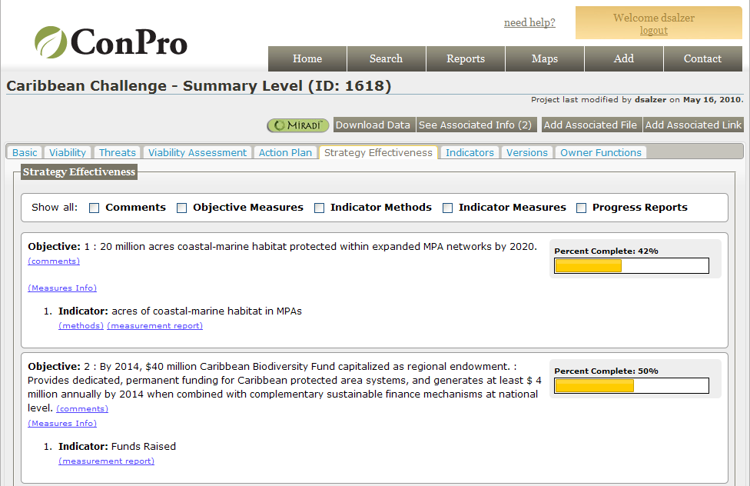
Percent Complete Measurements

Slide 26
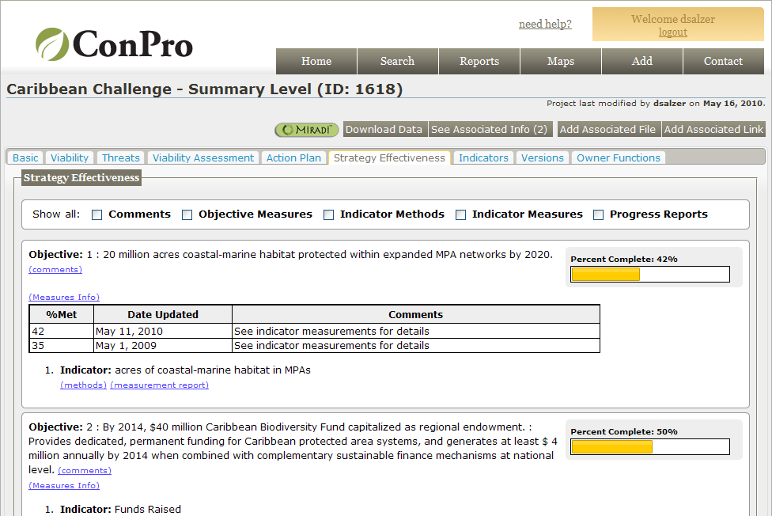
Percent Complete Measurements

Slide 27
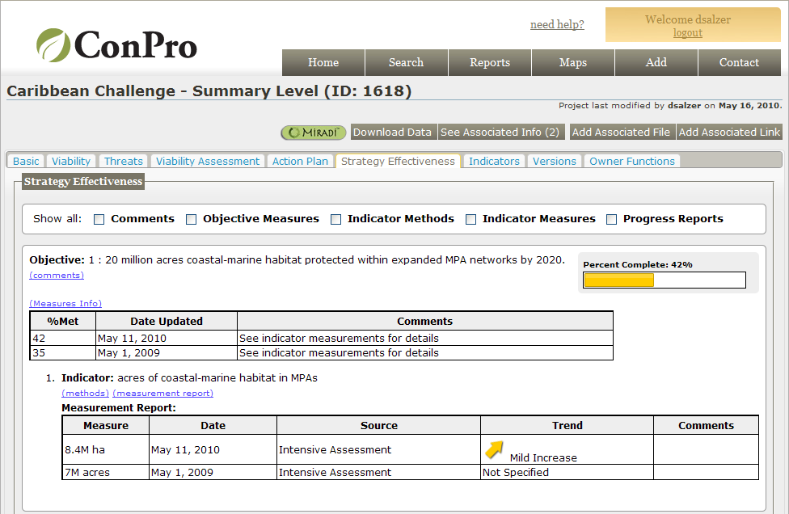
Indicator Measurements

Slide 28
Next Steps - Ingredients for achieving measures adoption
Broad recognition of applied value of Strategy Effectiveness
Sufficient guidance materials, training, and support
Executive leadership endorsement & mandate
Adequate financial support
Information systems that facilitate data entry, management, and full access

