Slide 1
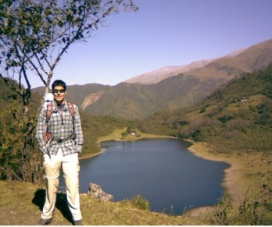
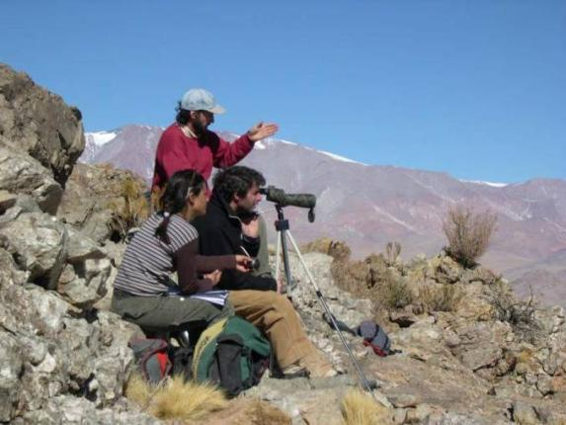
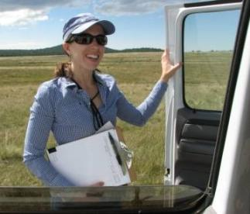
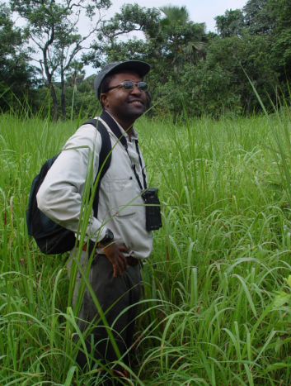
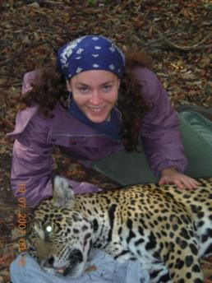
Conservation Project Planning & Adaptive Management
How do we train our practioners?
Notes:
Most of us in the room agree that to be effective in conservation we need to plan our projects well, monitor them, and adapt our efforts based on the evidence we see
A big challenge we face now how do we train practitioners in project planning and adaptive management
Including our current leaders who have may have 20 years of experience
And our emerging leaders, like these dedicated grad students

Slide 2
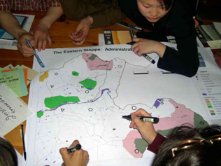

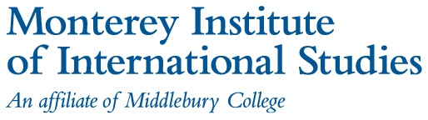

Exciting initiatives for training practitioners
2 examples of university-based opportunities
Strategy for expanding the network of institutions offering training
Notes:
I’d like to quickly tell you about a few exciting initiatives to train conservation practitioners in adaptive management
First, I’ll show you 2 examples of university-based courses being offerered
Then I’ll wrap up by telling you about our strategy, lead by Foundations of success, to expand the network of institutions offering training

Slide 3
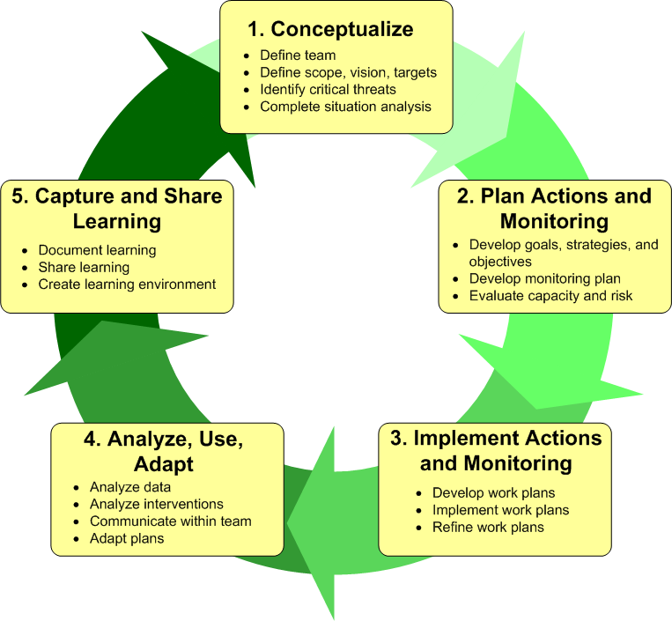

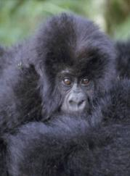
Semester-long course
Systematic Planning of Conservation Projects
CMP Project Cycle
Focus on first 2 stages
Participants become Miradi experts
Notes:
3
The first example I’ll mention is a course I’ve just finished teaching called…
The course was offered to both University of Florida grad students and staff at WCS
My course, as many of the courses I mentioned, is structured around Conservation Measures Partnerships Project Cycle, but focuses on the first 2 stages
Participants spend most of their time concepualizing a project, planning specific activities and strategies, and planning how they will measure their effectiveness.

Slide 4
Course Objectives (UF)
Students will be:
Fluent in the language of adaptive management
Familiar with the all basic steps & tools
Skilled at developing clear and useful visions, goals, objectives, and monitoring plans
Comfortable using several planning tools including Miradi, conceptual models, and results chains
Notes:
4
Some of the course objectives are for student, by the end of the semester, to be…

Slide 5
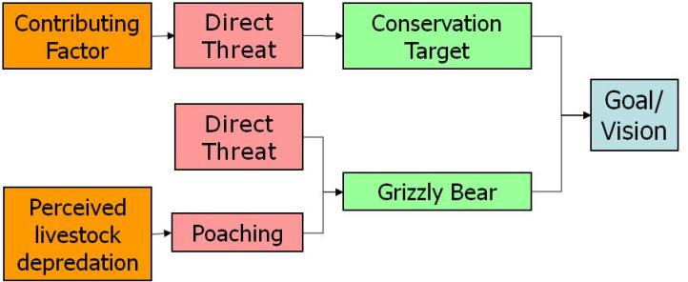
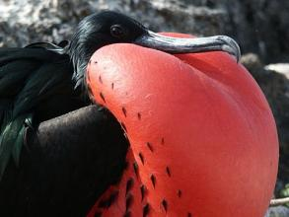
Topics
Vision statements
Stakeholder analysis
Threats assessment
Target selection
Conceptual modeling & results chains
Goal & objective setting
Effectiveness monitoring
Restore & preserve in perpetuity the ecological integrity of Somewhere National Park, so that its native species fulfill their ecological roles undiminished by human activities and exotic species, and the ecosystems of the park continue to provide critical services
By 2020, at least 100 pairs of nesting frigate birds are successfully reproducing in the Marine Reserve
Notes:
5
Just to give you a very quick sense of the meat and potatoes of the course, we cover these topics and more, including
Writing clear and engaging vision statements
Building conceptual models and results chains
And setting measurable goals and objectives
Among several other topics

Slide 6
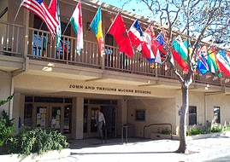
The Conservation Leadership
Practicum (CLP)
A unique two-week certificate course at the Monterey Institute of International Studies
Offered for the past 4 years to 85 students and mid-career professionals
Notes:
The second example of a training opportunity being offered that I’d like to flash in front of your eyes is a unique, intensive, certificate course at the Monterrey Institute of International Studies called the
Conservation Leadership Practicum or CLP
That has now been offered for 4 years and trained over ??? Students?

Slide 7
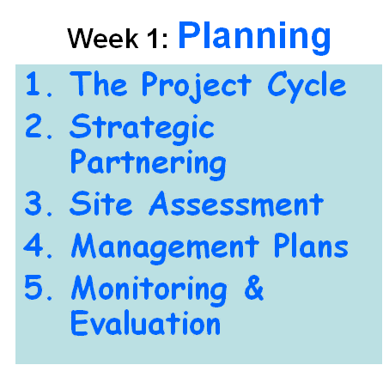
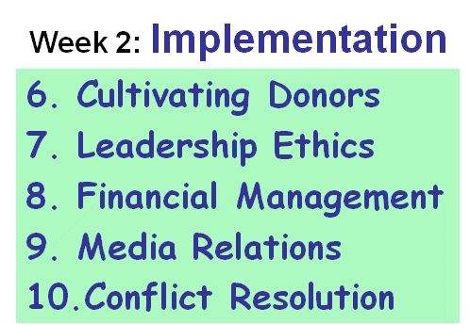
The Conservation Leadership
Practicum (CLP)
Delivering 10 priority skills that environmental leaders need to direct successful projects and programs
Notes:
The courses is structured around delivering 10 priority skills that environmental leaders need to direct successful project and projects.
The first week of the course is quick similar to what I showed you in my class, the conceptualization and planning and monitoring portions of the project cycle.
What’s really exciting and unique about this course is that it moves into the implementation part of the of the cycle
And teaches participants hugely valuable skills such as cultivating donors, financial management, and media relations.

Slide 8
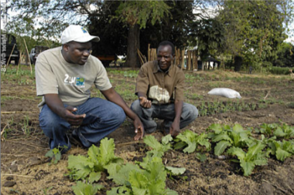

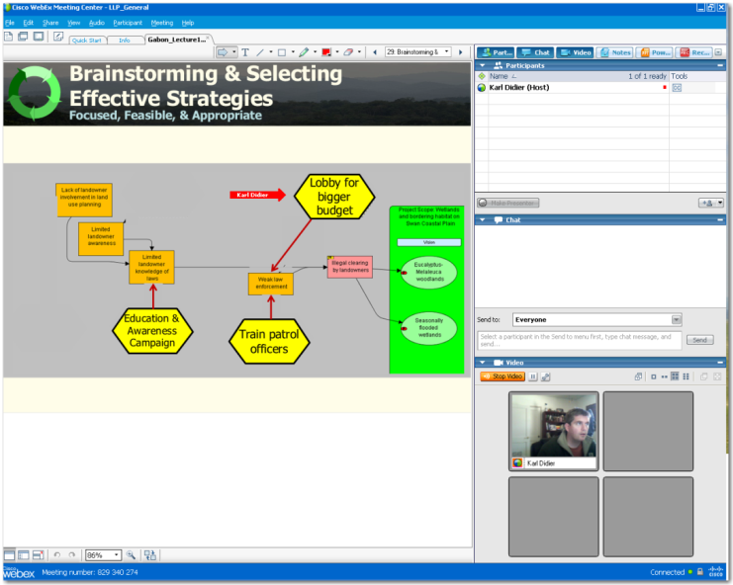
Highlights about AM courses
Aimed at both grad students & professionals
Heavy use of distance learning technology
Students apply principles to real life projects, produce useful conservation recommendations
Webex
Notes:
Just some quick highlights of my course and other AM course
They are aimed not just at grad students, but purposely aim to mix in conservation professionals. The mix is a huge benefit for both.
Because we mix in professionals from around the world, we make heavy use of distance learning technology, such as webex, so are really improving at reaching large global audiences
Students in the course are required to work in collaboration with existing conservation projects
And in many course, produce management plans and recommendations useful for those projects

Slide 9
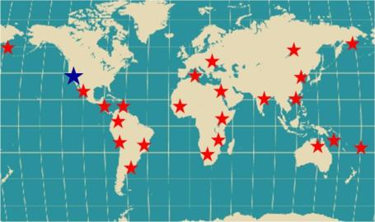
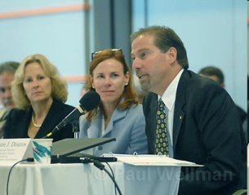
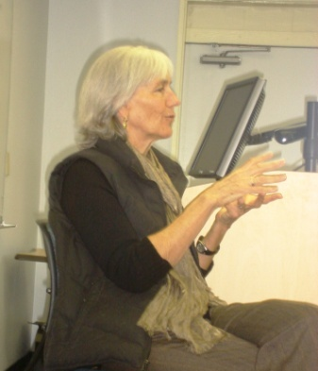
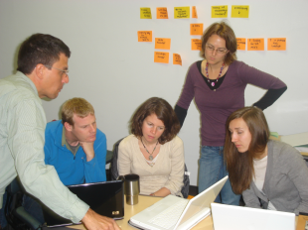
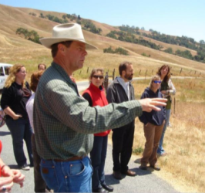
CLP’s Three Strategies
Hands-on Training
CLP
“Meet the Leader”
Project Site Visits
Notes:
The CLP uses 3 methods to get participant involved and excited:
Hands on training with conservation projects around the world, facilitated by highly experienced trainers
Site visits to see how implementation is occurring on the ground
And meet the leader opportunities, where student hear from some of the top leaders in conservation about what works and doesn’t work

Slide 10



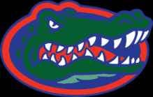



Two examples in a growing list
Univ. of Maryland
Monterrey Institute
Virginia Tech Univ.
Univ. of Florida
Org. for Tropical Studies
Univ. of California at Davis
North Caroline State Univ.
Colorado State Univ.
Columbia Univ.
Eberswalde Univ. (Germany)
Kasetsart Univ. (Thailand)
Latin American School for Protected Areas Training
(4 yrs running!)
Notes:
But a big point is that my course, as is the course at Monterrey Institute, is just one example in a growing list of semester long or intensive courses being offered across the US and in fact around the world now, many of which are modeled in part after the course first taught at the University of Maryland almost over 4 years ago.
We now have trained gators, terrapins, aggies, and hokies!

Slide 11
Vision for Training Emerging Leaders
All "top" conservation programs have a "high quality" course based on the Open Standards.
"By the end of 2015, at least 350 graduate students have successfully completed courses in adaptive management consistent with the CMP Open Standards..."
Notes:
So these courses are just the tip of the iceberg to come:
Foundations of Success’s has developed a vision for expanding the training of emerging leaders in Adaptive management
Including that all top academic programs have a course based in the open standards
And that by 2015, at least 350 grad students have been trained

Slide 12
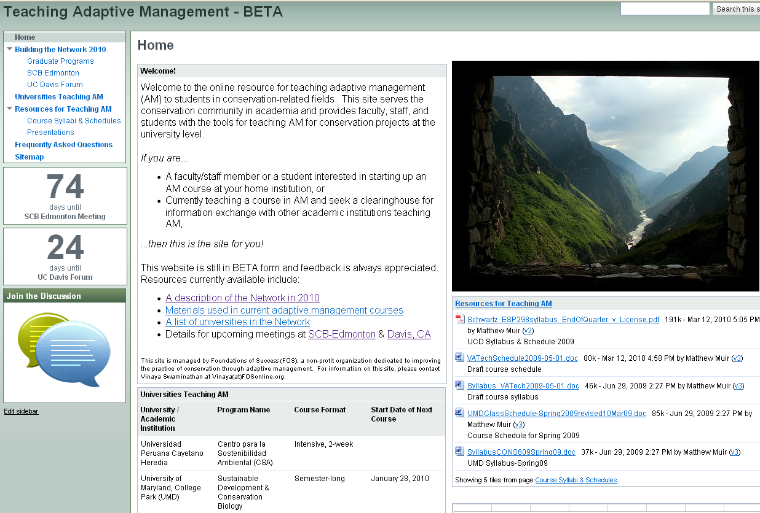
A strategy for reaching the vision
Online Network for Teaching Adaptive Management In Academia
Notes:
One strategy that FOS is leading on is to develop an online network for teachers who are facilitating or want to facilitate courses in adaptive management

Slide 13
A strategy for reaching the vision
Online Network for Teaching Adaptive Management In Academia
Listing & contacts for courses being taught
Places to share lessons & strategies from the classrooom
Tried & tested teaching materials
Notes:
The online network includes lessons from the classroom from those who have years of experience
An area for teachers to share information and discuss what works and doesn’t work
And a space to share teaching materials

Slide 14
Opportunities to link to the network
http://sites.google.com/site/teachadaptivemanagement/
Speed presentation & meeting @ SCB- Edmonton, July 2010
Contact us
Authors & contacts:
Karl Didier (WCS, UF) kdidier@wcs.org
Vinaya Swaminathan vinaya@fosonline.org
Jeff Langholz jeff.langholz@miis.edu
Notes:
That’s about all my time,
If you’re interested or know someone who would be interested in linking to the network, they can visit the networks website
Come to a speed presentation and meeting at SCB
Or just contact me or my co-authors!

