Slide 1
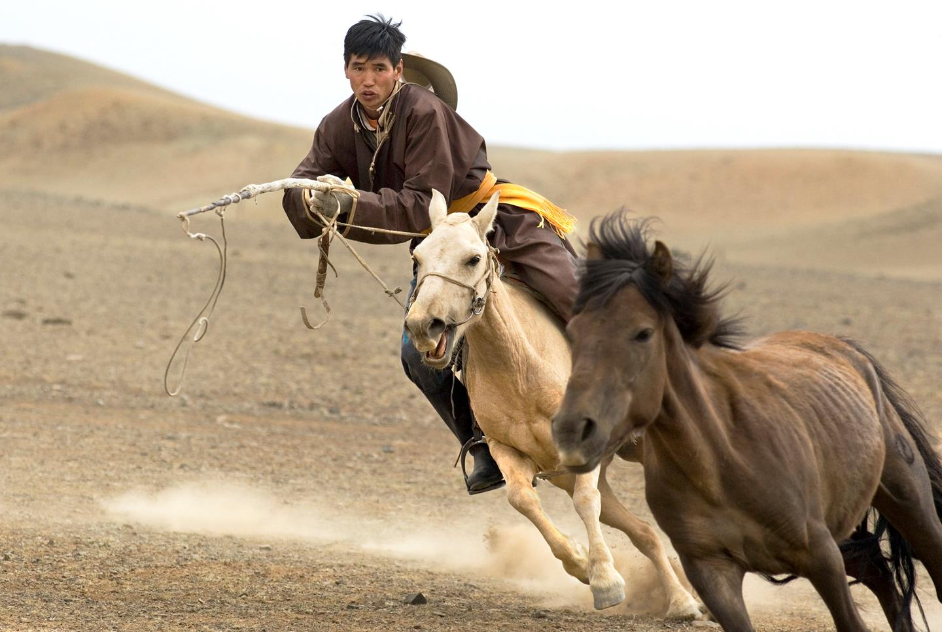
Putting the Open Standards to Work: Mongolia, Patagonia, and Colorado
© Ted Wood
Chris Pague, Senior Conservation Ecologist
Notes:
Welcome and tell a little about me.

Slide 2
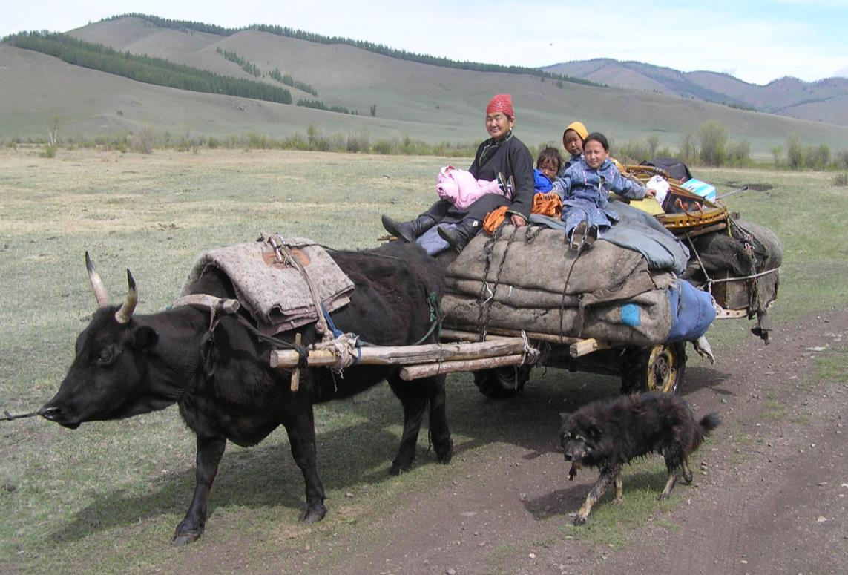
Example I: Mongolia
Notes:
For thousands of years the Mongolian people have lived on the steppe. Keeping the livestock in close herds to protect them from predators also meant that when the grass was eaten, they had to move to new grass. Mobility was and is still the rule of the people. Adaptability is the advantage.

Slide 3
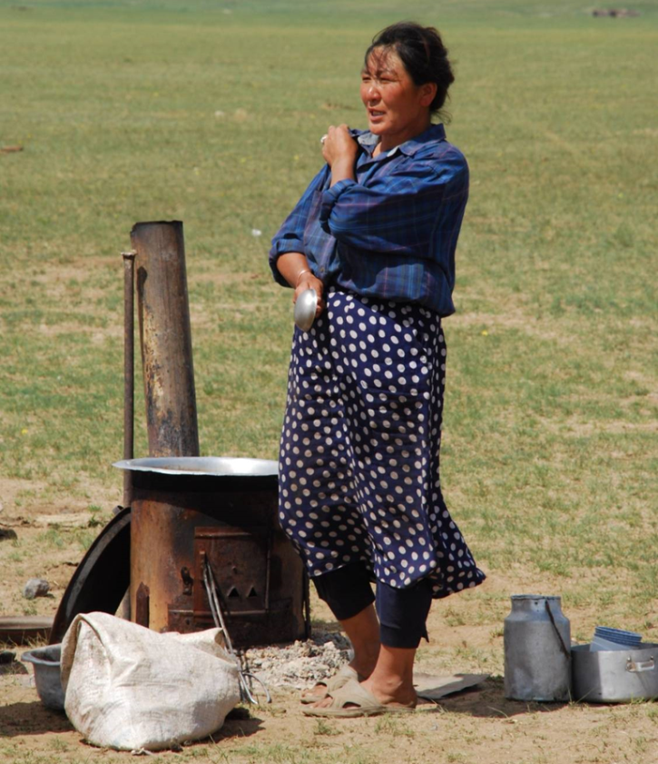
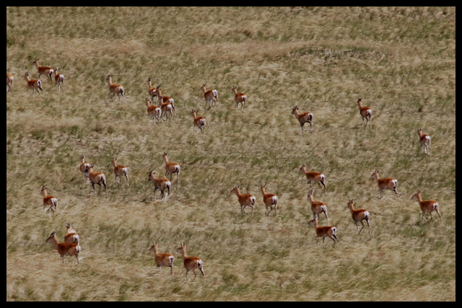
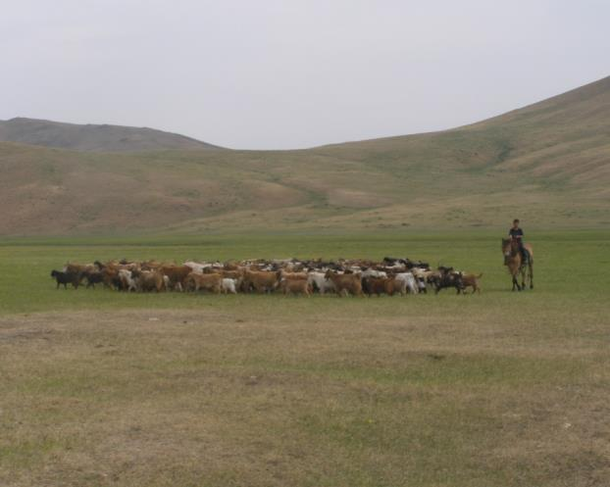
Compatible Use of Grasslands by Humans, Livestock, and Wildlife for Thousands of Years

Slide 4
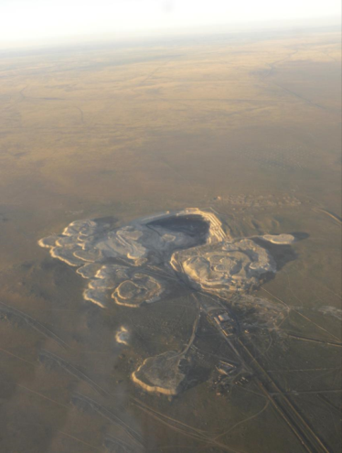
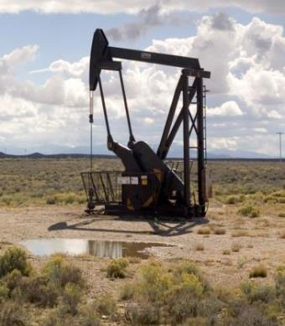
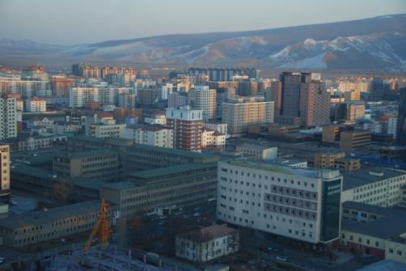
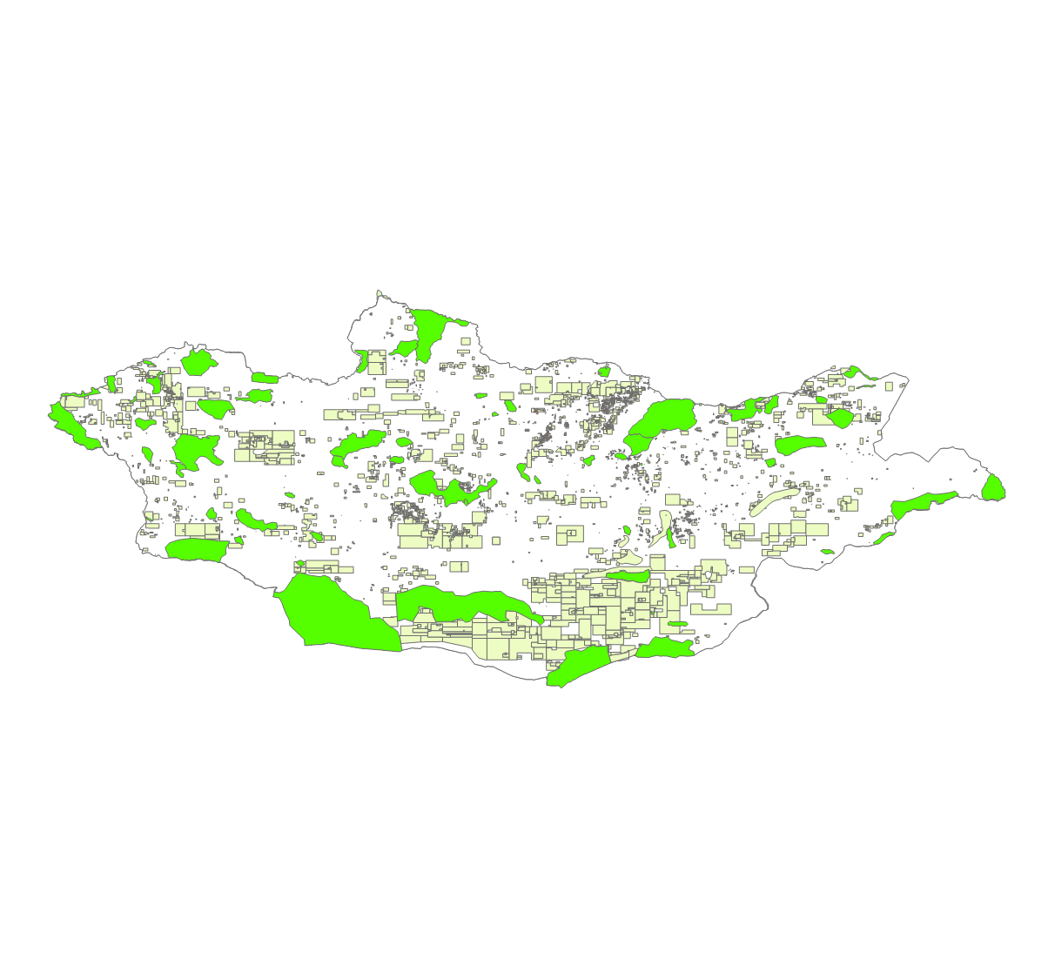
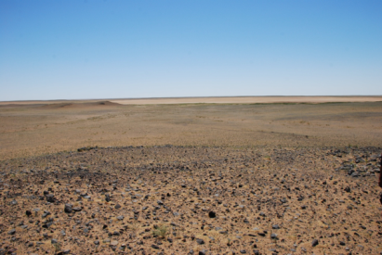
Things changed rather suddenly

Slide 5
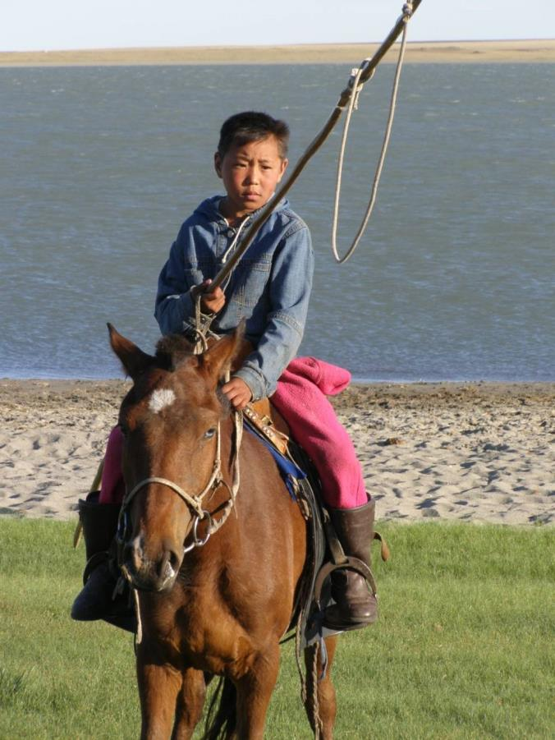
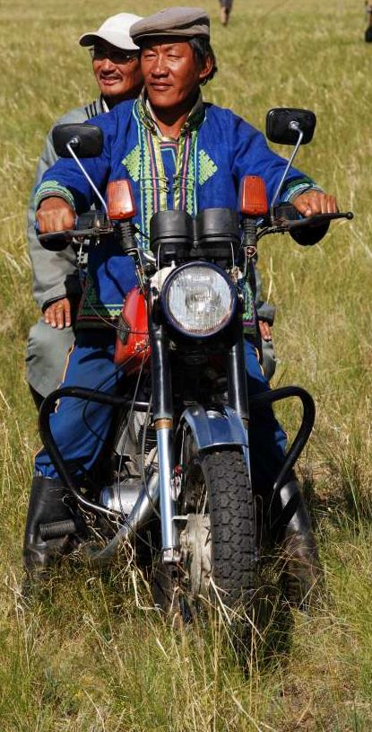
Lifestyles -- Rapidly Changing
Notes:
From horses to motorcycles and trucks. From silence to solarI have never seen a more hopeful people. “I don’t know what you can do, but we look forward to your help”.

Slide 6
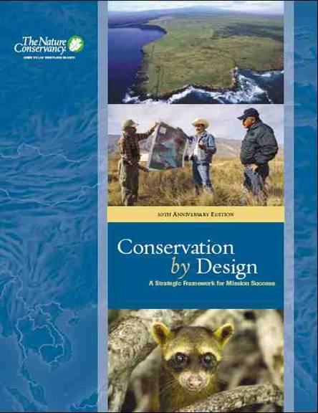
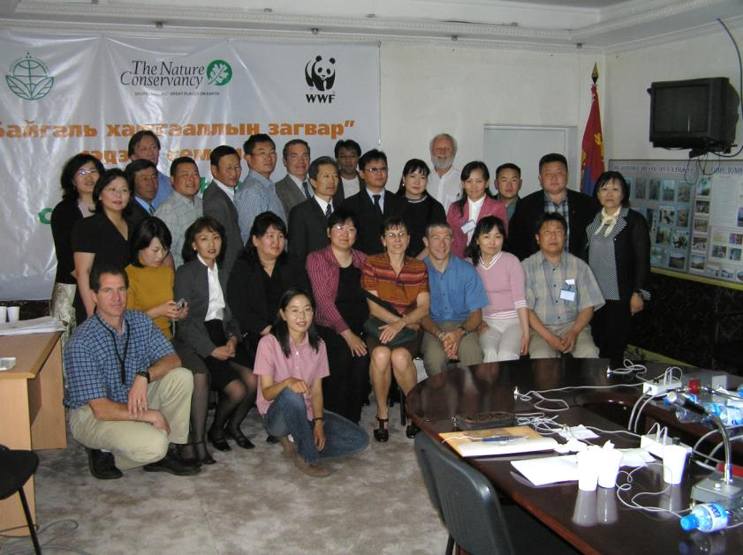
Conservation Methodology & Prioritization – an entrée -- 2005
Notes:
The framework is a simple and elegant statement of a conservation process that could be useful to a country that has already committed to 30% of Mongolia as protected lands.
Susan Antenen of the New York Chapter, with Russell Leiman’s guidance, initiated the due diligence work
Susan engaged the Colorado Chapter to conduct a Conservation by Design workshop with WWF, the Ministry of Nature and Environment, and TNC.
The result was interest by all parties to continue the relationship and efforts.
WWF attended Efroymson Coach training in Italy.
MNE sought continued training.
TNC was able to focus considerable effort on the grasslands – not a big focus until that time.
Note that Gala Davaa, our current Director of Conservation in Mongolia attended the workshop.

Slide 8
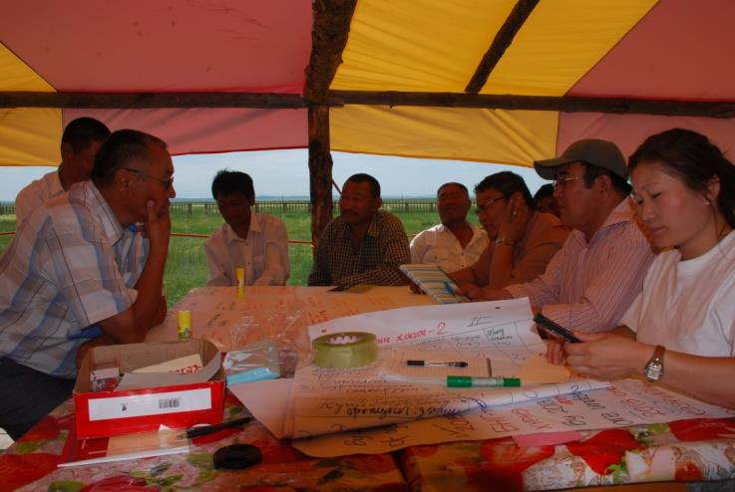
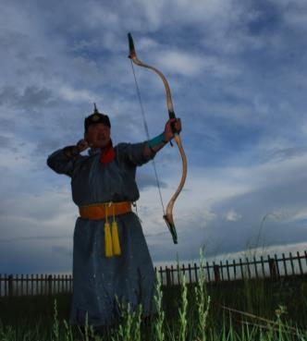
Conservation Planning with Partners and Stakeholders
2008 – CAP workshops for Toson Khulstai
Partners: WWF and WCS
Stakeholders: herders to Min. Nature and Environment
Result = conservation plan, implementation by a local advisory committee.

Slide 9
First Ever Gathering of People to Plan

Slide 10
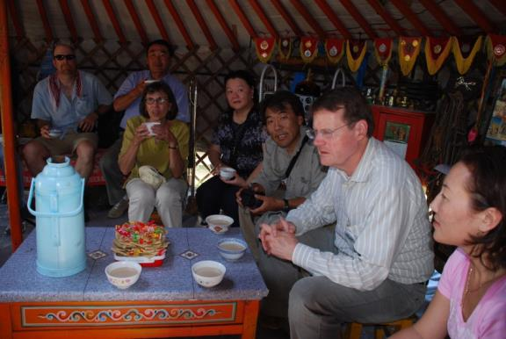
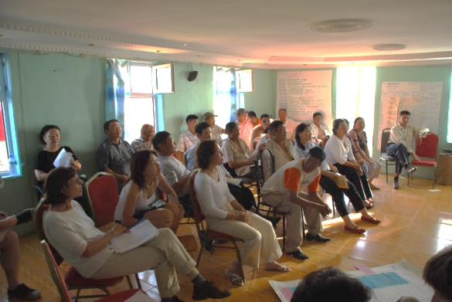
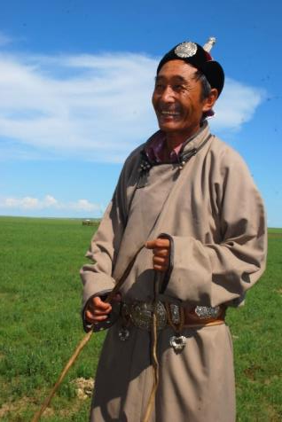
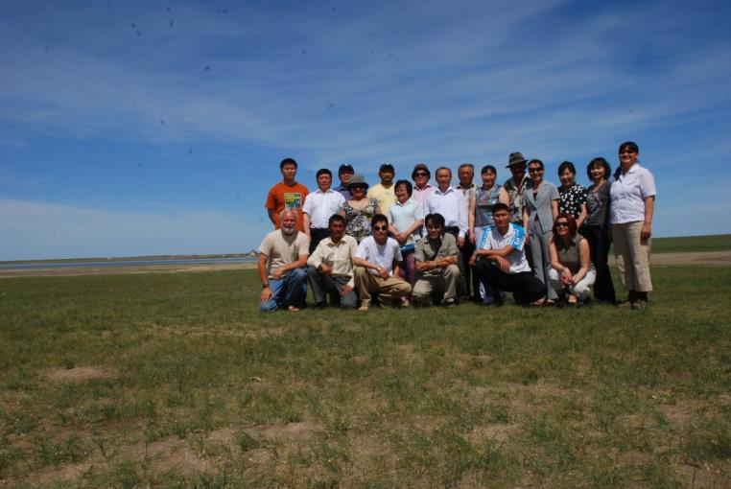
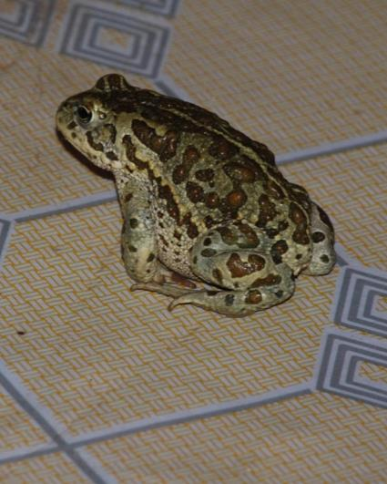
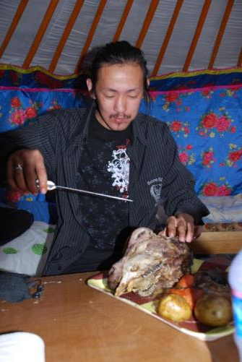
It was a very exciting time

Slide 11
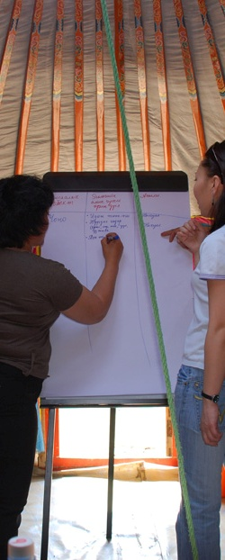
Established Toson Khulstai as a Demonstration Site for Open Standards
Stimulated demand for more projects.
Stimulated PA officials/ mgrs to US for study tour on conservation methods.
Protected Area Planning & Mgt
© Chris Pague

Slide 12
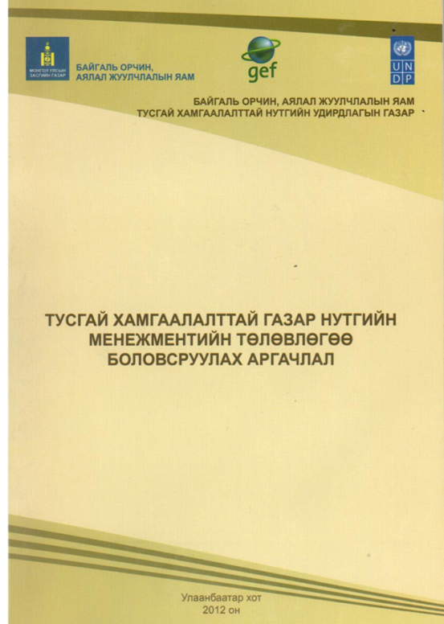
Country Standards for Protected Areas Management Planning – Open Standards

Slide 13
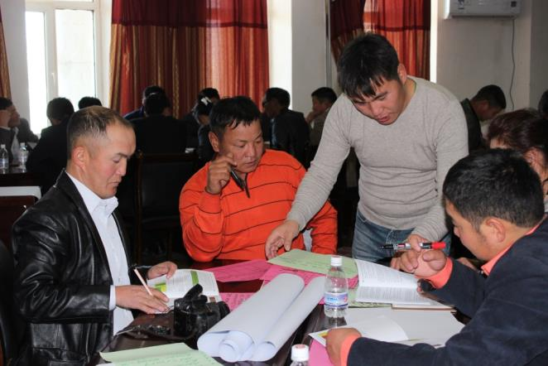
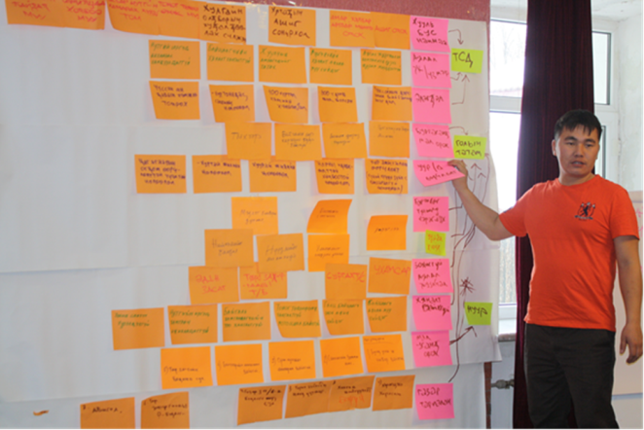
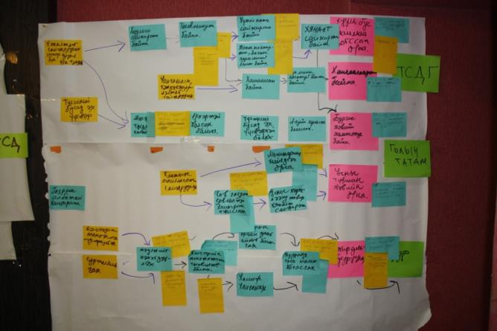
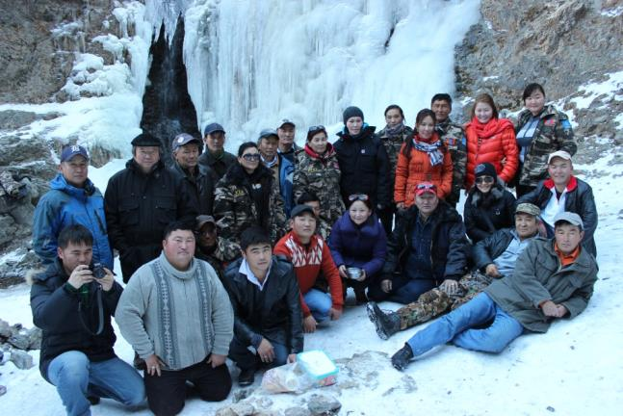
Quickly Resulted in Demand for More Planning

Slide 14
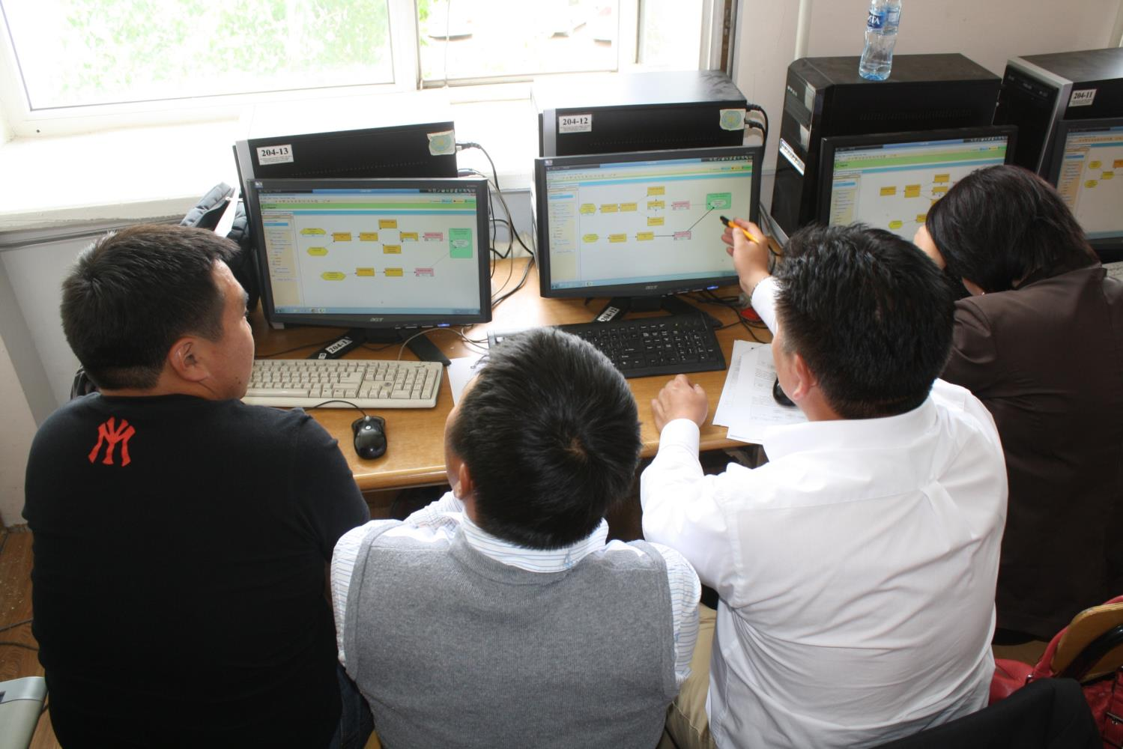
Miradi training for Protected Area Administration officers, 2013

Slide 15
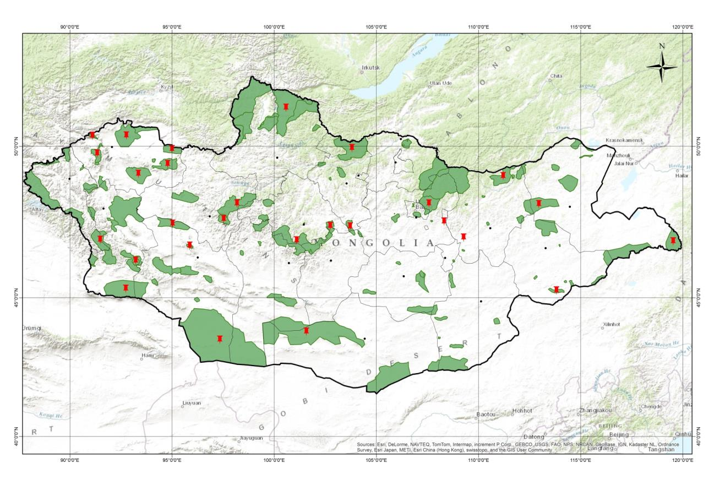
We completed about 40 CAP based management plan (2012 - 2014)

Slide 16
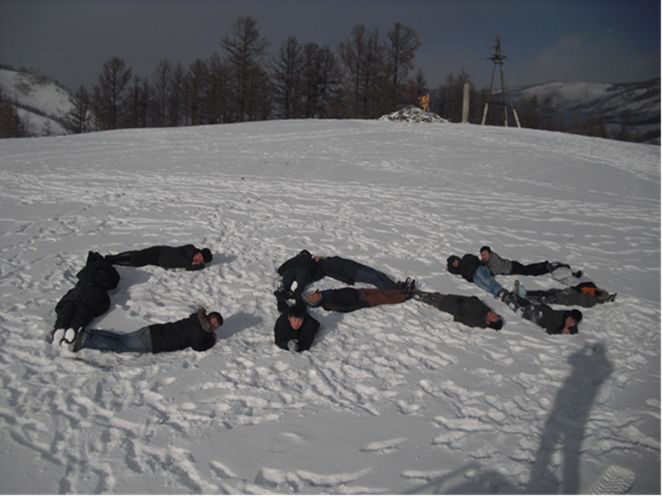

Slide 17
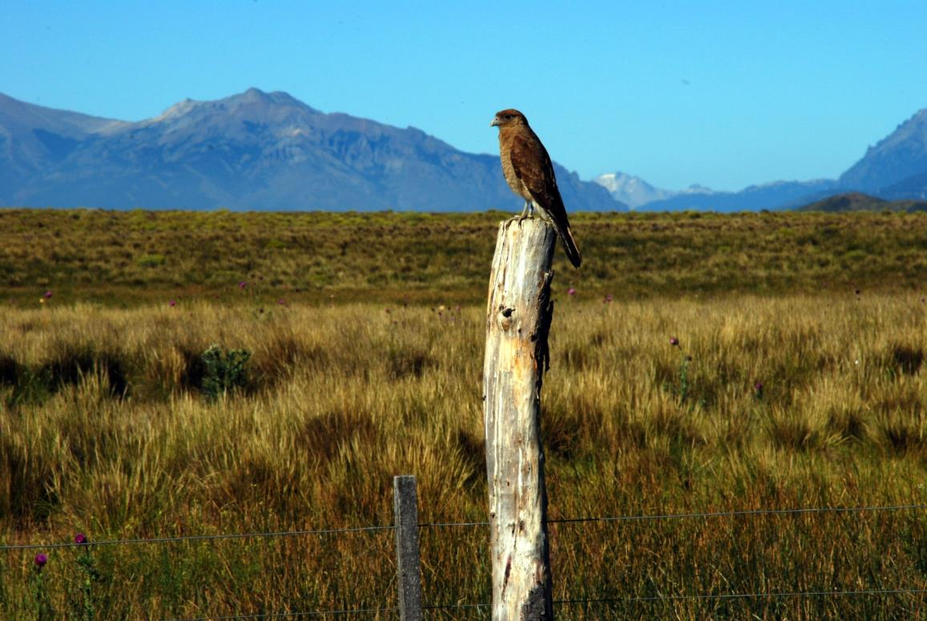
Example II: Patagonia
Notes:
For thousands of years the Mongolian people have lived on the steppe. Keeping the livestock in close herds to protect them from predators also meant that when the grass was eaten, they had to move to new grass. Mobility was and is still the rule of the people. Adaptability is the advantage.

Slide 18
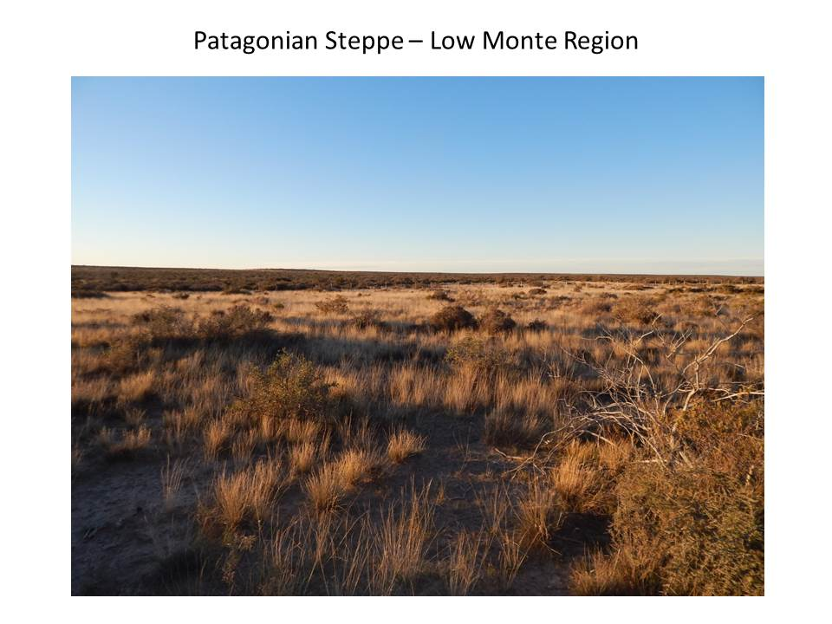
Sustainable Grazing Initiative

Slide 19
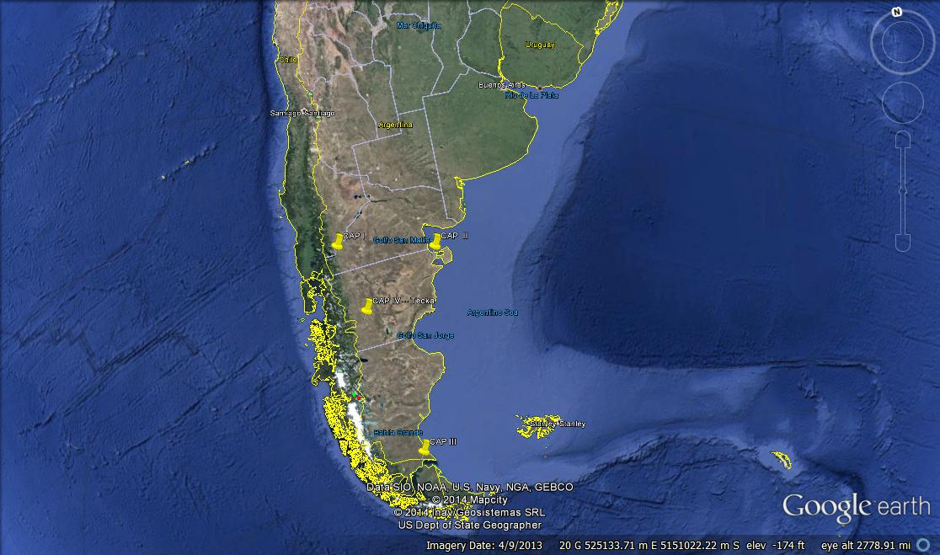
Regional Scale Planning

Slide 20
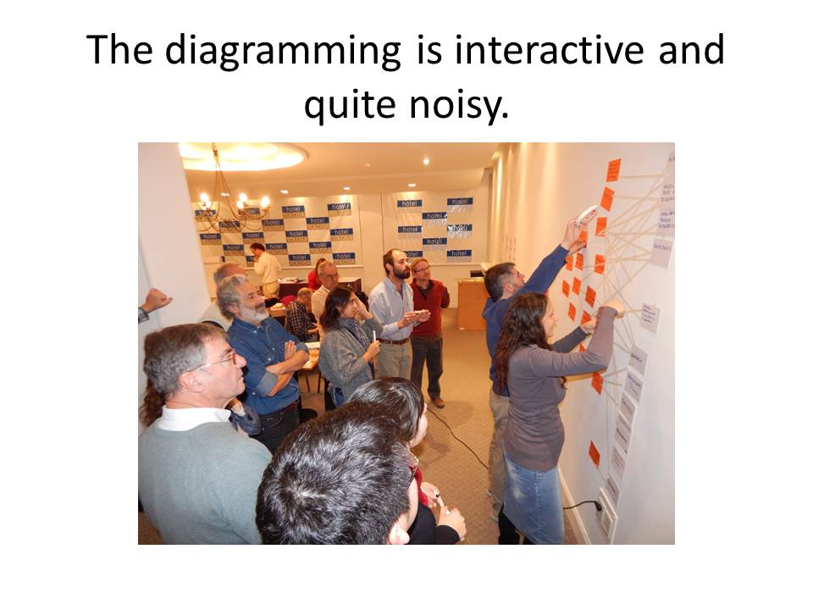
Open Standards are enthusiastically received by many stakeholders

Slide 21
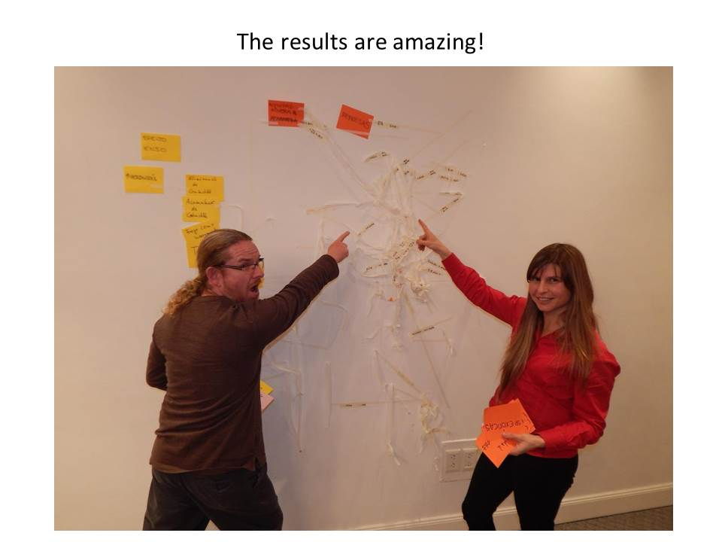
Results are astounding (and may show in NYC’s MoMA)

Slide 22
Outcomes and Challenges?
Great Interest and Enthusiasm
A Medium for Distribution Exists
BUT:
Large Scale may mismatch current application
Institutional Capacity of Country limited

Slide 23
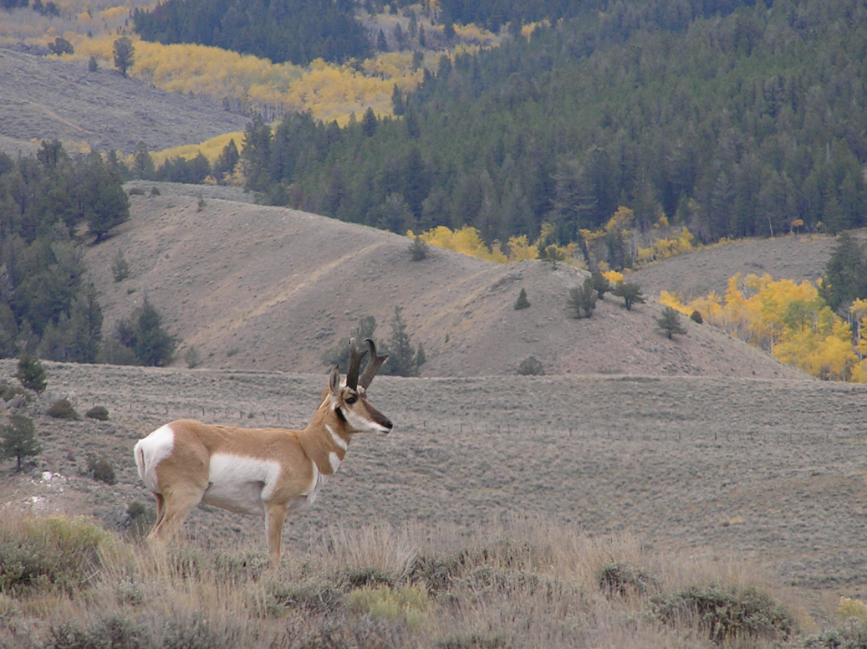
Example III: Colorado/the Western U. S.
Notes:
For thousands of years the Mongolian people have lived on the steppe. Keeping the livestock in close herds to protect them from predators also meant that when the grass was eaten, they had to move to new grass. Mobility was and is still the rule of the people. Adaptability is the advantage.

Slide 24
Example III: Colorado/the Western U. S.
Colorado BLM shown Open Standards
Grand Junction Office -- OS in Resource Management Planning Process
Open Standards used by BLM National Training Center since 2008
Language changed to be more BLM specific
http://www.ntc.blm.gov/krc/viewresource.php?courseID=201
Notes:
For thousands of years the Mongolian people have lived on the steppe. Keeping the livestock in close herds to protect them from predators also meant that when the grass was eaten, they had to move to new grass. Mobility was and is still the rule of the people. Adaptability is the advantage.

Slide 25
Example: Language Changes for use of OS by BLM
Conservation targets – priority species and vegetation
Threats – effects
Viability - health
Notes:
For thousands of years the Mongolian people have lived on the steppe. Keeping the livestock in close herds to protect them from predators also meant that when the grass was eaten, they had to move to new grass. Mobility was and is still the rule of the people. Adaptability is the advantage.

Slide 26
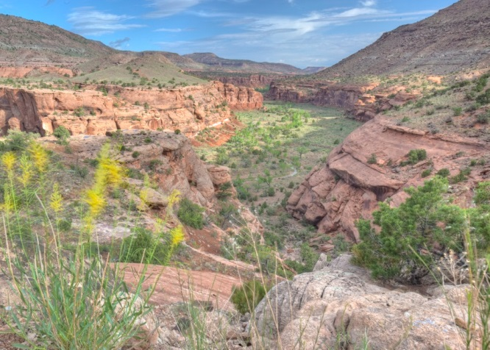

Best Example: Dominguez Escalante National Conservation Area
Appendix A in RMP – Viability Assessment
https://www.blm.gov/epl-front-office/projects/lup/33152/43170/46185/default.jsp?projectName=Dominguez-Escalante+NCA+Draft+RMP
Notes:
For thousands of years the Mongolian people have lived on the steppe. Keeping the livestock in close herds to protect them from predators also meant that when the grass was eaten, they had to move to new grass. Mobility was and is still the rule of the people. Adaptability is the advantage.

Slide 27
Outcomes and Challenges?
Outcomes hard to see at this stage – high level change.
Reports that planning team more cohesive group and more indepth and richer conversations -- better strategies.
Challenges – Broad applicability.
Some offices --very traditional “multiple use” attitude.

