Slide 1
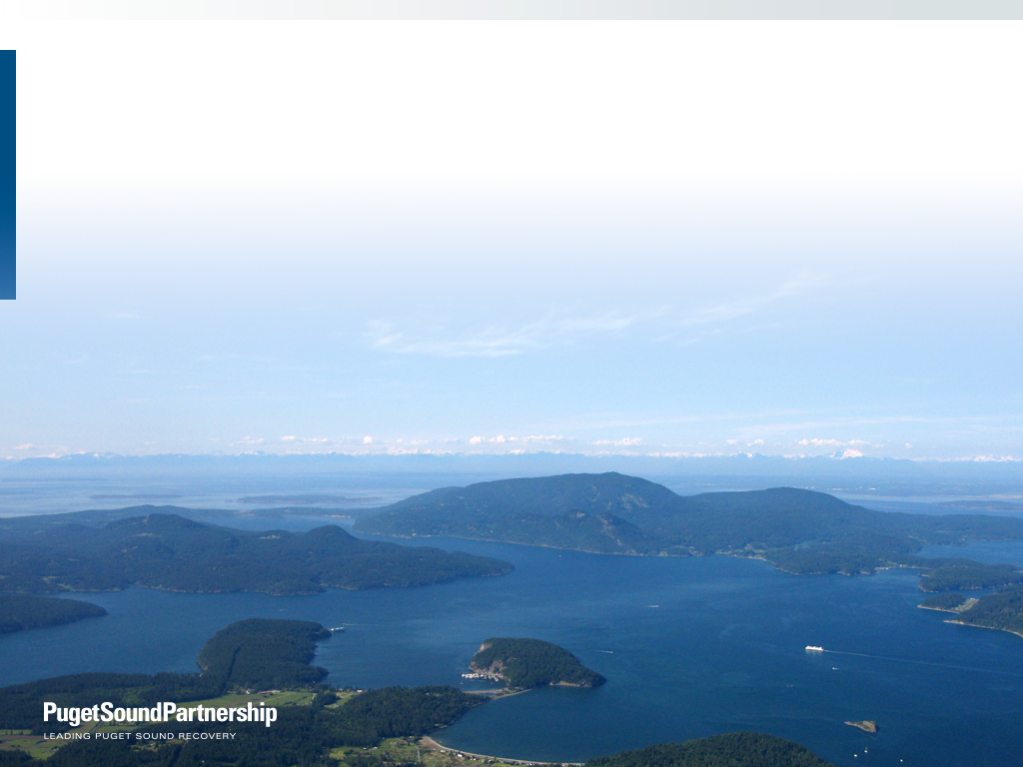
Using the Open Standards
to Advance Puget Sound Recovery
Kari Stiles, PhD
Puget Sound Partnership
Conservation Measures Partnership
Oct 7-9, 2014

Slide 2

OUTLINE
Who, where, what, why of PSP
Puget Sound Recovery Context – 2008
Puget Sound Recovery – 2014
  Open Standards + Miradi + Miradi Share
2016 and beyond

Slide 3

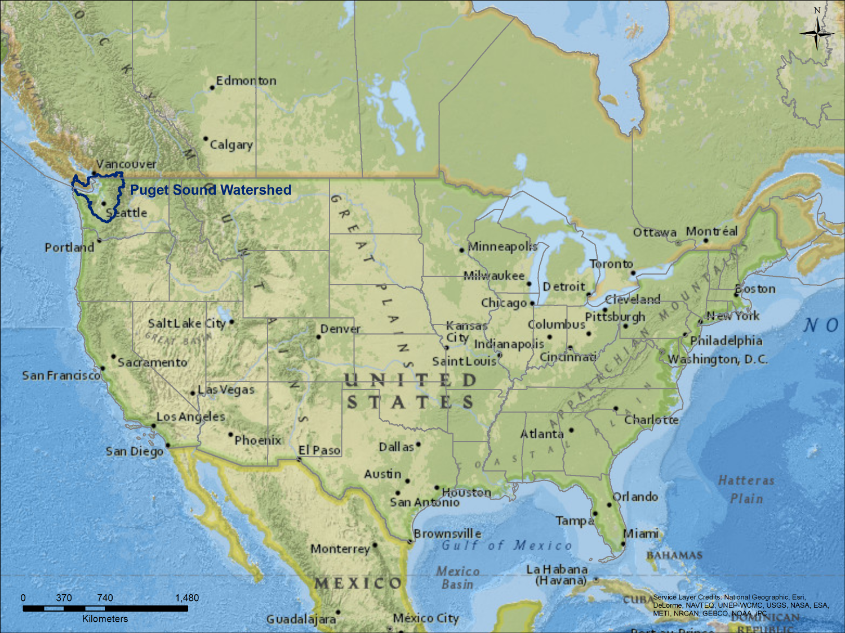

Slide 4
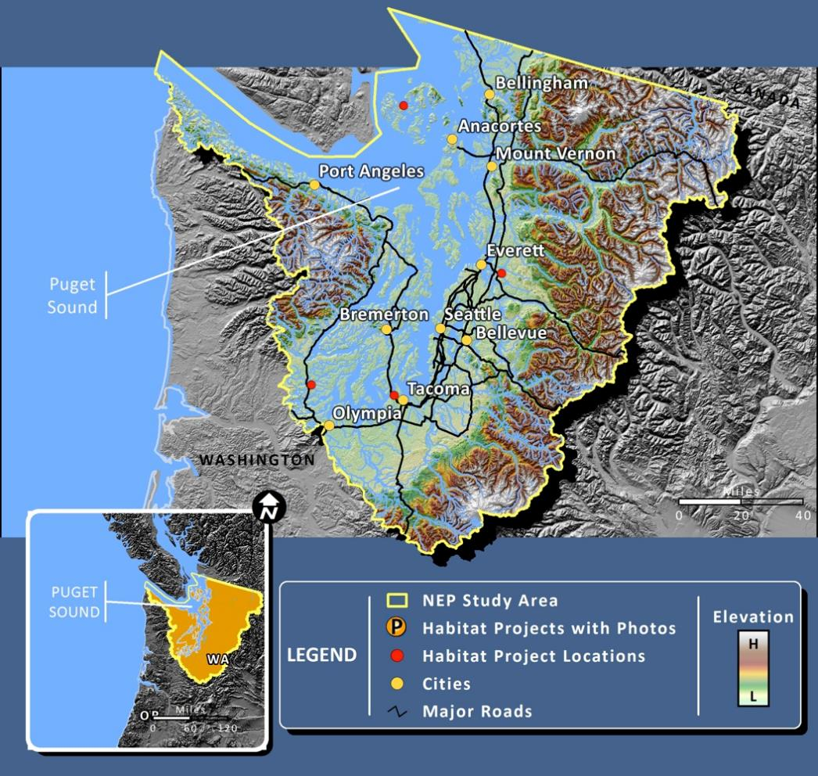
National Estuary Program (EPA)
16,500+ sq miles
International border
12 counties
100+ cities
20+ tribes

Slide 5
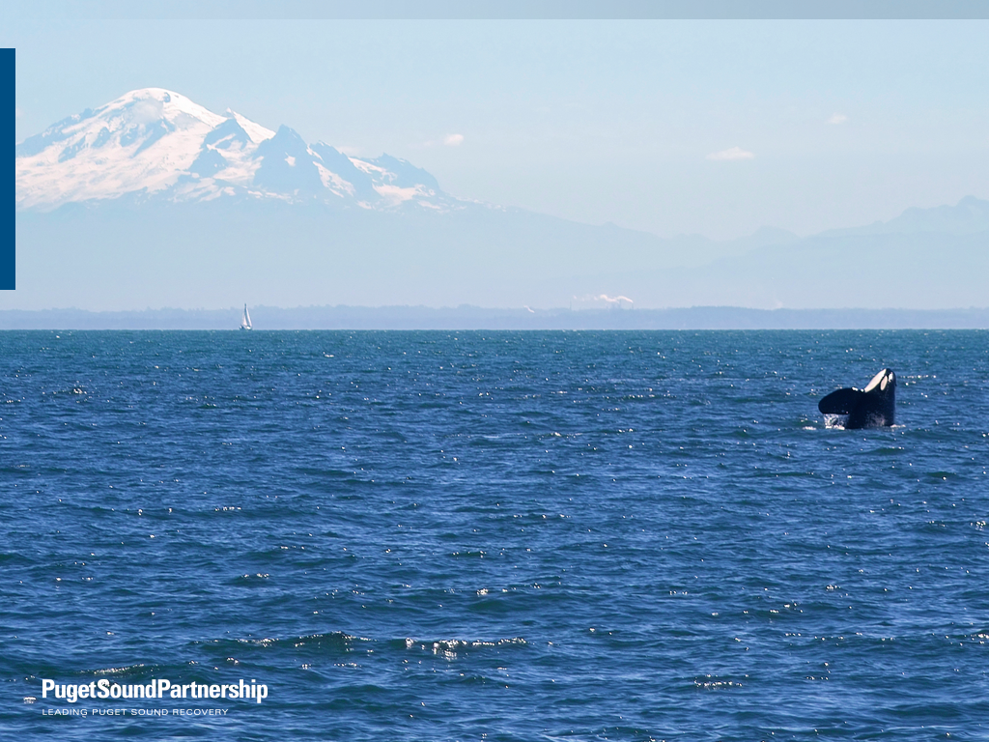
Snowcaps to Whitecaps …
with a focus on the watery bits

Slide 6
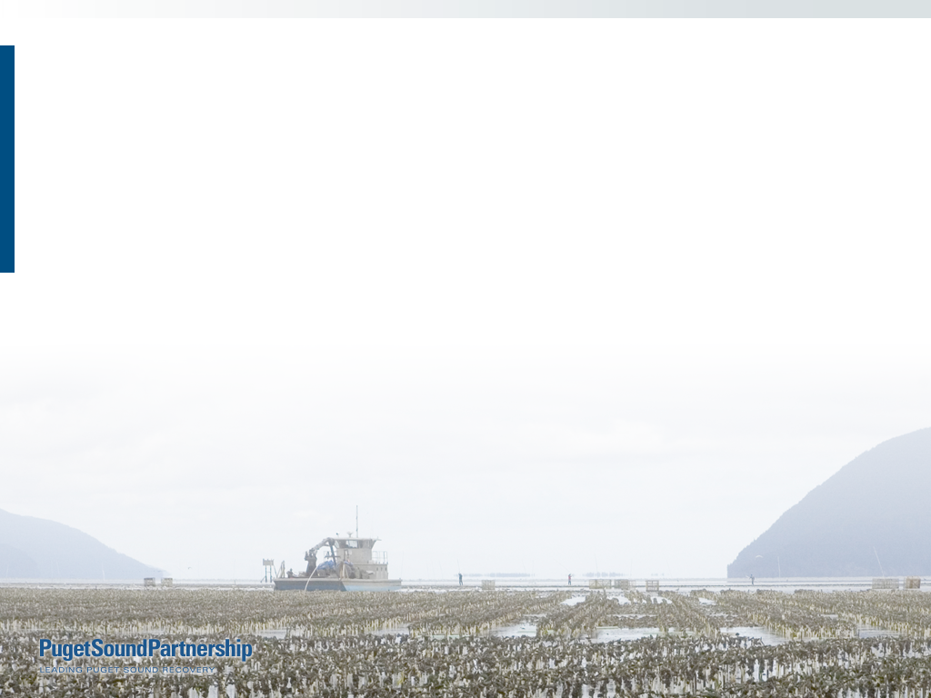
Recover Puget Sound by 2020
  “swimmable, fishable, diggable, drinkable”
  6 goals: Habitat
  Species
  Water Quality
  Water Quantity
  Human Health
  Human Well Being

Slide 7
Puget Sound restoration and protection (2007)
Washington State Statute at RCW 90.71.200(2)
Puget Sound Partnership: coordinate and lead the effort to restore and protect Puget Sound. The partnership will:
  Define a strategic action agenda (2-year cycle)
    prioritizing necessary actions, both basin-wide and within specific areas
    addressing complex connections among land, water, species, human needs
    based on science
    include clear, measurable goals for the recovery of Puget Sound by 2020
  Determine accountability for performance, oversee the efficiency and effectiveness of money spent
  Educate and engage the public
  Track and report results to the legislature, the governor, and the public
  Not have regulatory authority
Partners: All governmental entities, including federal and state agencies, tribes, cities, counties, ports, and special purpose districts
  Support and help implement the partnership's recovery efforts

Slide 8
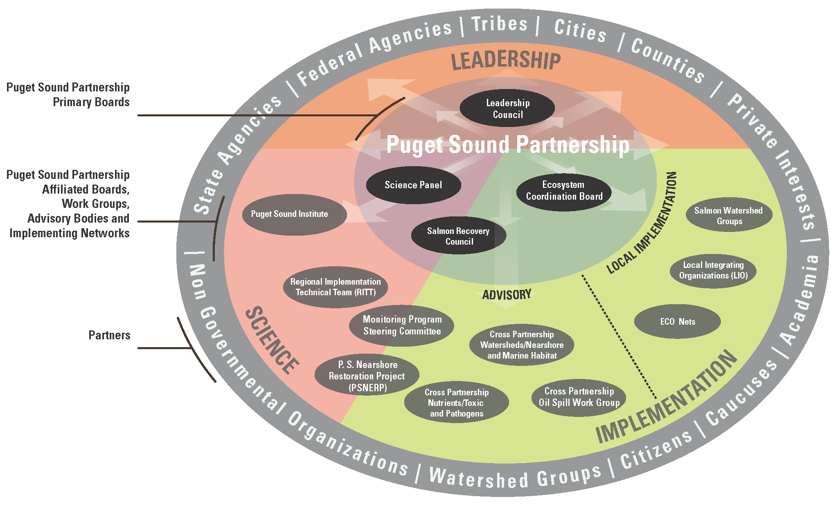

Slide 9

PUGET SOUND RECOVERY CONTEXT
2008

Slide 10
Death by 1,000
cuts
Recovery by 1,000
uncoordinated actions

Slide 11
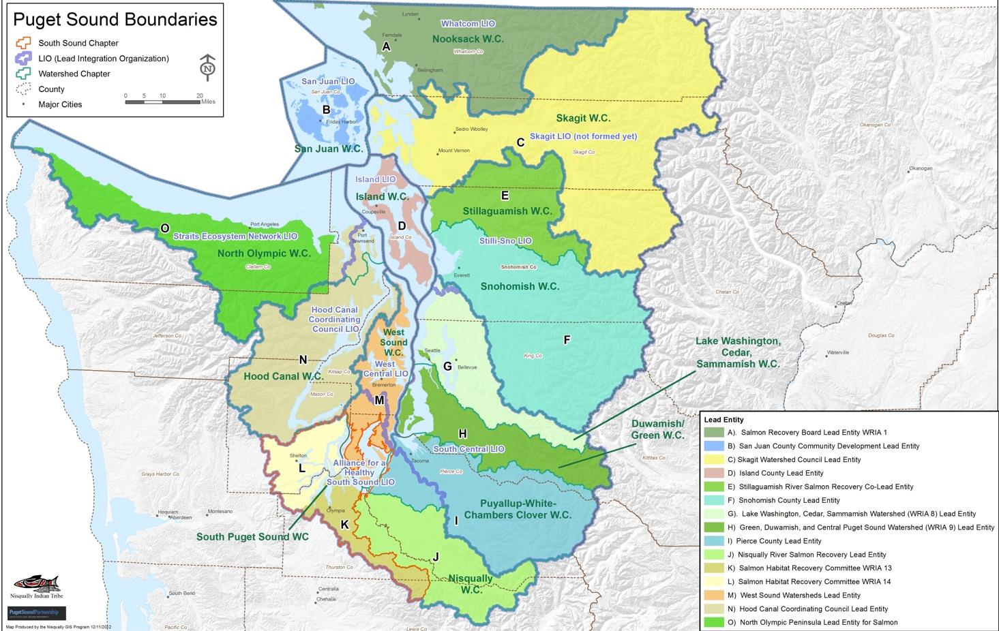

Slide 12
Locals
watersheds
action areas
(cities, counties
tribes, NGOs)
Region
State
feds
16 watershed Chinook recovery plans (NOAA)
1 regional Chinook recovery plan (NOAA)

Slide 13
Decision makers
Scientists

Slide 14
Decision makers
?
2008
Priorities
Actions
Gaps & needs
Actions
Actions
Locals
Region
Actions
Actions
Actions
Actions
Scientists
Notes:
Common goals? With priorities? And measures?
Common pressures? With priorities? And measures?
Assumptions about actions and effectiveness?
Reporting against what targets?

Slide 15
Adaptive Management of Puget Sound Recovery Efforts
2009-2014
Open Standards, Miradi, Miradi Share

Slide 16
Decision makers
2008
Locals
Region
Scientists

Slide 17
Decision makers
2014
Recovery Priorities
Priority Threats
Monitoring & Gaps
Ecosystem Status
Effectiveness & Impacts
Locals
Region
Scientists

Slide 18

Decision makers
Locals
Region
Scientists

Slide 19

Common language
Puget Sound Taxonomies
Ecosystem & Human Wellbeing
Pressures
Strategic Initiatives
Action Types
Barriers, Corrective Actions
Common tools
Theories of Change
(aka. Results chains)
Common database

Slide 20
Standard taxonomy for ecosystem components
Status in Puget Sound
Status within watershed
  geographic unit

Slide 21
accessible habitat
Small river channels
Poor
Large wood
Pool frequency
Fair
Good
Very Good

Slide 22
16 Chinook watersheds → regional story
Extent of intertidal habitat
Distribution of estuarine habitat
Riparian community structure

Slide 23
Puget Sound: Vital Signs linked to Ecosystem Components
Estuaries

Slide 24
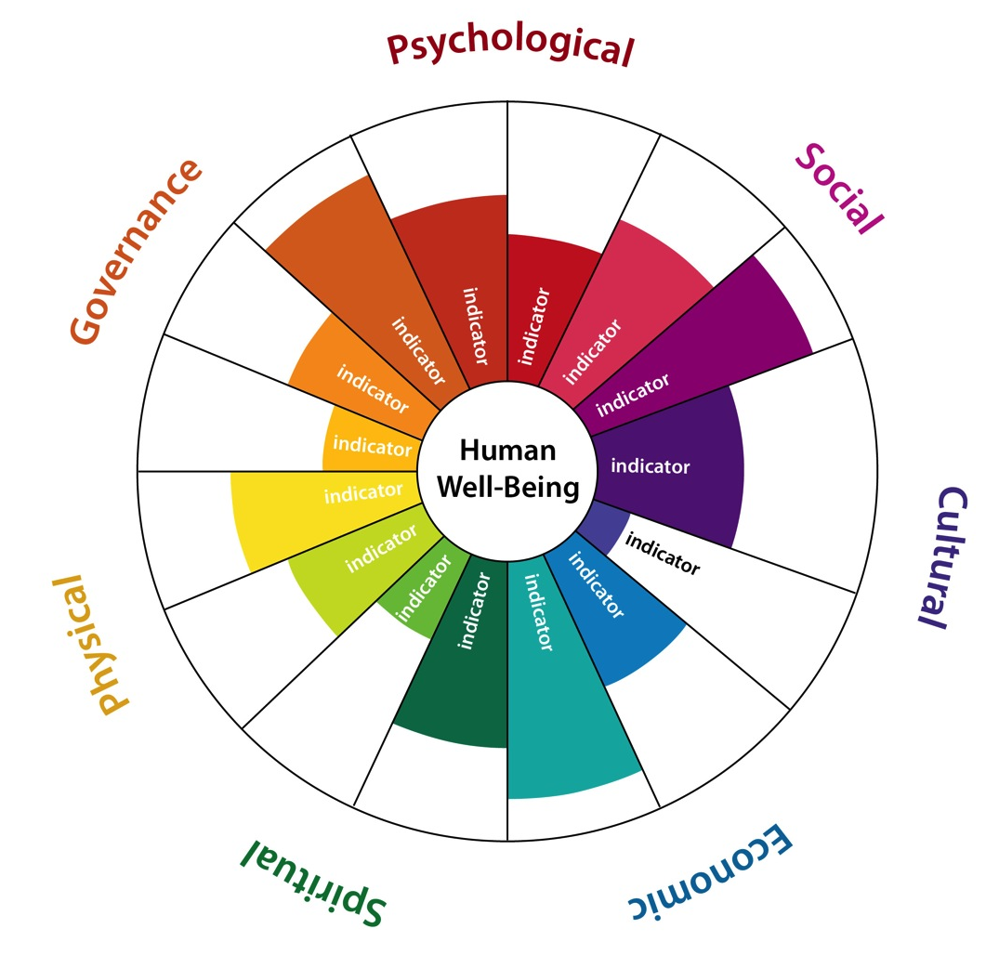
Puget Sound:
Indicators linked to Human Wellbeing Components
Physical wellbeing

Slide 25
Chinook watersheds contribute to regional goals

Slide 26
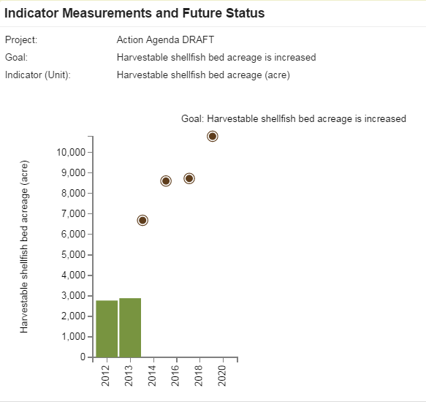
Shellfish Beds

Slide 28
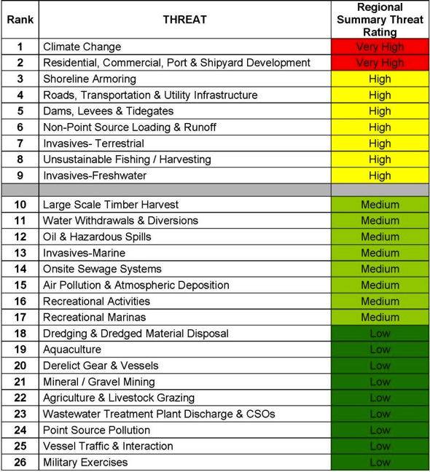
2009 Puget Sound Threats and Soundwide Rating
X

Slide 29
Puget Sound Pressure Taxonomy
SOURCES of pressure on Puget Sound ecosystems and people (41)
STRESSORS - proximate actors on ecosystem (47)
SOURCE – STRESSOR DIAGRAMS illustrating source-stressor relationships
Pathways of Effect
(Stressed)
source of
acts on
Pressure (Source)
Stressor
Ecosystem Component
Stressor
Stressor
Development
Land conversion
Reduced floodplain habitat extent

Slide 30
Chinook watersheds & Puget Sound pressures
Stormwater
Roads & railroads
Marine shoreline armoring
Dams
Utility Lines
Onsite Sewage Systems
Invasive Species
(%)

Slide 31
Pressure
Intrinsic Vulnerability
Ecosystem Endpoint
Potential Impact
Assessment units: watershed
marine basin
Puget Sound

Slide 32
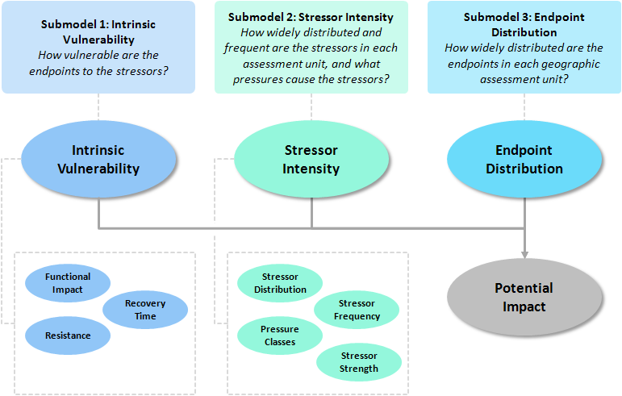
Notes:
Expert elicitation
Online survey tool
Scalable

Slide 33
Pressures
Pressures posing greatest risk
(Puget Sound example)
Land Cover Conversion – Development
- Transp. & utilities
Large Spills

Slide 34
Ecosystem Components & KEAs
Most vulnerable parts of the ecosystem
(Puget Sound example)
Cuthroat Trout
Coho salmon
Chinook salmon
Riparian vegetation
Small, high-gradient streams
species
habitats & processes

Slide 35
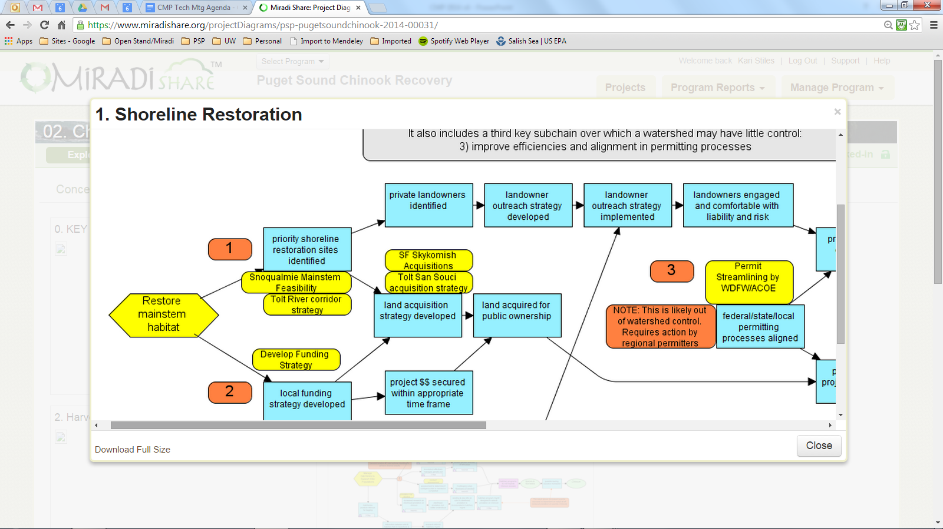
Theories of Change: Actions linked to desired outcomes
All 16 Chinook watershed plans (2005) (2005 plans expect lots of miracles)
2014-2015: Regional “Implementation Strategies” focused on key Vital Signs

Slide 36
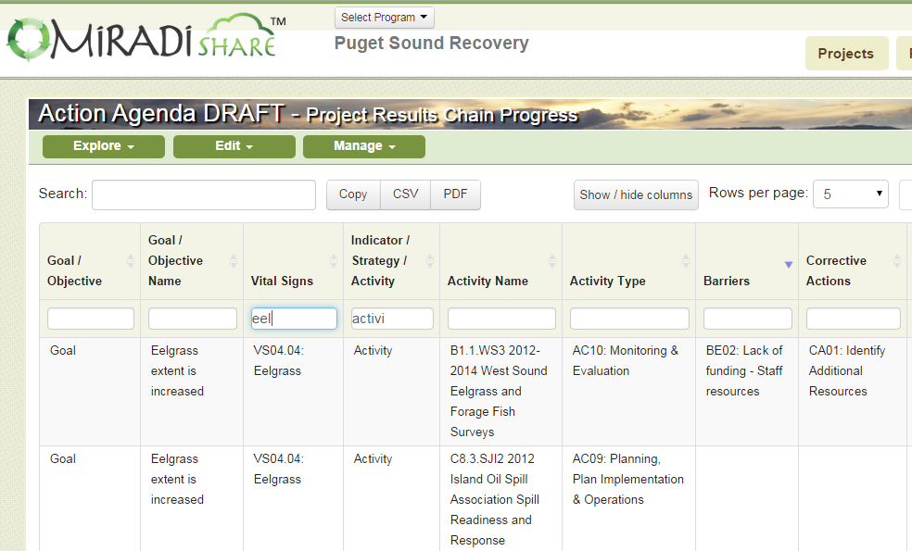
Theories of Change + Puget Sound Taxonomies

Slide 37
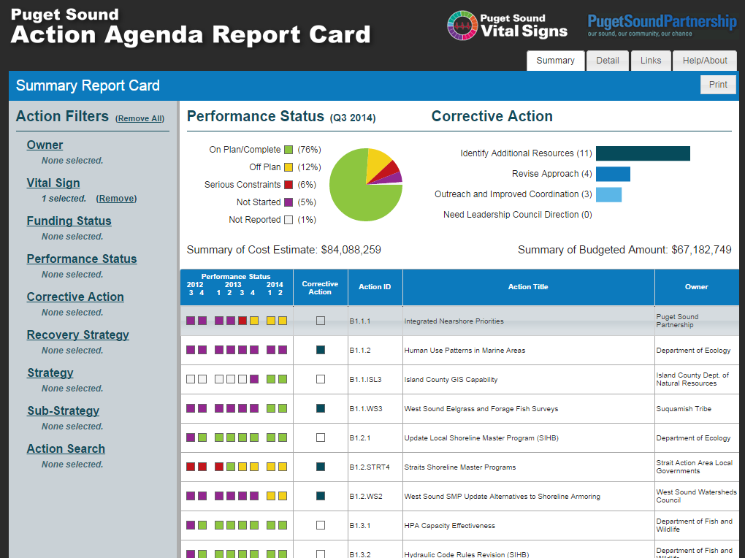

Slide 38
2016 and beyond
Refine common language
  multi-scale information sharing and assessments
Refine and apply common tools
  improve prioritization of recovery goals, pressures, actions and science needs
Develop Steelhead recovery plan (NOAA)
Develop regional theories of change (“Implementation Strategies”)
as basis for
  2016 Action Agenda
  2016 Biennial Science Work Plan
  Effectiveness Assessment
  (2015 &) 2017 State of the Sound reporting

Slide 39
