Slide 1
Rare’s CampaignTracker
A brief overview of its design and function and what we have learned so far.

Slide 2
Background & Purpose
The CampaignTracker is a tool built to house Rare’s reporting tools and processes that provide a consistent global language with which to measure and assess the progress and quality of Rare’s work around the world.
GOALS: reduce barriers to data entry for Rare staff and Partners and improve campaign management and impact.

Slide 3
Design Guide: Clear Audience, Action Oriented
Clear Audience
Rare Campaign Team (Rare, EDF, UCSB, UTEP)
Track, and approve milestones
Report on campaign progress through Weekly Flash Reports and the Pride Scorecard
Implementation Partner Team
Upload milestones, see milestone scores
Blog and upload multimedia resources
View their own and other campaign pages and updates on rare.org
Designed for Action
When designing features in the CampaignTracker, or considering new features, we will ask these questions:
Does this feature highlight key actions required by users?
Does this feature make the transaction simpler/faster?
Notes:
Message points
Multiple roles
Action oriented
Simple/transactions
2- 2 clicks per action
PSC links to BSC

Slide 4
Key CampaignTracker Components
User Dashboards
Designed to direct users to the actions they need to complete next
Find a Program
Sortable list to find campaigns within a specific cohort
Find a Campaign
Searchable list of all campaigns ever launched
Navigate to see more details via Action button
Reports and Snapshots
Monthly cohort snapshot
Campaign Pride Scorecard report
Pride Scorecards
Aligns institutional data collection with site level data collection
Weekly Flash Reports
Milestone management
www.rare.org links
Hierarchy and organization of campaign display, map and campaign page info all from the CT

Slide 5
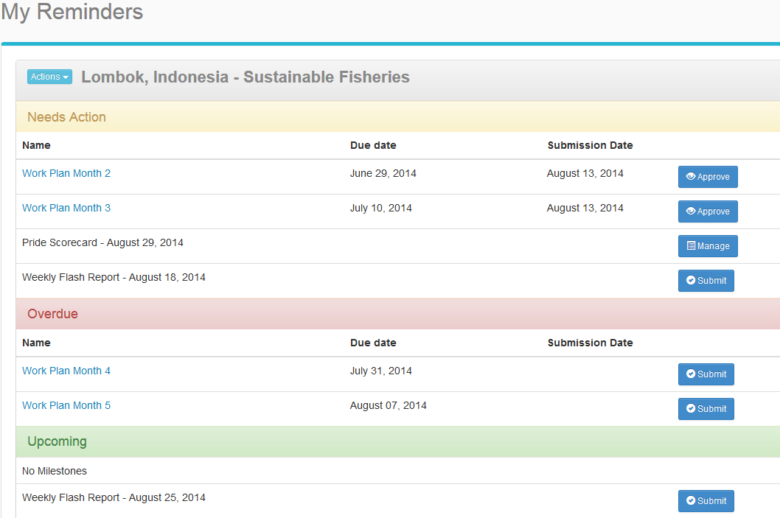
What has Worked
Simple Design & User Interface
Simple design & workflows: no distractions, no extras
Its easy to get data in
Low tech users find the interface smooth & intuitive
Can add anything we want or change anything we want (features, workflows, etc.)
Pushes data to our public website

Slide 6
What has not worked
Custom Built = High Costs
Foundational database structure will not meet Rare’s growing organizational needs at a sustainable cost
A significant investment went into creating basic functionality that exists in off-the-shelf tools
Maintenance & support costs add up quickly
Built interim workarounds initially due to high cost of certain features

Slide 7
What we would do differently
Utilize IT
Involve and utilize IT department and expertise from the beginning to better understand the current and long term cost and technological implications of our options.
Explore existing platforms and tools, not just vendors.
Evaluate long term application of database structure
Build to sync with other existing platforms

Slide 8
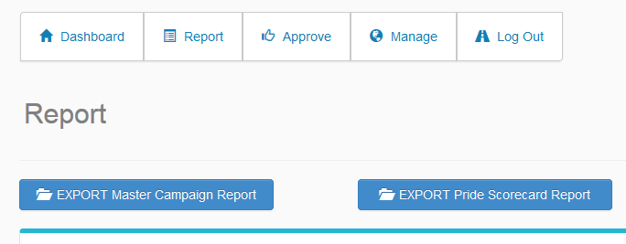
Future Use
Extend to other databases & build reports
Currently, we’re exploring syncing with Salesforce and off-the-shelf reporting software to leverage reporting and data visualization capabilities.
We’re designing more program level roll-ups, snapshots and reports.

Slide 9
Rare inspires change so
people and nature thrive.

