Slide 1
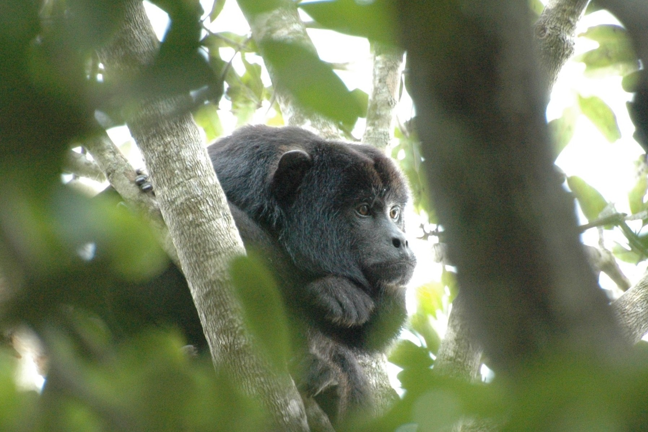
WWF - Measuring and communicating high level results
© PJ Stephenson

Slide 2

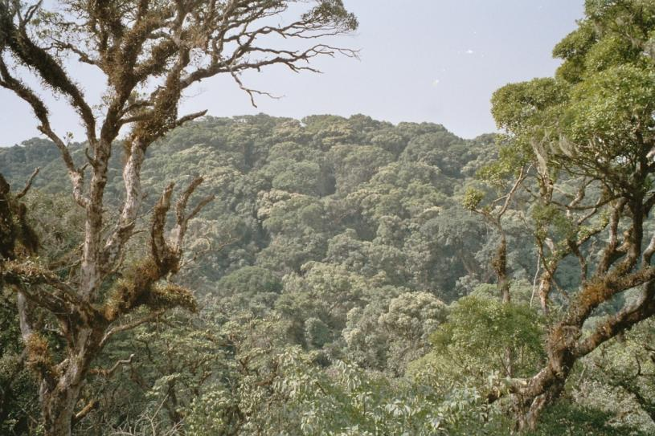
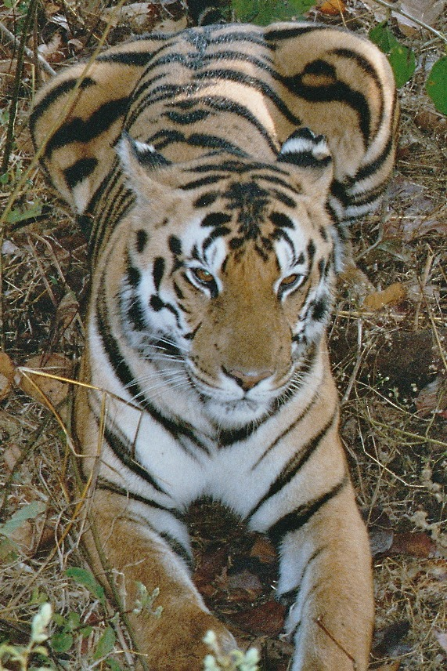
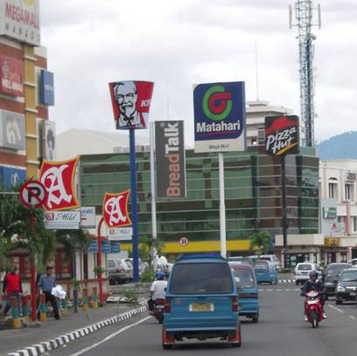
Challenges - Diverse programme portfolio
© PJ Stephenson
© PJ Stephenson
© PJ Stephenson
Notes:
We have diverse global priorities – from tigers to forests to climate change, cod to the Coral Triangle. Many projects and programmes have traditionally been good at measuring their activities but how do we measure if we have improved biodiversity, and reduced footprint?
We are one third of the way through the GPF – are we getting there?

Slide 3
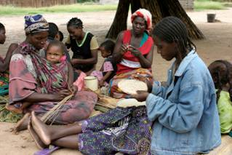
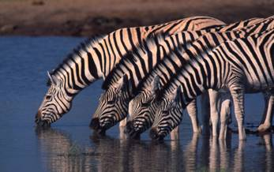
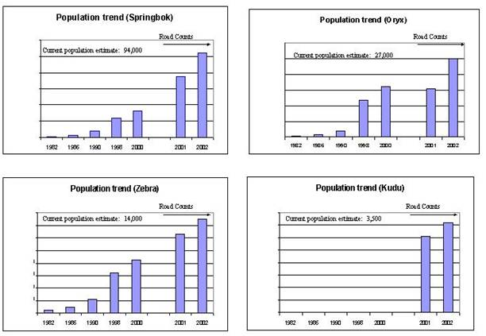
Few examples of programmes monitoring impact
© WWF-Canon/Folke WULF
© Martin Harvey/WWF-Canon
LIFE Project, Namibia
Notes:
End on a high note – some projects have been showing impact.

Slide 4


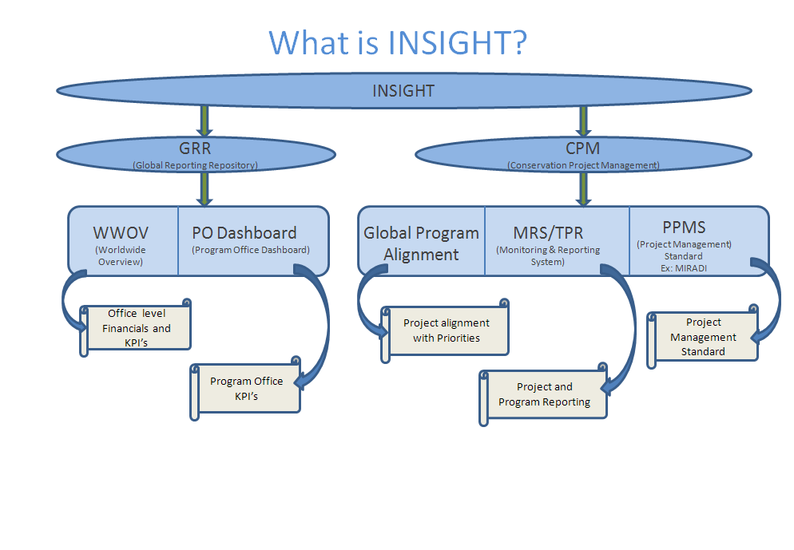
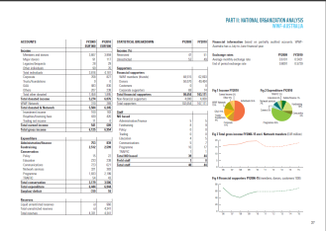
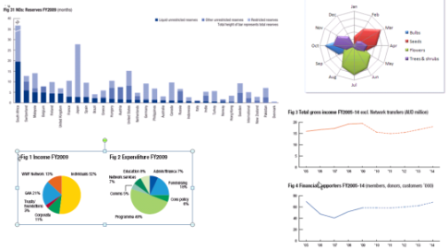
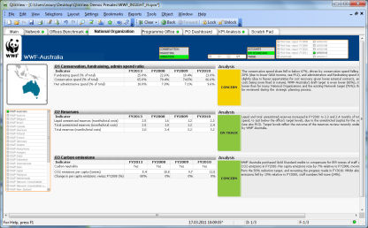
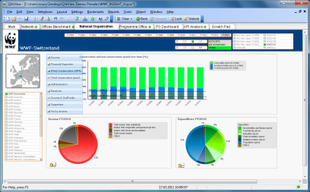
INSIGHT

Slide 5
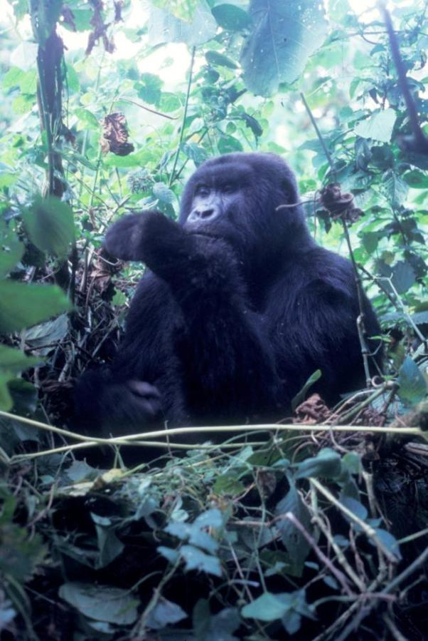
Key elements of the improved GPF monitoring & reporting system
The system is based on what
is already good practice:
Strategic plans
Indicators for goals and objectives
Data collection and analysis
Reporting (using data)
Peer review and evaluations
© PJ Stephenson

Slide 6
WWF common programme indicators
Indicator | Status
S1. Habitat cover | In use - data available
S2. Habitat fragmentation | In use - data available
S3. Flagship species populations | In use – data available
S4. Environmental flows | Under development – freshwater prog.
S5. State of the ocean (to be determined) | Under development – marine prog.
S6. Species diversity index | To be developed
P1. Habitat loss and degradation | In use - data available
P2. Offtake of flagship species | Under development – TRAFFIC
P3. Over-exploitation of footprint species | Under development – TRAFFIC
P4. River fragmentation | FINALIZED
P5. CO2 gas emissions | In use - data available
P6. Energy consumption | In use - data available
R1. Size of protected areas | In use - data available
R2. Protected area management effectiveness | In use - data available
R3. Wildlife trade | Under development – TRAFFIC
R4a. Sustainable production of commodities | In use - data available
R4b. Sustainable production of commodities | In use - data available
R5. Sustainable production of energy | In use - data available
R6. Sustainable production of water | To be confirmed by footprint progs.
B1. Number of beneficiaries | Under development – SD4C
I1. Partnerships | Under development - CSPU
Notes:
There are currently 21 common indicators. Eleven were assessed this year based on global datasets; it is hoped all 21 will be active in two years.

Slide 7
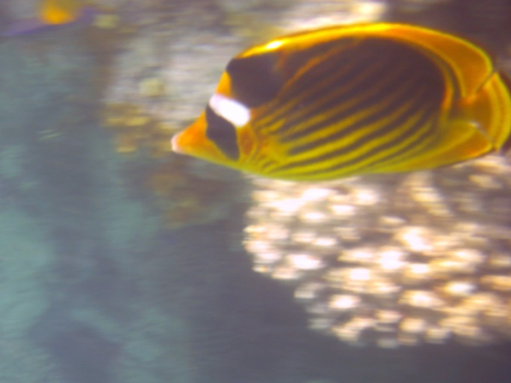
Considerations for selecting marine indicators
Complement what we have already
Use what existing programmes need :
- Global priority places with marine ecoregions (Arctic, Coastal East Africa , Coral Triangle, Galapagos, Madagascar, Mediterranean , Southern Chile, Southern Ocean , Southwest Pacific, West Africa Marine
Smart fishing
Market transformation
Global Marine Programme
Overarching principles for common indicators:
keep them based on what teams need anyway
keep number low
make them feasible and cost effective
© PJ Stephenson
© PJ Stephenson

Slide 8










© PJ Stephenson/WWF-Canon
© PJ Stephenson
Notes:
To go back to the main focus here – the outside world. Our work has been shared by CBD so all 194 governments who’ve signed CBD and NGO observers will see the report. This is the highest UN body we can influence on conservation measures so it may not excite everyone but it certainly excites us.
To ensure we also move on these recs we met the CBD boss at the AC and are now following up with his team and our field programmes and many of our key monitoring partners to see how we can work to improve conservation measures.
Going forward we’ll also need to continue to work with all of our key monitoring partners – a selection shown here.

Slide 9
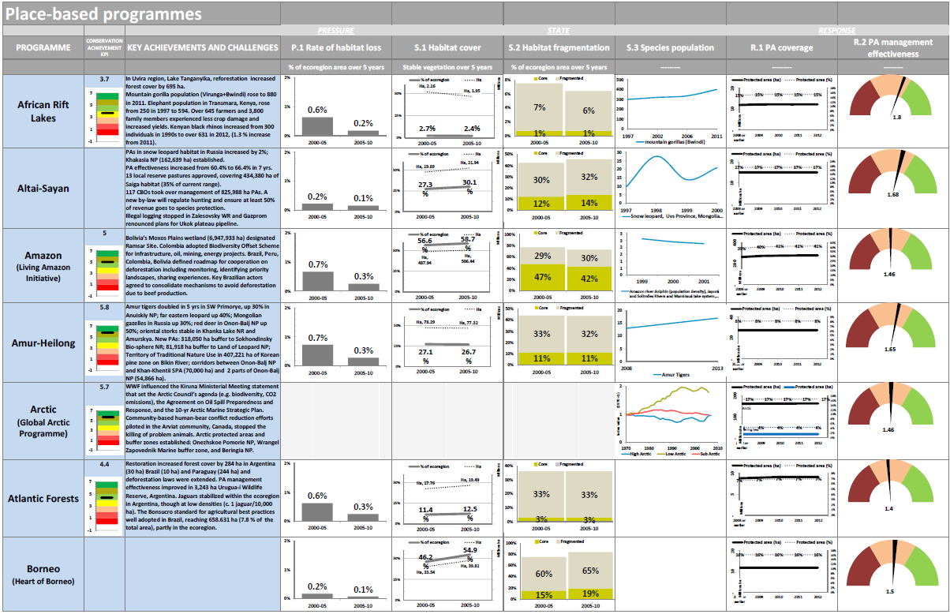
Place-based Programme Dashboard
Notes:
9

Slide 10
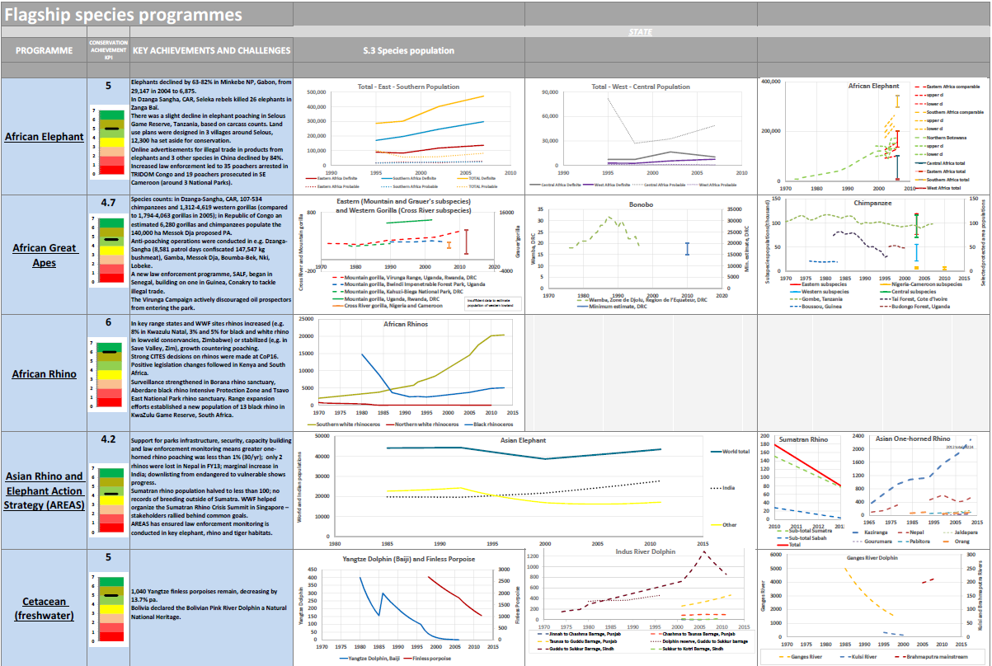
Species dashboard
Notes:
10

Slide 11
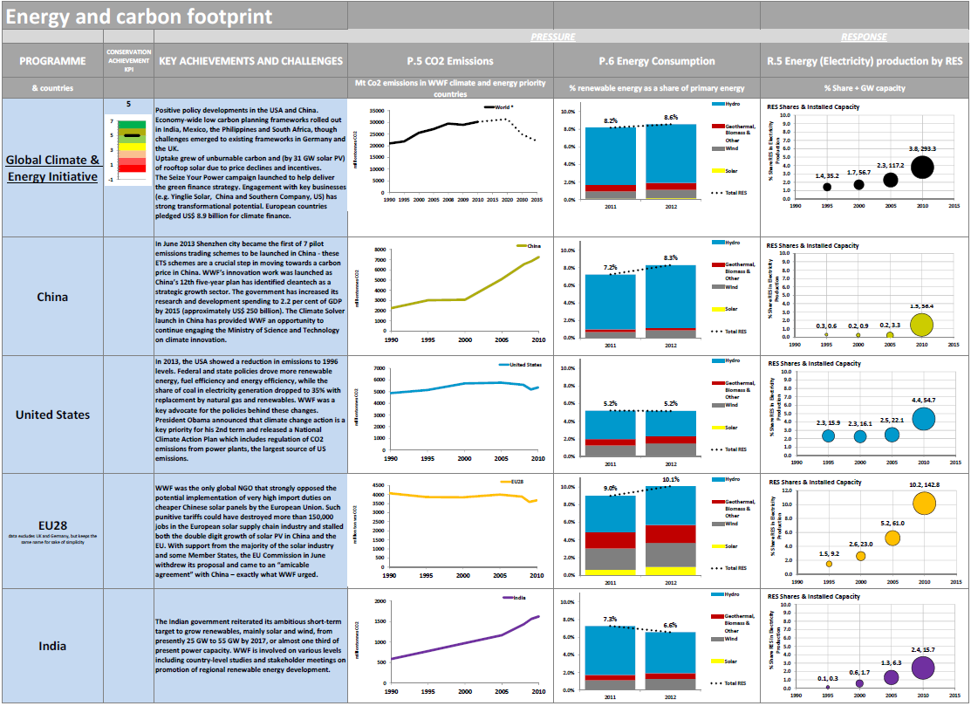
Climate and energy programme
Notes:
11

Slide 12
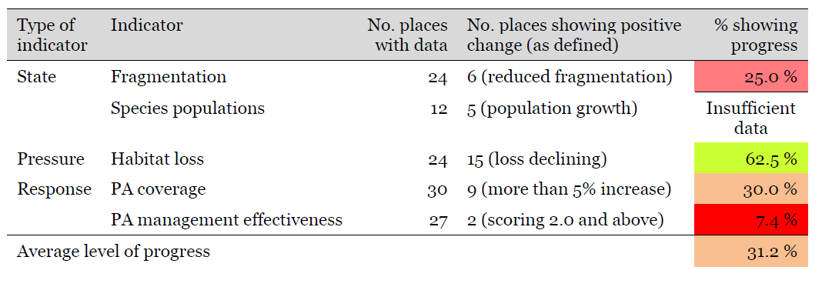
Global 2020 Places Goal:
Are WWF priority places protected and well managed?
Notes:
That also gave us an opportunity to identify areas we are doing well in (e.g. Reducing deforestation) and areas we need to improve on (e.g. PA management effectiveness) and we made a first attempt to estimate how we are doing against our global goals

Slide 13
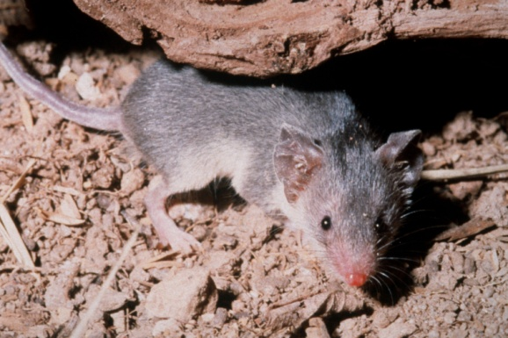
Share, learn, improve
Creating partnerships and policies to collect, analyze and share data
Harmonizing indicators and monitoring systems
Renewing efforts to fill data gaps
Using data to inform decision-making, policy development and adaptive management
Developing new indicators with a bottom up approach so data are also relevant to national or local project monitoring
© PJ Stephenson
Notes:
I am sure you are dying to hear all my lessons and recs in detail but given time here’s a summary:
We aren’t claiming to have the perfect system or know all the answers – as you can see, essentially we are just encouraging more of a sense of partnership and collaboration so everyone makes more effort to collect and share data and use it.

