Slide 1
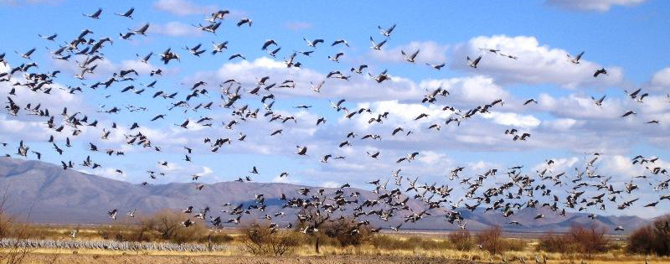
National Fish & Wildlife Foundation
Christina Kakoyannis
Director, Strategic Planning & Evaluation
CMP Technical Meeting – Bright Spot
October 2014

Slide 2
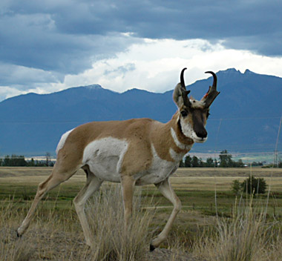
2006 NFWF Board Mandate
Develop long-term, science-based conservation initiatives with measurable outcomes that “move the needle” for key species, places of importance, or issues

Slide 3
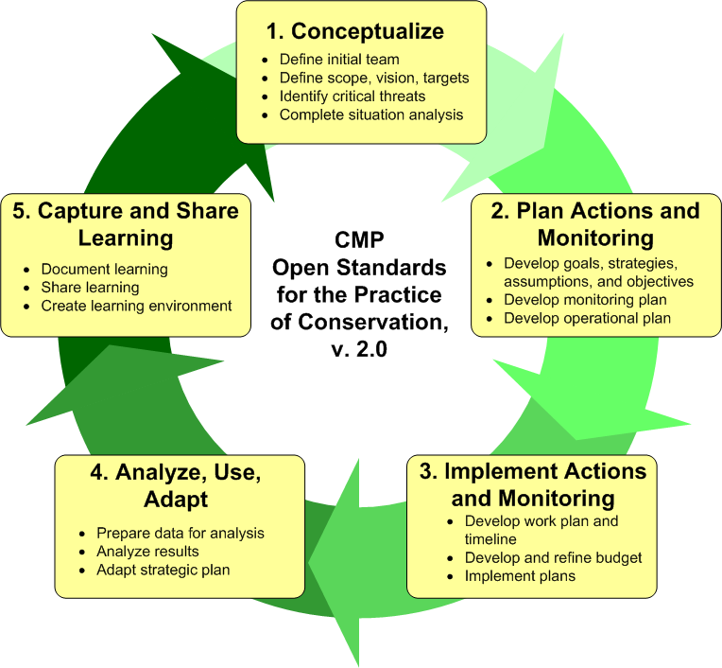
Open Standards

Slide 4

Product of Planning Effort
Business Plan that guides initiative grantmaking

Slide 5
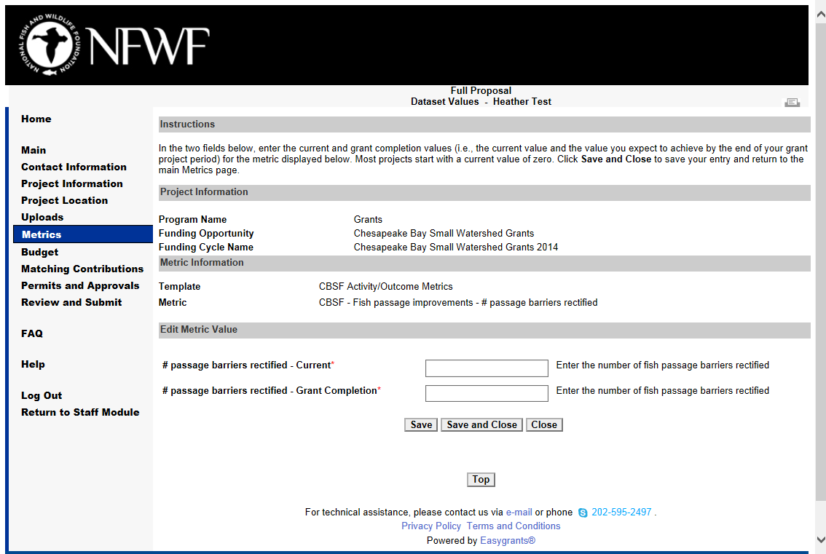
Implementation
  Grantmaking: Fund grants aligned with plan
  Monitoring:
    Applicants provide estimates for indicators
    Grantees update data

Slide 6
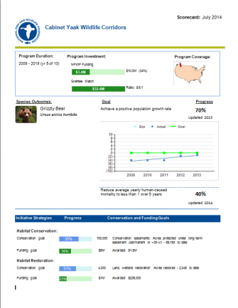

Step 4. Analyze, Use, Adapt
  Annual Scorecards
  Rapid Assessments
  Third-party evaluations

Slide 7
Initiative Scorecards
  Snapshot of key metrics:
    Funding
    Conservation progress

Slide 8
Scorecard

Slide 9
No progress on road decommisioning objective.
Perhaps solicit some proposals for this.
Better than expected progress.
Perhaps allocate funds elsewhere.

Slide 10
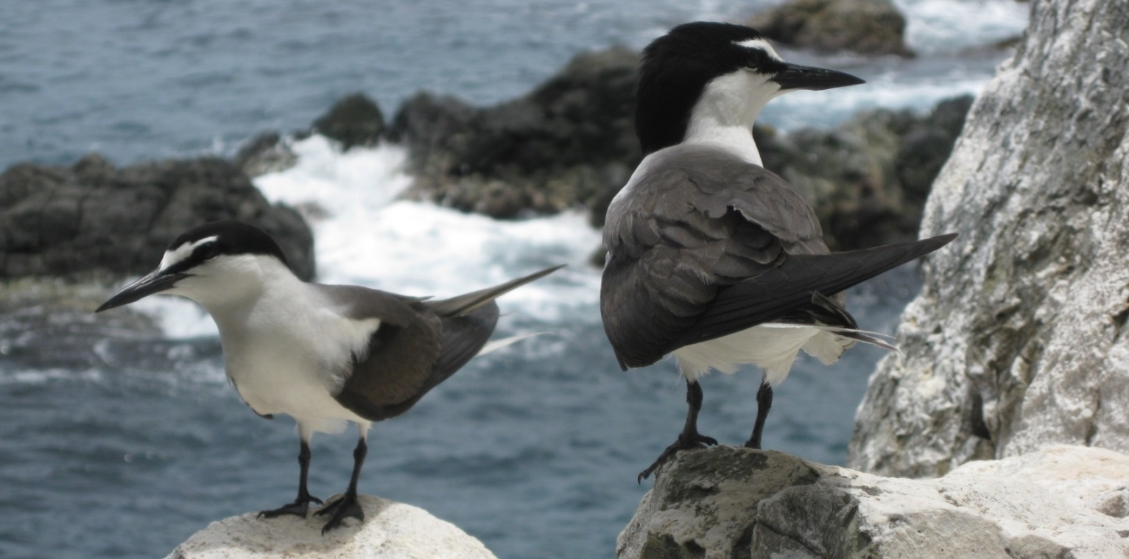
Internal Rapid Assessment
Assessment Criteria:
Implementation Process
Conservation Progress
Long-Term Sustainability
Lessons Learned, including broader impacts
Review of business plan
Bridled Terns (photo courtesy of Island Conservation)

Slide 11
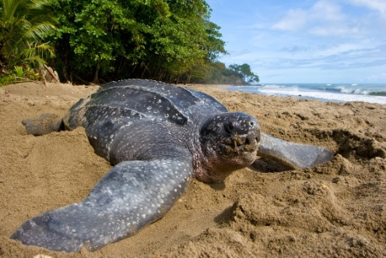
I. Implementation Progress
Funding of Strategies
  Actual spending in line with budget?
  % of NFWF’s investment from funding sources?
Implementation of Strategies
  Key strategies/activities implemented?
  Grant progress expected?
  Alignment of grant portfolio with plan?
Monitoring & Evaluation
  Systematic monitoring of implementation, outcomes, and focal species?

Slide 12
Addressing Recommendations
Rec # | Recommendation | Priority | Action | Status
1 | Business plan should include quantitative outcome targets | High | Developed targets for scorecard. Hired monitoring person. | Complete
2 | Lead an effort to have organizations share demographic data & meta-analyses | Medium | Hired monitoring person will engage on this | In progress
3 | Consider broadening single species focus to increase partner participation | High | Working on having as focal species of other initiatives | In progress

Slide 13
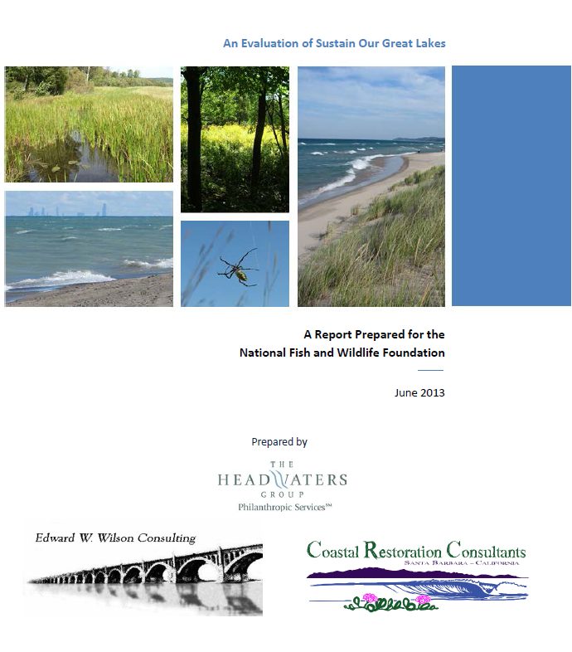
Commission Third-Party Evaluations
Develop NFWF response to evaluation recommendations

Slide 14
Levels of Assessment
  Third-party Evaluations
Depth & Resources required
  Rapid Assessments
  Scorecard
Frequency

Slide 15
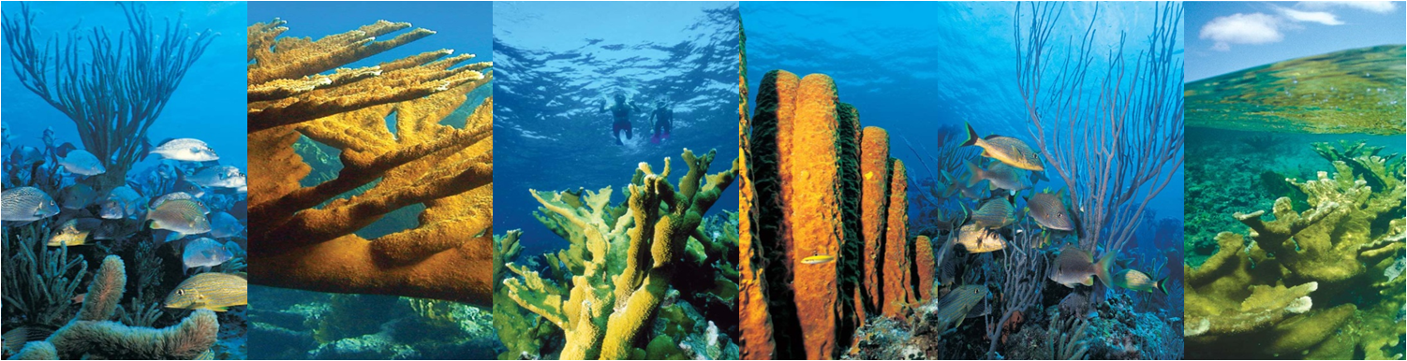
Thanks

