Slide 1
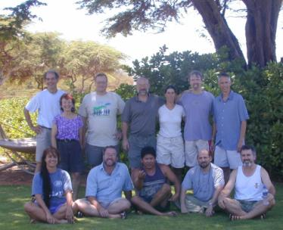
What is the problem CCNet is trying to solve?
Problem: Project teams lacking good project design for RBM and the capacity, knowledge and skills to facilitate and improve this process.
Evolution of approaches to problem:
Conservation by Design becomes core TNC practice leading to the development of “Conservation Action Planning” (CAP)
CMP Open Standards developed;
TNC Coaches Network formed
Conservation Measures Partnership (CMP)
11 NGOs sign CMP Partnership Agreement
2004 - First coaches trained and first franchise - Pacific Islands
1996
2002
2004
2007

Slide 2
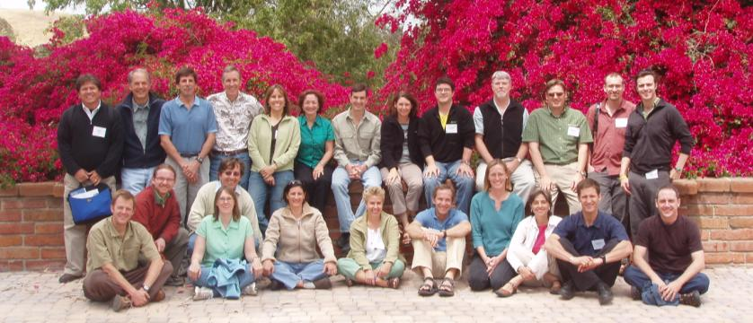
What opportunities needed to be addressed?
CCNet evolved from CMP and TNC’s Efroymson Coaches Network in response to the opportunity to:
Influence a growing community of OS/CAP users
Address demand for project team support (Conservation Coaches)
Expand to serve areas beyond those served by CMP Partners
Expand and enrich the network’s community of practice
First Draft CCNet Strategic Plan
CCNet Chartered
May 2008 Planning team
1996
2002
2004
2007
2008
2009

Slide 3
What is CCNet’s theory of change?
By providing project teams across multiple institutions with well trained coaches experienced in the Open Standards and facilitation skills and;
By providing updated collection of tools and guidance materials and;
By building and sustaining a network as a multi-institutional decentralized community of practice; and
By supporting knowledge sharing of best practices and a market-place of tools and practice;
We will build project teams with improved project designs and an adaptive management approach leading to more effective conservation.

Slide 4
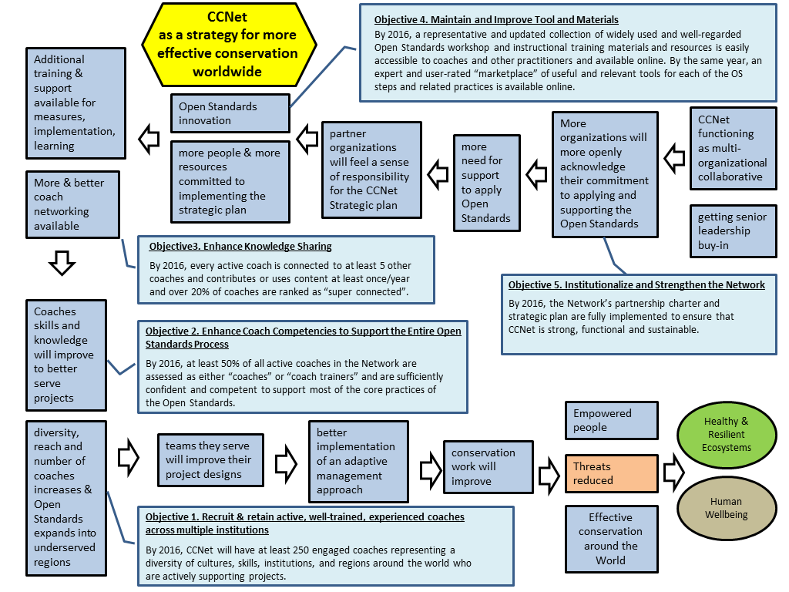
Overview of strategy logic

Slide 5
What is CCNet’s Core Business
Mission: Empower people to develop, implement evaluate, adapt and share effective strategies that achieve tangible conservation results all over the world.
2016 Objectives:
Objective 1. Recruit & Retain Active, Well-Trained, Experienced Coaches across Multiple Institutions.
Objective 2. Enhance Coach Competency.
Objective 3. Enhance Knowledge Sharing.
Objective 4. Maintain and Improve Tools and Materials.
Objective 5. Institutionalize and Strengthen the Network.

Slide 6
How is CCNet organized?
Organization/Structure
Partners (4)
Franchises (14)
Coaches (400+)
“Affiliated members” coach organizations (100+)
Governance
Board composition: Partners, Franchise Leads.
Planning
Strategic plans – 2009-12; 2013-16
Annual Coordination Team Workplans
Annual Individual Franchise Workplans

Slide 7
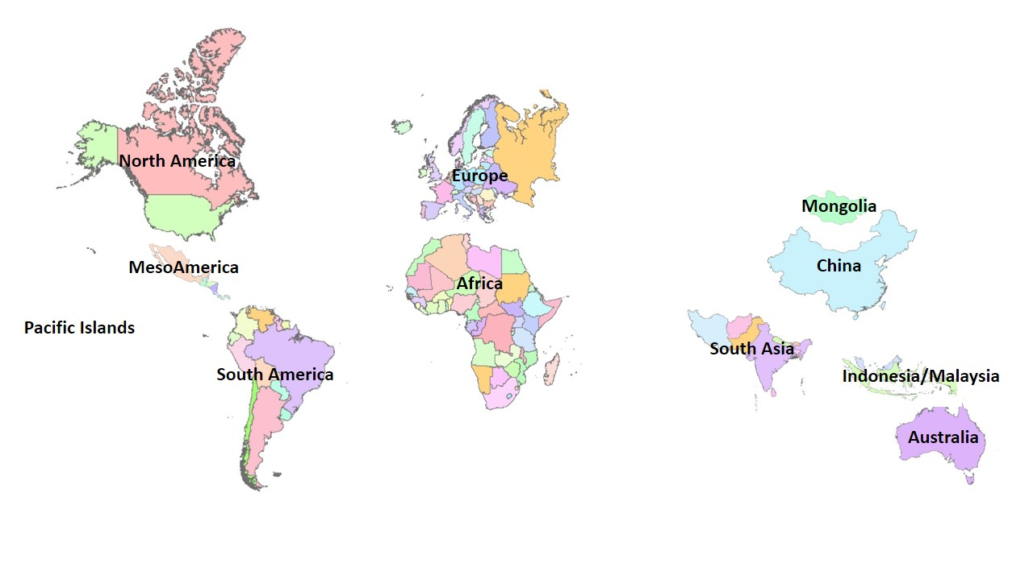
How is CCNet organized?
Franchises
+ Teaching Adaptive Management Network
Franchises drive the coach trainings
Some have their own workplans, websites, coach rallies, meetings
Try to adhere to a set of ‘Franchise Best Practices’
Future: Middle East, Indochina

Slide 8
How is CCNet organized?
Coaches
Who CCNet is built to serve – trained and experienced practitioners who can lead planning and implementation teams in the Open Standards
Growing in numbers, organizations, geographies
A significant number of coaches - 35% - are from smaller, non-partner organizations

Slide 9
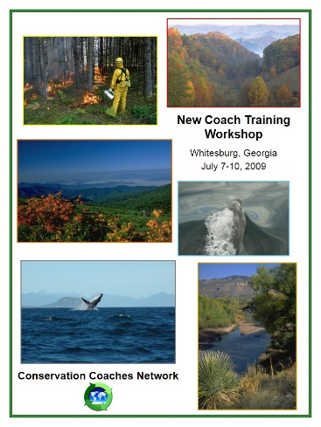
What are ​CCNet's Core Products
Coach Trainings
Designed to teach practitioners to lead others
Supported by an extensive & detailed Coach Notebook
Trainings and Coach Notebook in Spanish, French, Portuguese
Desire – hold trainings in each franchise almost annually as needed

Slide 10
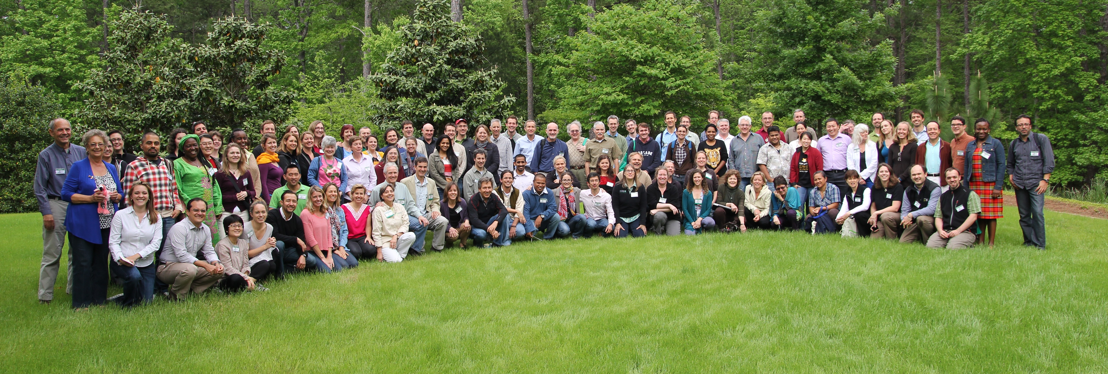
What are ​CCNet's Core Products
Coach Rallies
5 Rallies (2005-2013) held in US & Mexico to date
Composition & tone has changed over time, from TNC-focused to a worldwide mix of global participants from many organizations
2013 Rally (Pine Mountain, GA)
137 participants
47 different institutions
29 countries
33 sessions over 3 days
Next Rally September 2015 in Barcelona

Slide 11
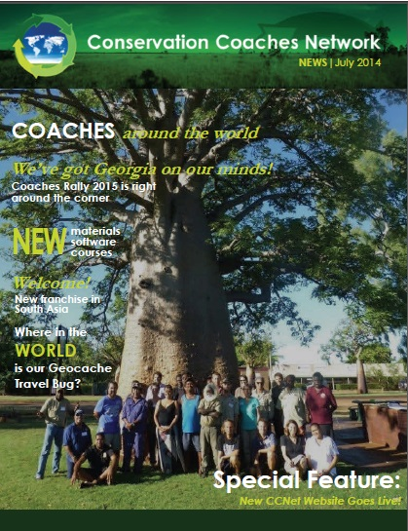
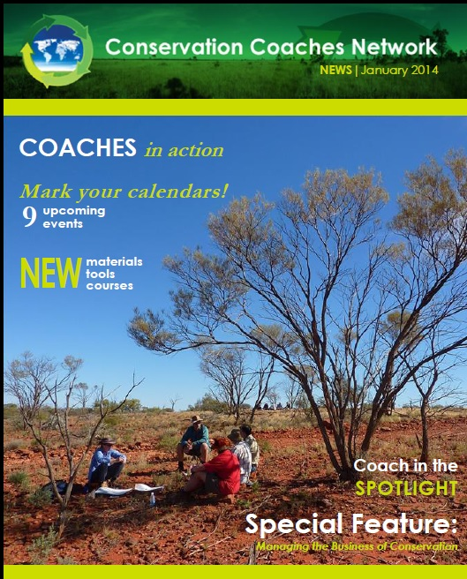
What are ​CCNet's Core Products
CCNet News
Since 2007
Semi-annual
Franchise stories, upcoming events, training/education opportunities
CCNet/CMP Website
List Serve – A forum for questions, innovations.

Slide 12
FY 2015 CCNet Work Plan
Strengthen Franchises
Training (new & continuing)
Implement a communications plan
Improve coach database
Long-term funding

Slide 13
What are the challenges & trends that influence our work?
Opportunities:
Growth in number of coaches and demand for OS use;
Growth in number and interest in franchises;
Donors’ interest in capacity building, networks and organizational collaboration​;
Availability and use of social network technology.
Challenges:
Variability and fluctuation in funding and programmatic support within partner organizations;
Variability in coach experience, ability and skills;
Absence of franchise and coach coverage in some geographic areas;
Persistent weakness in implementation of M&E and adaptation components of OS;
Adapting OS to complex non-place based projects.

Slide 14
What is CMP-CCNet’s Operational Relationship?
Development of a formal relationship
2010 CCNet and CMP Board members met to discuss shared aspirations and unique attributes
2011 “Collaboration Statement”
2012 MOU
2013 Joint Board Meeting
Specific Joint Activities include:
Reviewing structure and governance
Holding Joint meetings
Third-party CMP/CCNet evaluation
Joint website
Guidance material review
Conducting coaching capability assessment
Examining royalty and property rights issues
Unresolved relationship issues:
How tight a bind (loose to merged)
Funding confusion
Who is promoting OS?

Slide 15
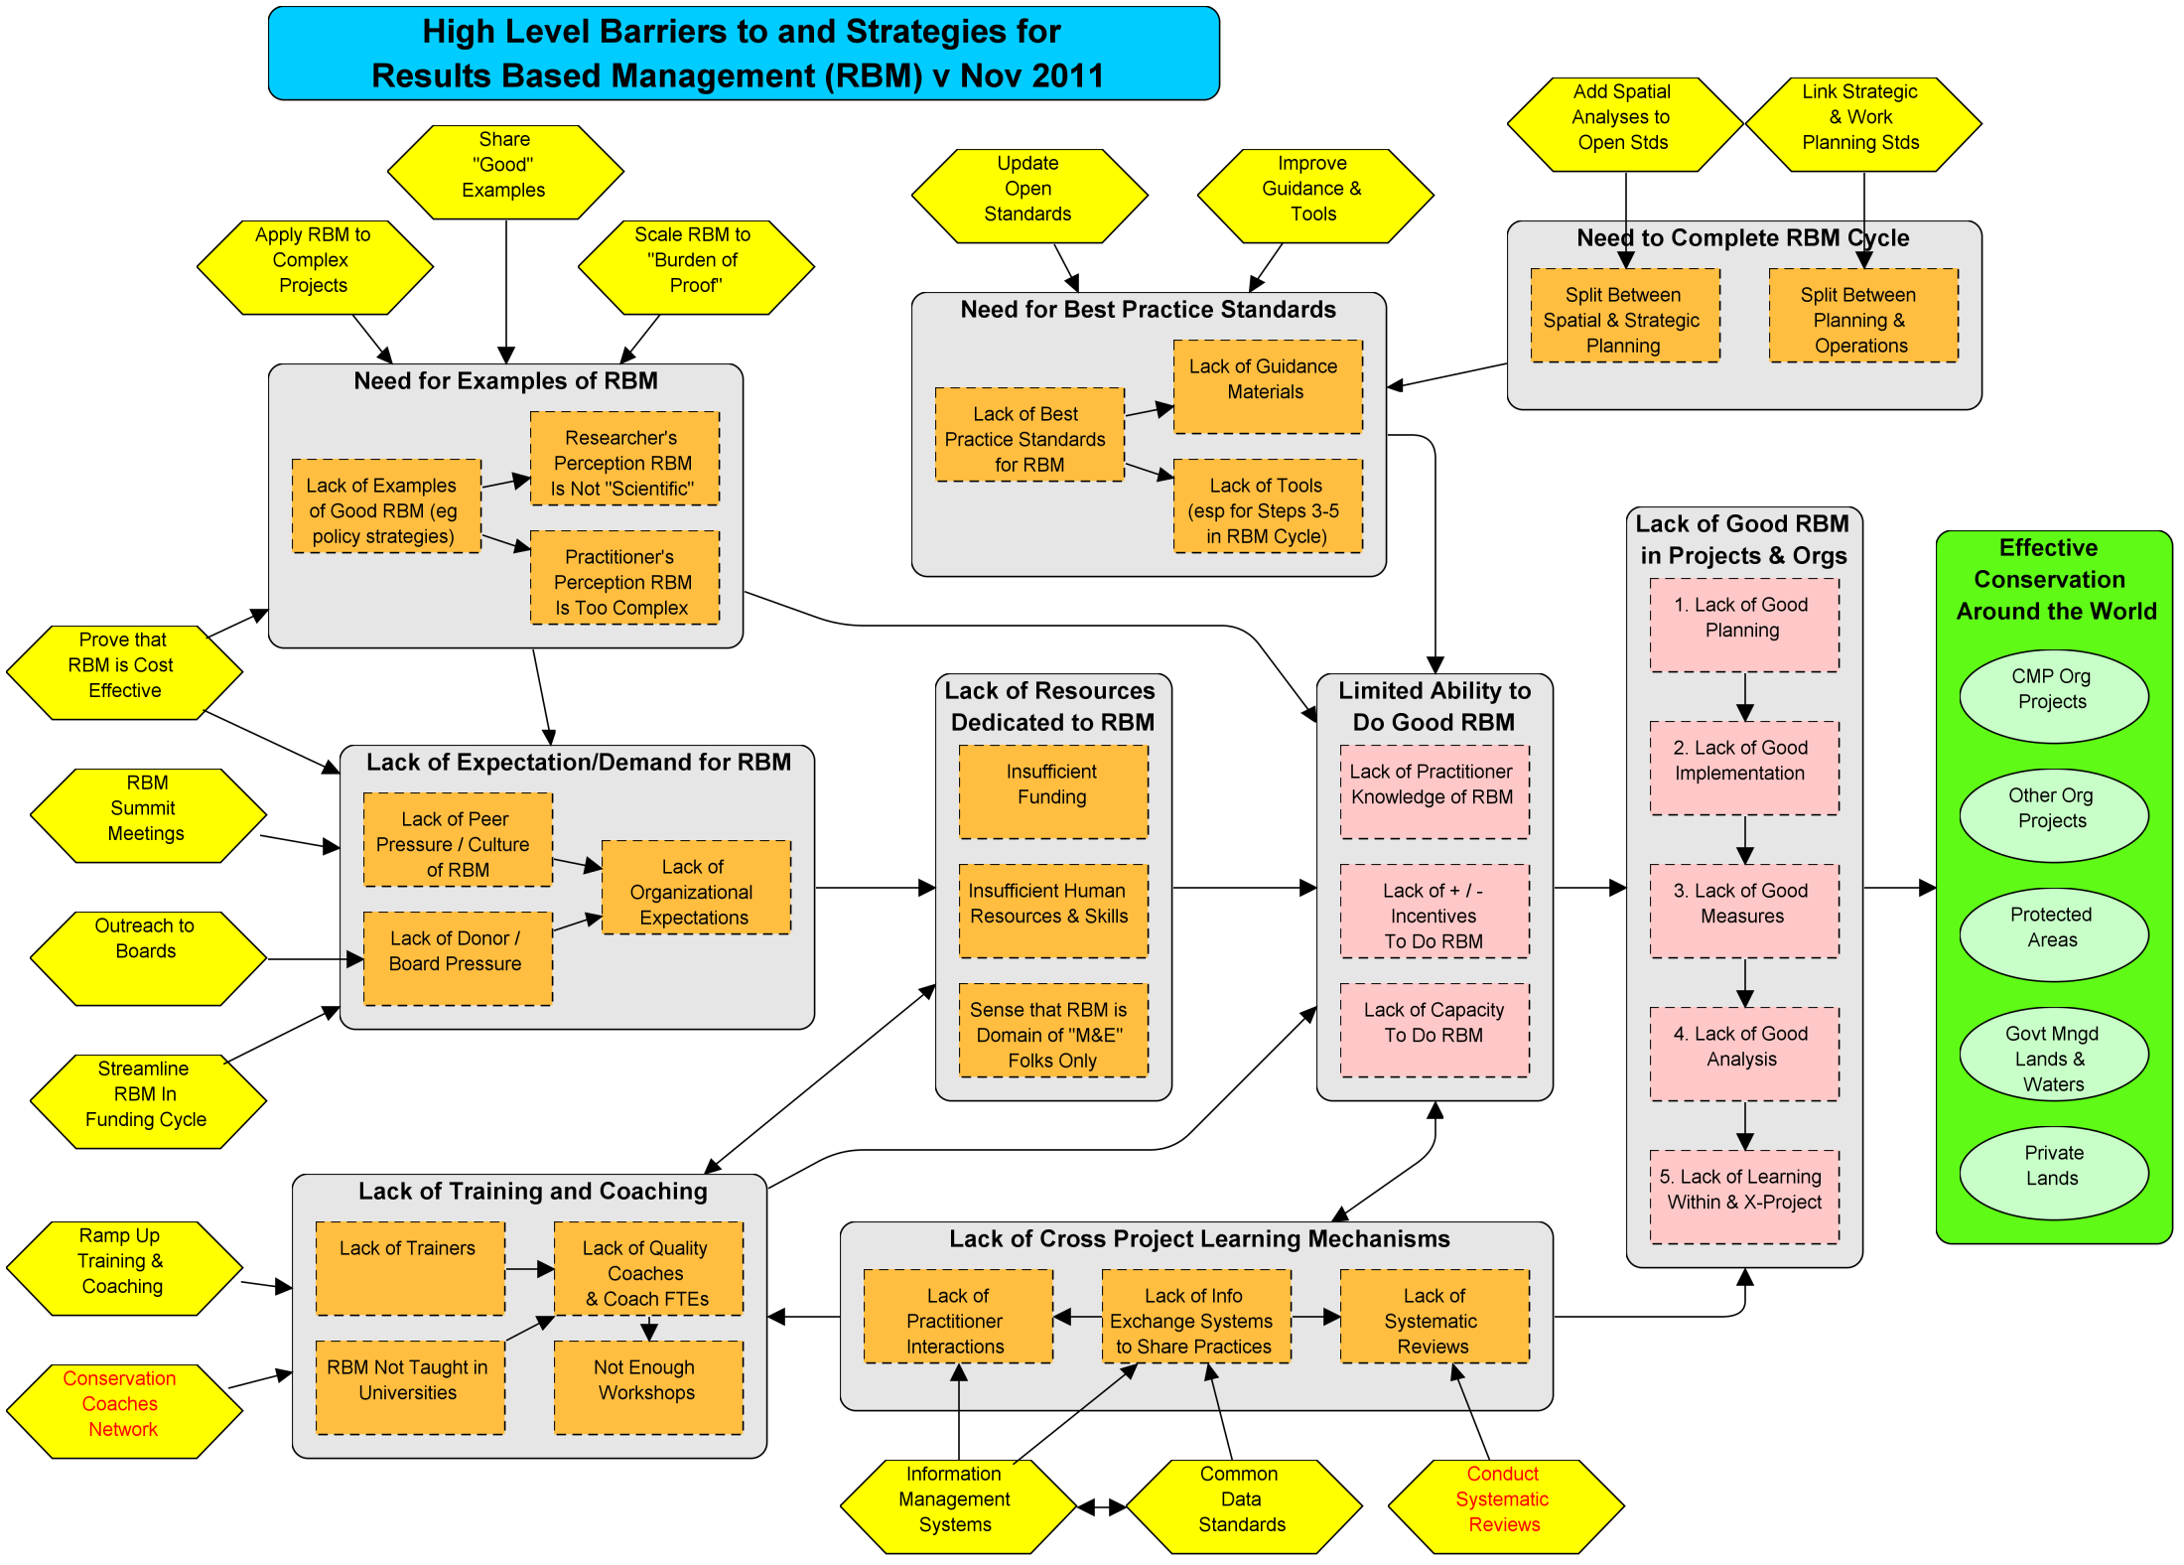
Obj 3: Enhance Knowledge Sharing
Obj 4: Maintain & Improve Tools & Materials
Obj 3: Enhance Knowledge Sharing
Obj 4: Maintain & Improve Tools & Materials
Update training materials, share, & train
Develop & share approaches, rate coaches on all RMB steps
Obj 5: Institutionalize & Strengthen Network
Strength ties to CMP, aggressive funding strategy, expand and diversity partners/franchises, increased outreach
Obj 1: Recruit & Train Coaches
Empowered Human Capacity
Obj 3: Enhance Knowledge Sharing
Obj 4: Maintain & Improve Tools & Materials
Obj 2: Enhance Coach Training
Training events, needs evaluations, skill assessment tools, mentoring program
Web site, Rally, fellowships, online tools, OS Tutorial, rate current tools

