Slide 1
Value for Money
Measurement is often focused here
Resources /
Investment
Service & Wider
Outcomes
Money
Economic
QUALITY
People
Inputs
Outputs
Social
Environment
Determining social value requires evidence of this relationship
Environmental

Slide 2
It’s challenging e.g. capturing “additionality”
Definition: at a very basic level, additionality is about measuring net, rather than gross, impacts. In other terms:
This can also entail capturing so-called “positive knock-on outcomes and impacts”.
Counter-factual
Outcome
Contribution
Impact
Displacement

Slide 3
Impetus for the work
Internal Management/ Governance bodies
Operations: interest in economy and efficiency
Programmes: recognition of the complexity
DFID PPA
Pressure on use of public funds
Economy, and Effectiveness ‘measures’
“If you don’t define value, someone else will do it for you.”

Slide 4
Approach - framings for Value for Money
What is your organisational position on VfM?
It’s about what is right for you and your organisation to make good decisions.
1) Organisational economy and efficiency
Overall quality management system
Procurement process
Overhead costs
etc.
2) Individual programmes (programme cycle)
Managing through the cycle with VfM in mind
Sometimes deeper evaluative techniques (cost effectiveness, SROI)
3) Programme portfolio management
Supporting decision-making

Slide 5
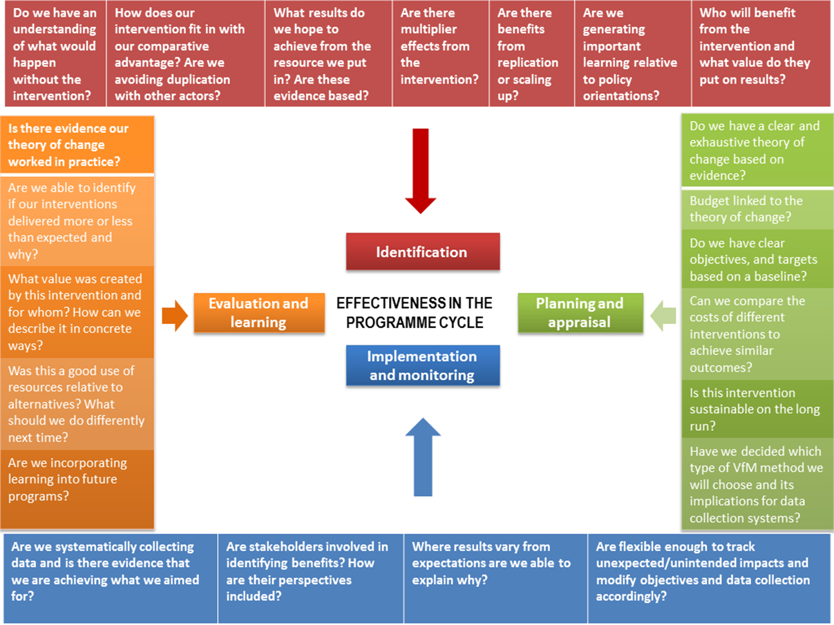
Effectiveness in the programme cycle

Slide 6
DFID feedback on WWF reporting
...a very good understanding of VfM
…a commitment to the VfM agenda.
…the cost category/ cost driver section is strong
…economy: demonstrates good practice and specific savings.
…VfM ‘measures’ too vague. Did not provide ‘specific metrics’
…evidence on effectiveness is good, indicating WWF is committed to results and maximising your impact.
With the exception of the VfM measures which could be improved, we would like to congratulate WWF for your strong VfM reporting.

