Slide 1

Mainstreaming the METT
Bailey Evans
Conservation International

Slide 2
Why is CI Interested In PAME?
Supports Conservation of Critical Natural Capital
Adaptive Management (in field & executive)
Allows for time-scale M&E, and refining strategy
Fosters support from partners and stakeholders

Slide 3
What is the METT?
An assessment (scorecard) of the management effectiveness of a PA
Utilized by donors (foundations, multi-laterals, etc.), civil society, and NGOs to monitor management of a PA
A subjective approach – which should be participatory – to assessing the conditions of management within a PA
Themes Assessed: management plan, budget, demarcation, gazettement, protection, enforcement, community engagement & monitoring, etc.

Slide 4
CI’s Process
Research
Development of CI’s METT through adaptation of the IUCN/WWF Management Effectiveness Tracking Tool (METT) and the World Bank MPA Scorecard
Began Assessments in 2013 – Completed by Field Programs Annually in August
Data Consolidated & Analyzed
Reported to Board of Directors on Natural Capital Achievements

Slide 5
Successes
Gathered 200+ Assessments for 2 Years
Now an Institutional Standard
Fostered New Partnerships and Stakeholder Relations in Field Program Countries
Provided Opportunity for National-Level Policy Engagement
Identified gaps – funding, staff, etc.
Translated to Spanish (soon Portuguese, French, & Bahasa Indonesia)

Slide 6
Challenges
Unfunded Initiative
Getting Institutional Buy-In
Ensuring [Accurate] Completion of Scorecards by Field Programs
Database Management & Analysis
Fostering an Understanding of Results
Maintaining Momentum for M&E in Institution
Staff turnover in Field Programs
Capacity Building on M&E in general….

Slide 7
Statistics
2013: 134 Assessments in 20 Countries
2014: 156 Assessments in 18 Countries
Average change in management effectiveness across the board was +3 between the two years (out of 100)

Slide 8
Interest to CMP
Standard Approach
Able to link PA management outcomes to use of Open Standards
Supports tracking Aichi Targets
Link to Broader PAME efforts & Global Database by WCMC

Slide 9
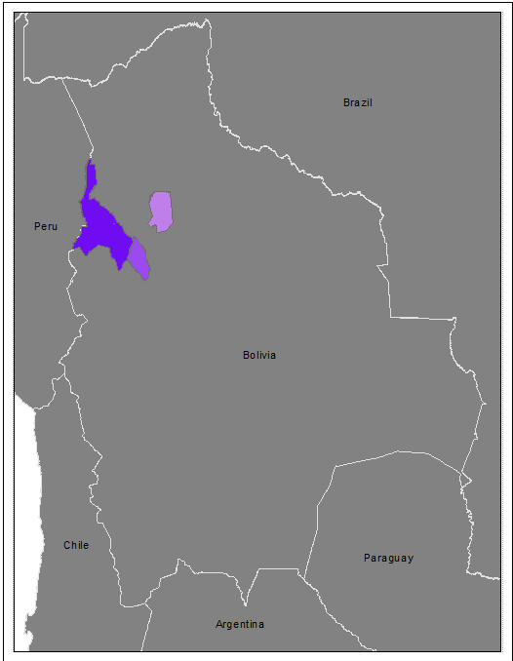
Bolivia Example
Use of same-color scale within countries
Has a grading of 10
Minimum score of 24
Maximum score of 87
Allows for time-scale monitoring of management effectiveness
Visualizes and centralizes data [storage]

Slide 10
Come here more about…
Getting institutional support
Operational processes (25+ country reporting)
Ideas for analysis and linking to impact

Slide 11
Thanks!
Bailey Evans
Manager, Field Program Management
bevans@conservation.org

