Slide 1
Got Culture? A Proposal for Addressing Cultural Identity in the Open Standards
Caroline Stem, Annette Stewart, Stuart Cowell, Nick Salafsky
CMP Members’ Meeting, October 5-7, 2014

Slide 2
Why Culture Now?
HWT Guidance widely used
Cultural aspects not emphasized
Disregarded by some working with indigenous cultures
Greater potential for use

Slide 3
A Proposal for “Cultural Targets”

Slide 4
Target Selection as a Value Process
Influenced by who is involved, world view
Example: Salmon as a conservation target
Because it’s a top predator and has important ecological function;
Because it’s a charismatic species with strong marketing potential; AND/OR
Because it’s culturally important

Slide 5
“Tangible/Physical” Cultural Targets
Archaeological sites, temples, and ruins
Could be considered special types of conservation targets because:
In most cases, similar threats
Similar or synergistic strategies
However, may involve decisions of where to prioritize resources

Slide 6
“Tangible/Physical” Cultural Targets
Archaeological sites, temples, and ruins
Could be considered special types of conservation targets because:
In most cases, similar threats
Similar or synergistic strategies
However, may involve decisions of where to prioritize resources
Require special attention but too different to include in threat rating

Slide 7
“Tangible/Physical” Cultural Targets

Slide 8
“Tangible/Physical” Cultural Targets

Slide 9
“Tangible/Physical” Cultural Targets

Slide 10
“Tangible/Physical” Cultural Targets

Slide 11
Intangible Cultural Targets
Cultural identity, cultural knowledge, cultural cohesion
To date, considered Human Wellbeing Targets
Proposal to maintain this
General rule: Intangible cultural targets are HWTs that benefit from conservation via ecosystem services (esp. cultural services)

Slide 12
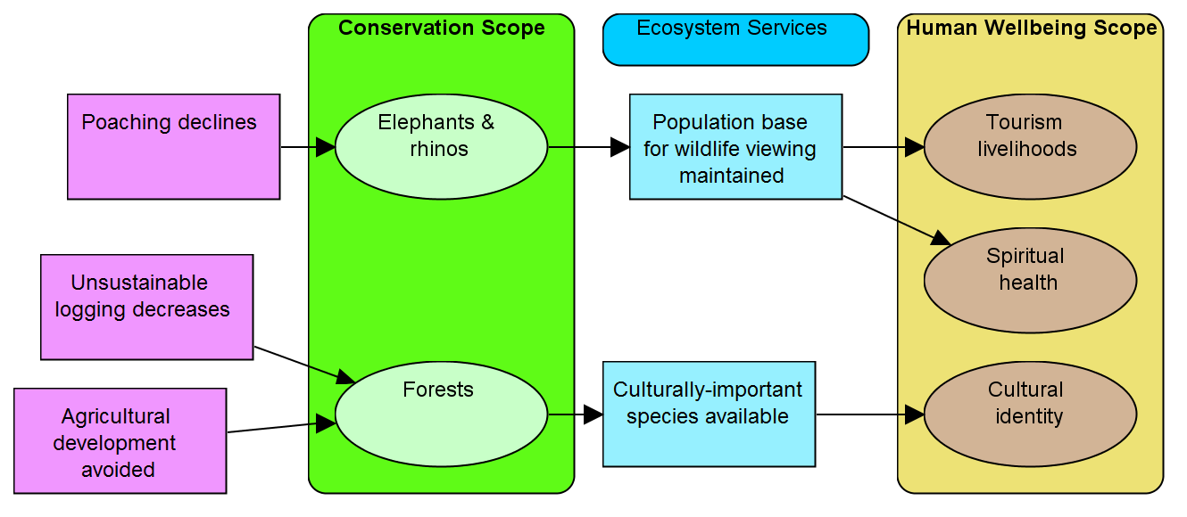
Intangible Cultural Targets
Cultural identity as human wellbeing target

Slide 13
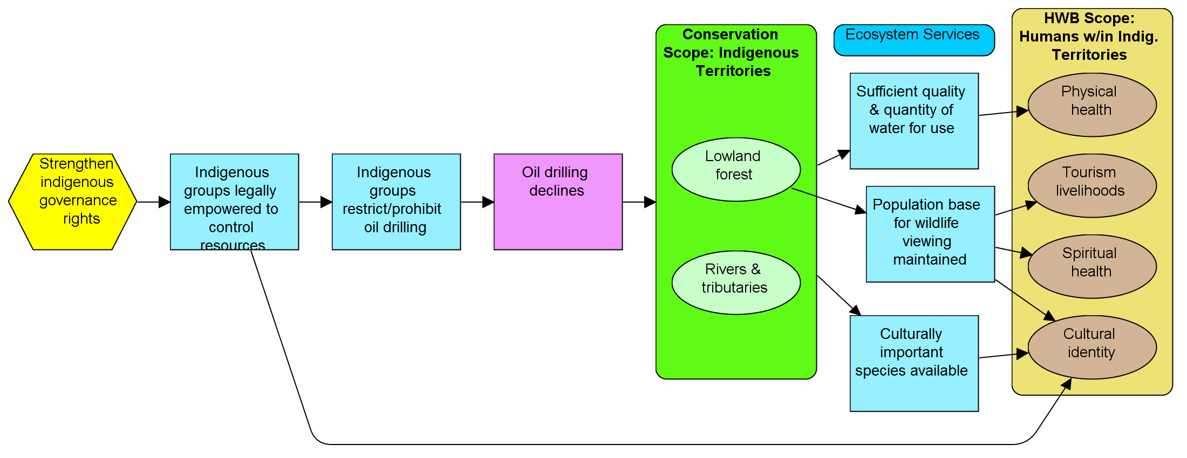
Intangible Cultural Targets
Result that contributes directly to cultural wellbeing (as well as conservation)

Slide 14
Intangible Cultural Targets
Proposed recognition: In some cultures, explicit distinctions may not resonate. May be more appropriate to include cultural targets as conservation targets or as key attributes of an ecosystem, habitat, or species
Extra caution is needed to be clear about relationships and trade-offs

Slide 15
Examples of How Cultural Targets Have Been Handled
Many of these concepts get translated to key attributes

Slide 16
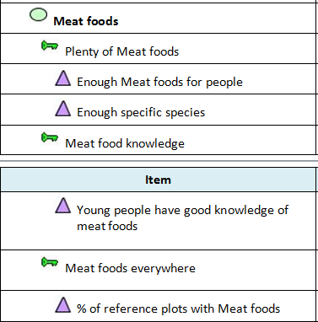
Example A: How Cultural Targets Have Been Handled
As “conservation targets” defined around cultural interests/ needs
As key attributes related to a “conservation target”

Slide 17
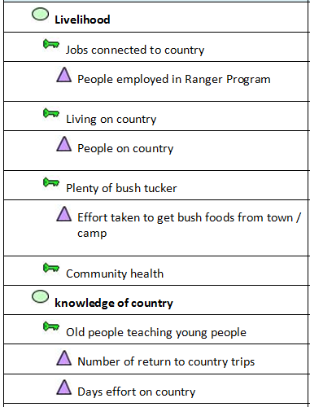
Example B: How Cultural Targets Have Been Handled
Acc. to the CMP guidance, these are human wellbeing targets with HWB KEAs

Slide 18
Example B: How Cultural Targets Have Been Handled
What this would look like following CMP HWT Guidance

Slide 19
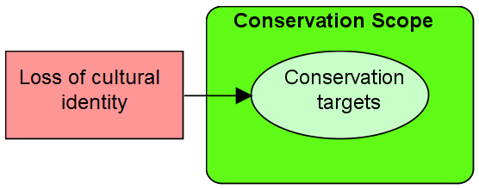
Example C: How Cultural Targets Have Been Handled
Adaptation: loss of cultural identity as direct threat
How OS handles loss of cultural identity: Indirect threat
How OS handles loss of cultural identity: HWT or key attribute of HWT

Slide 20
Issues in Need of Discussion
IF CMP members accept concept of cultural targets, to what degree do OS or OS guidance reflect different ways of handling those targets (esp. Intangible cultural targets)?
What are the benefits and trade-offs of showing different approaches?
Source for image: Ansgar Walk http://upload.wikimedia.org/wikipedia/commons/8/87/Qamutik_1_1999-04-01.jpg

Slide 21
Summary
Proposal:
Tangible, physical cultural targets (ruins, temples, archaeological sites) are a special type of conservation target
Intangible cultulral targets are human wellbeing targets
Recognize that adaptation may be needed for some cultures, esp. indigenous societies
Biggest issues:
To what degree do OS or OS guidance reflect different ways of handling those targets?
How do we keep OS clarity when conflicting use of cultural targets – some as conservation targets, some as HWTs, some as contributing factors?

