Slide 1
“It was bad, because the bandits would come, and we would fight them…During those days, you really slept with your shoes on your feet. But now, we have Sera Conservancy, now we are free move, and our animals are free to go anywhere in those areas, and that’s the goodness we have seen”.
Samburu woman, Northern Kenya

Slide 2
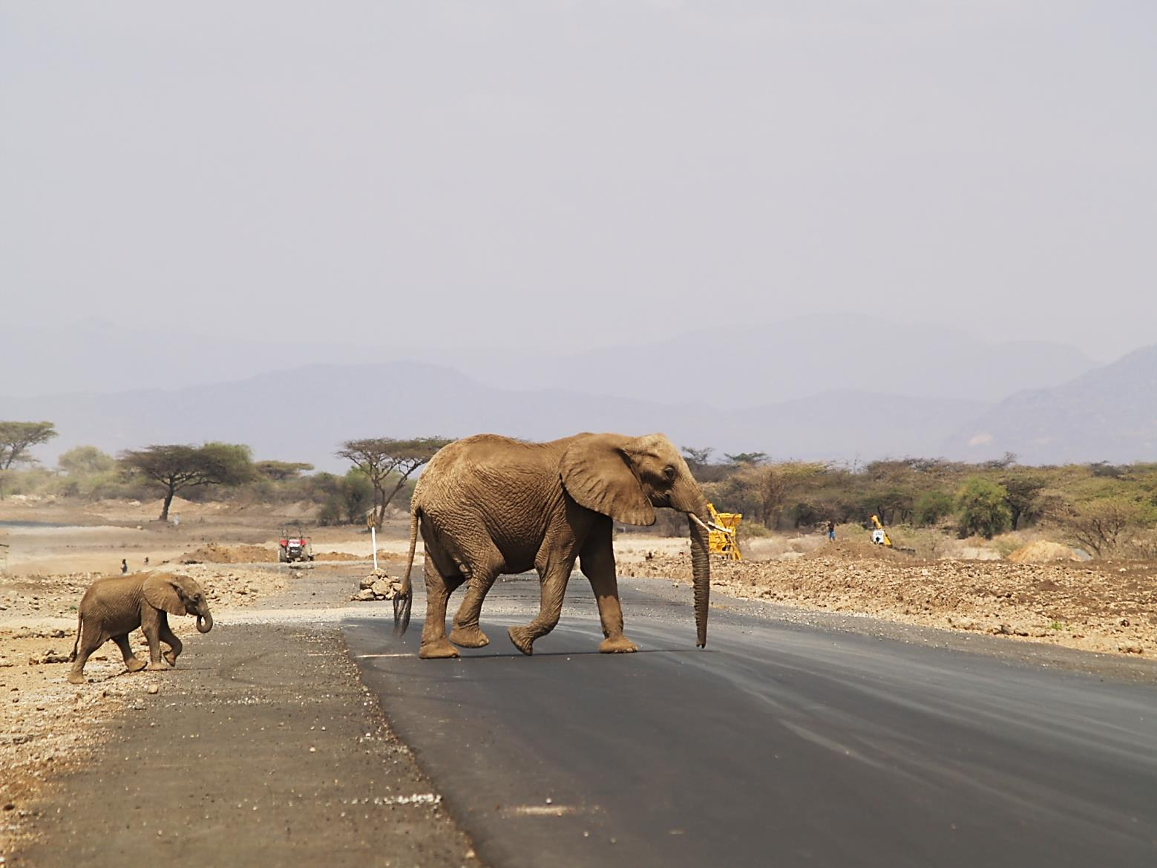
Impact Evaluation
“the systematic process of measuring the intended and unintended causal effects of conservation interventions, with emphasis upon long-term impacts on ecological and social conditions”
Mascia et al. 2014

Slide 3
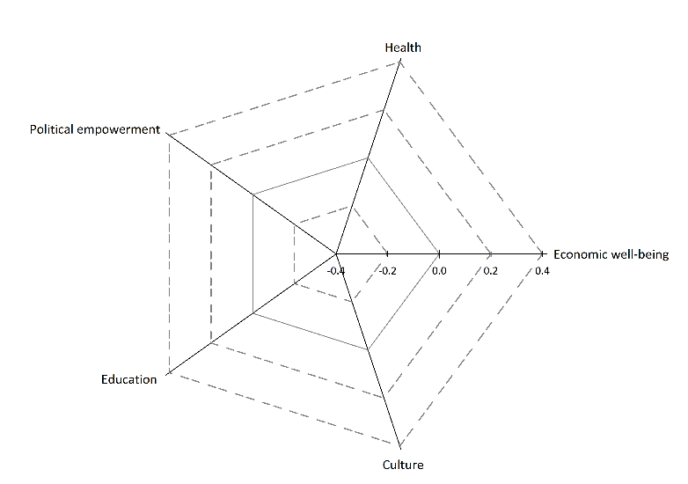
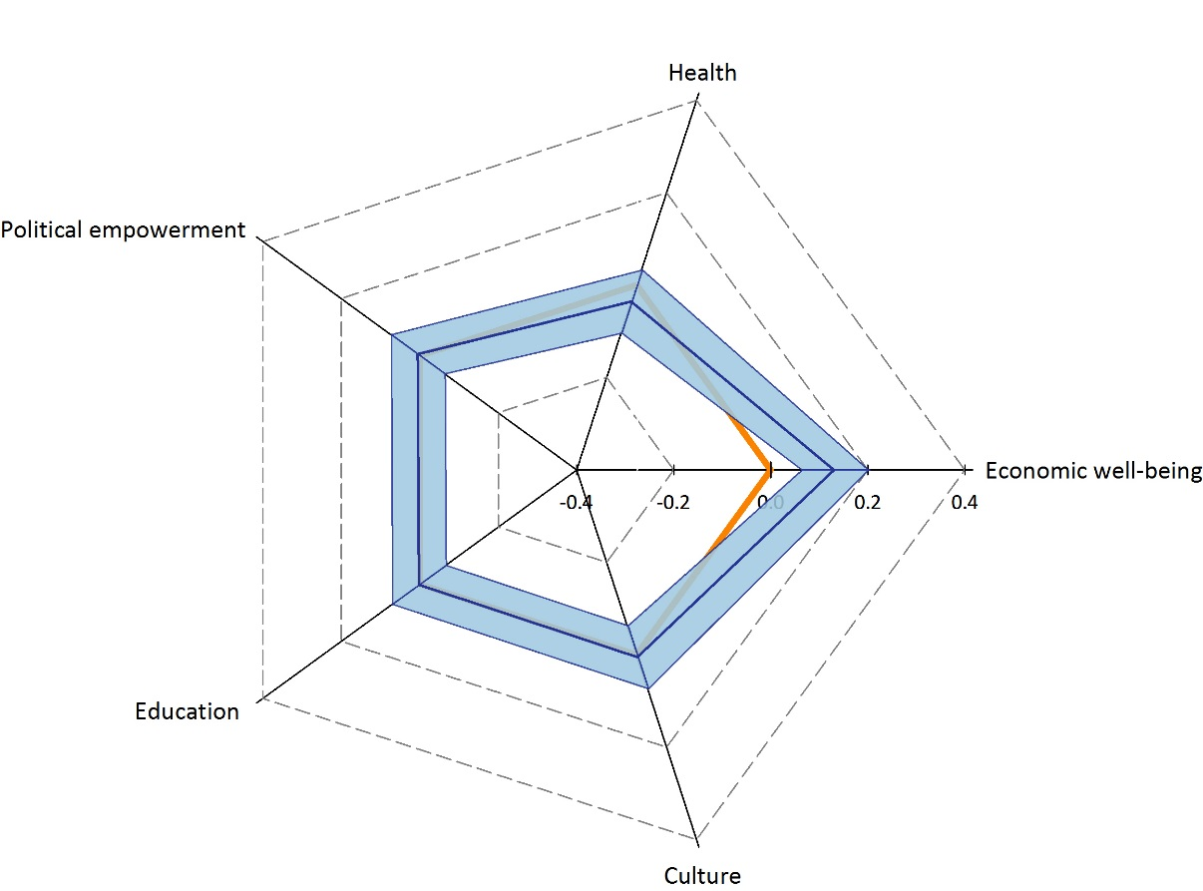
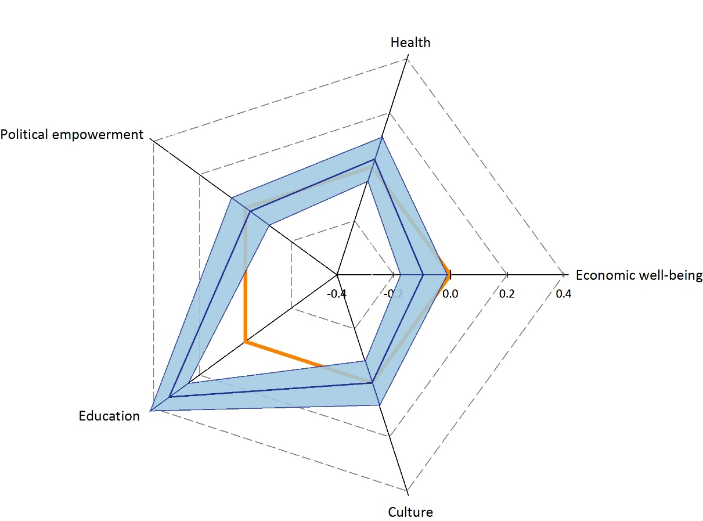
Variable MPA impacts
Negative MPA impact
Positive MPA impact
MPA social impacts across five human well-being domains
Political empowerment
Education
Teluk Cenderawasih National Park
Teluk Mayalibit MPA
Blue line represents average treatment effects (ATT) converted to standardized mean differences. Abadie-Imbens standard errors (converted to standardized mean differences) shaded in pale blue.

Slide 4
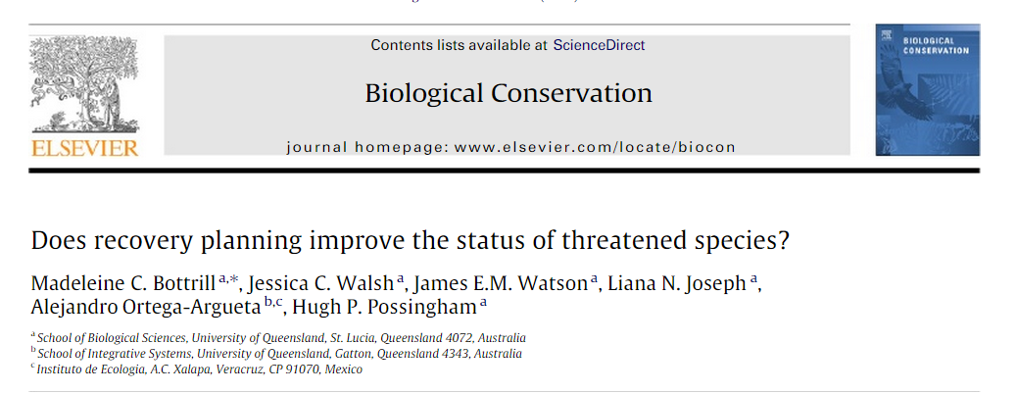

Slide 6
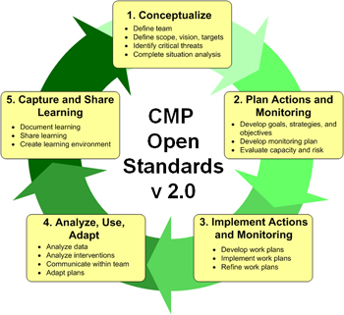
Impact Evaluation Guidance for the Conservation Sector
When to evaluate impact?
How to commission an impact evaluation?
How to make decisions based on
IE evidence?
How to design an impact
evaluation?
How to communicate IE findings
to key audiences?
How to analyze and interpret impact
evaluation findings?
How to manage an impact evaluation?

Slide 7
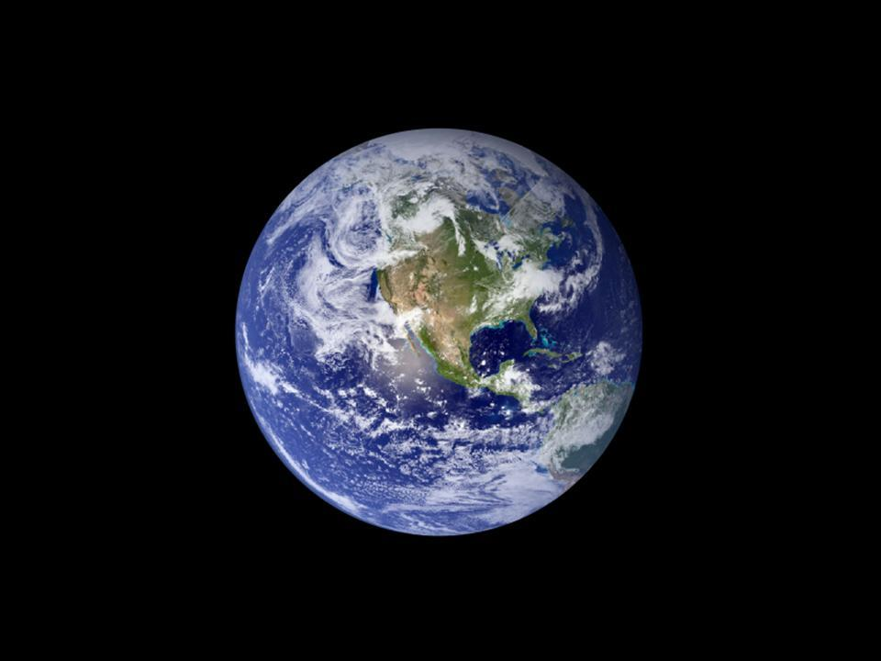

Slide 8
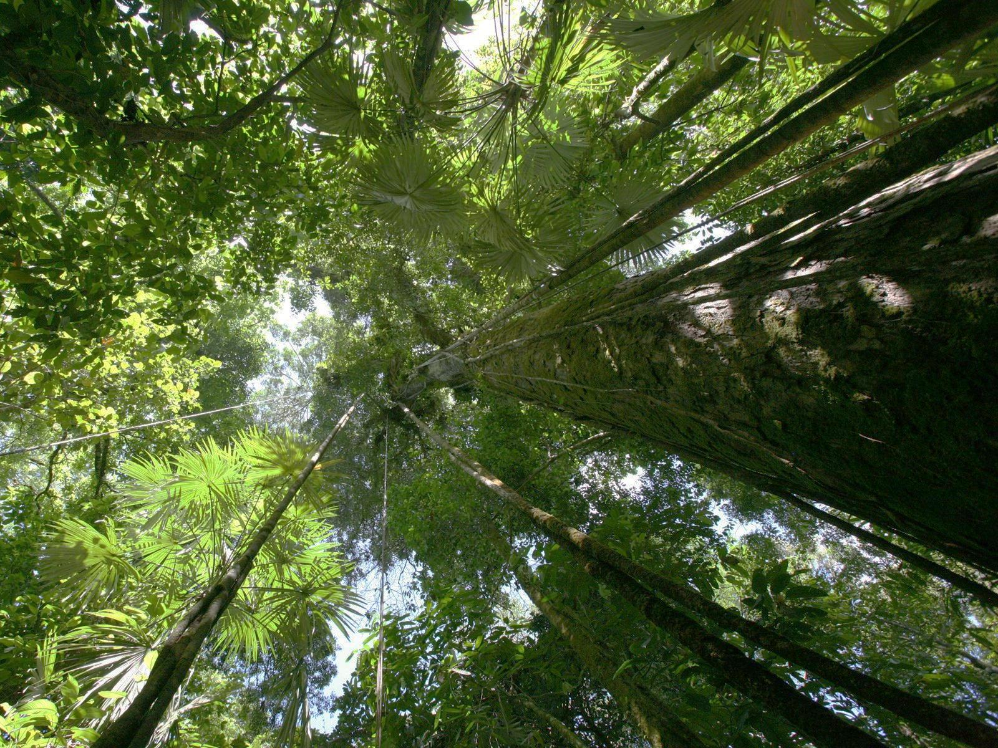
When To Evaluate? The Power, Potential and Pitfalls of Impact Evaluation in Conservation
Louise Glew, World Wildlife Fund US
Madeleine Bottrill, Conservation International
Notes:
Need to add 3IE logo and CI logo.

Slide 9
Mascia et al. 2014
Notes:
This slide –how does IE fit into program cycle? Make clear that it is COMPLEMENTARY to other M&E approaches, -> only used FOR A SMALL SUBSET OF INTERVENTIONS/PROJECTS

