Slide 1


Managing the Business of Conservation
Conceptualise
Communicate
Plan
Implement
Analyse, Adapt
Implement
Notes:
Intro - Bush Heritage is a small organisation, of about 60 people, running conservation projects in Australia
We’ve been using the OS & Miradi for the past few years, and now manage all of our projects using this approach
This quick presentation will focus in on the Implementation step –
particularly looking at how we use the Work-planning capabilities within Miradi to manage implementation of our projects.
In the past we’ve had a lot of projects that failed to be implemented, or implemented well, mainly because they weren’t well resourced;
so we’ll look at some reports we use to review the portfolio of projects and manage resourcing of them with people and money;

Slide 2
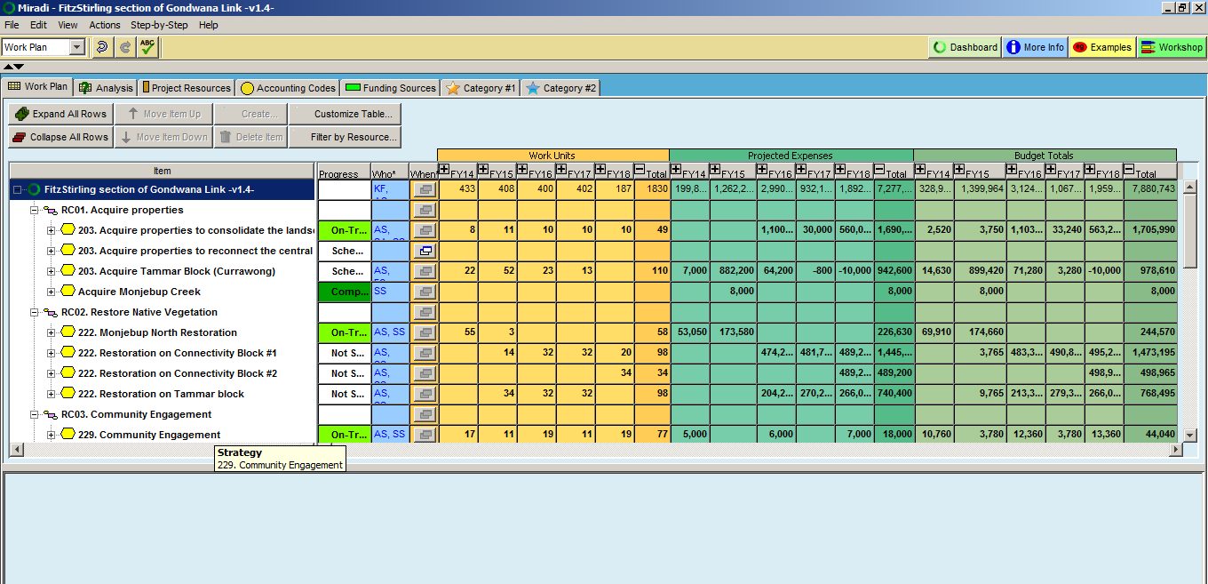


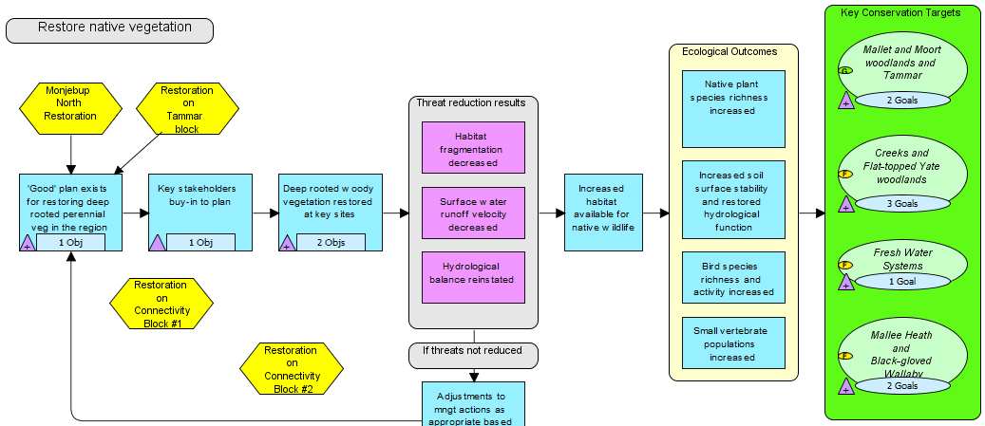
Work planning in Miradi
Finance System
Notes:
We have a Miradi file for each project; where we store all the usual information about Targets and Threats etc,
We use the Work-planning feature extensively, to define the costs associated with implementing the work,
the Workplanning feature -
lists all of the strategies that the team has defined in their project
And lets them assign people or groups to do the work
and add in the expenses that they will incur
Miradi then calculates the total costs by taking the days * daily rate plus expenses
It also rolls up these costs to show the total cost of the project
We use a timeframe that’s appropriate for the project, but for most we plan for up to the next 4-5 years
We also use the progress Reporting feature to keep track of how implementation progressing
There’s a setting * that only populates the Workplan with information from Results Chains *
Which means a Strategy has to be described on a results Chain, including the outcomes we expect the strategy to achieve and
the indicators we’ll use to monitor progress, before a budget can be prepared for it
We automatically flow the information from this workplan view into our Finance System, which opens the way for funds to be allocated;
So, anything appearing in the finance system can be traced back to the outcomes articulated in a RC

Slide 3
Project-level Resourcing
Notes:
There are a few cross-checks we can do at the project level to make sure the workplan & budget is aligned with the conservation priorities identified in the project
The Target Viability table -
shows the Current Viability* based on monitoring,
And the Desired Future Viability - where the team is trying to get to.
We can map on the budget developed in the Workplan to see where the effort is going
In this instance, there’s days & $s aimed at improving the viability of the 4th Target, but there’s nothing happening for the 2nd
Sometimes there’s a good reason for that, sometimes not
Similarly, can do the same with Threats -
The table shows a “High” threat with no resourcing allocated, and a bunch of “Low” threats which are being resourced
Again, there’s sometimes there’s a good reason for that, sometimes not
it generally means that some of the project’s goals are unlikely to be achieved without a change to the workplan
A review like this helps make sure that the workplan is well linked to the Project’s overall goals so that it stands a chance of achieving its desired outcomes

Slide 4
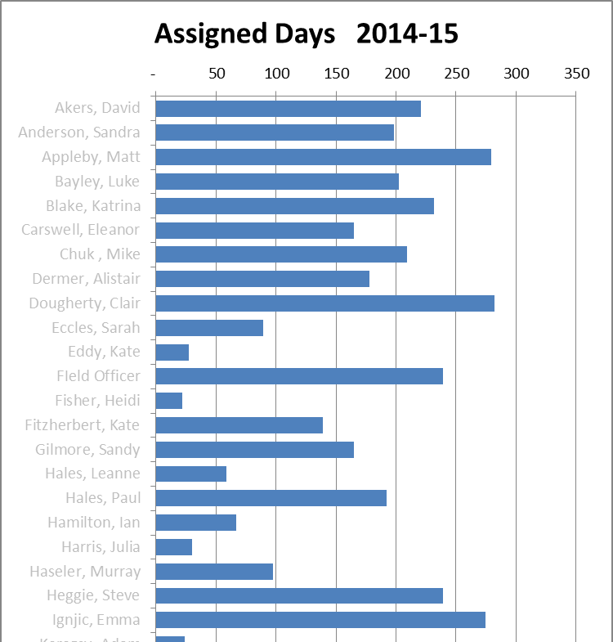
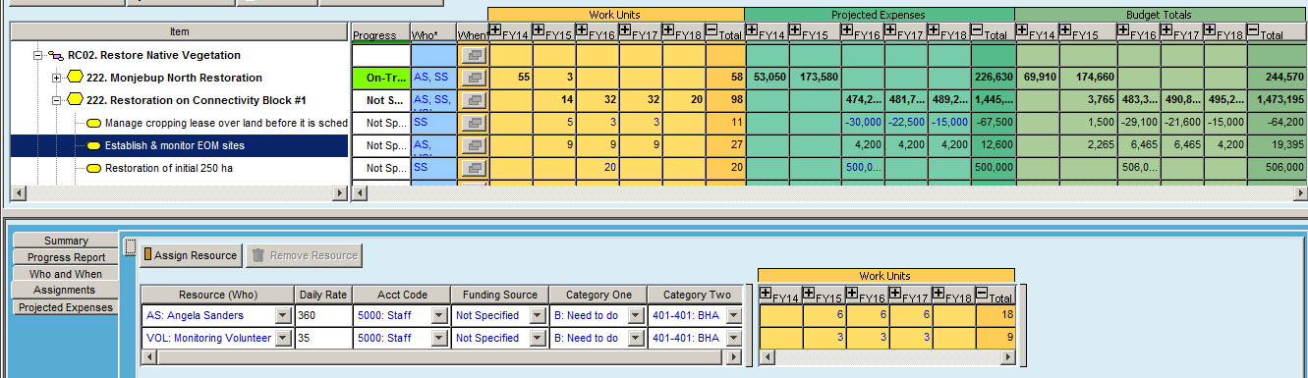
Resourcing the work - staff
Projects:
Notes:
First look at resourcing in terms of people, and will then look at resources from the financial perspective
One of the problems we’ve been trying to deal with is burnout –
people are passionate about what they do and tend to take on more than is possible,
so we had projects that were not delivering, or were running well behind expectations, because we had taken on more work than we could handle
Now we can see where the time is going, and try to make sure individuals have do-able workloads
Within Miradi we Assign people to the planned Strategies & Activities –
Using reasonable estimates – no expectation that they are precise, but good-enough ;
Use the same process for volunteers
Entering a charge-out rate means Miradi can calculate the cost of the work and add that into the project’s total budget
we can pull all the projects together and see workloads for individuals across all projects;
Our rule of thumb is to plan for 80% of people’s time, to leave space for other things –
that’s the red line
often find that people are well over this;
Can drill down to see the Projects, Strategies & Activities that the person has been assigned to
This sort of analysis can lead to -
Work being reprioritised, often shifted out to a later date
Or work being re- assigned to someone else
And in some cases it has been used by teams to make the case for extra staff

Slide 5
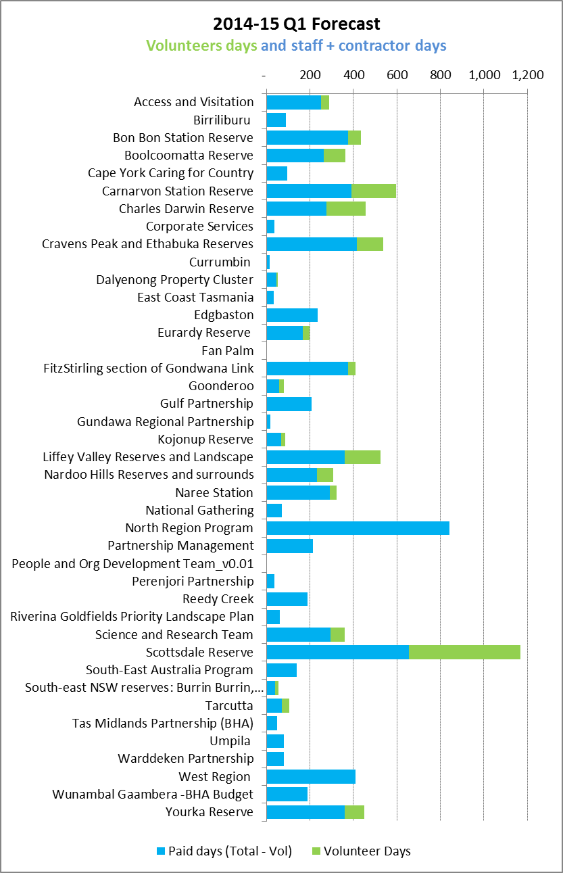
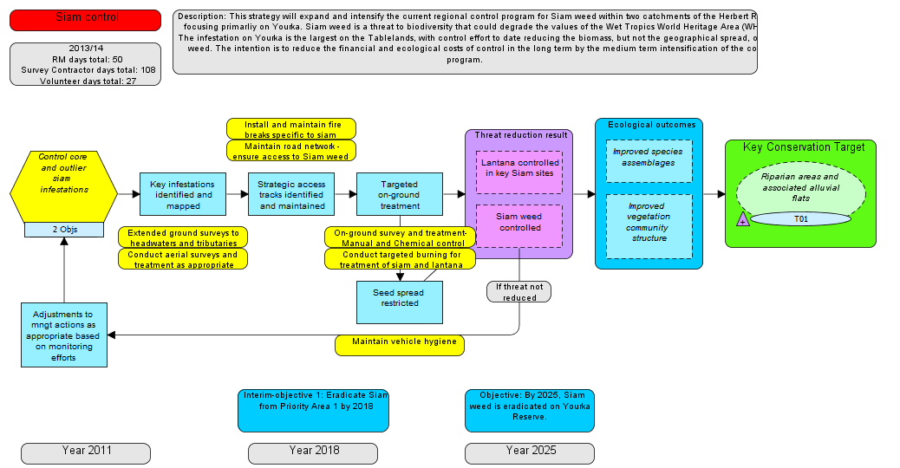
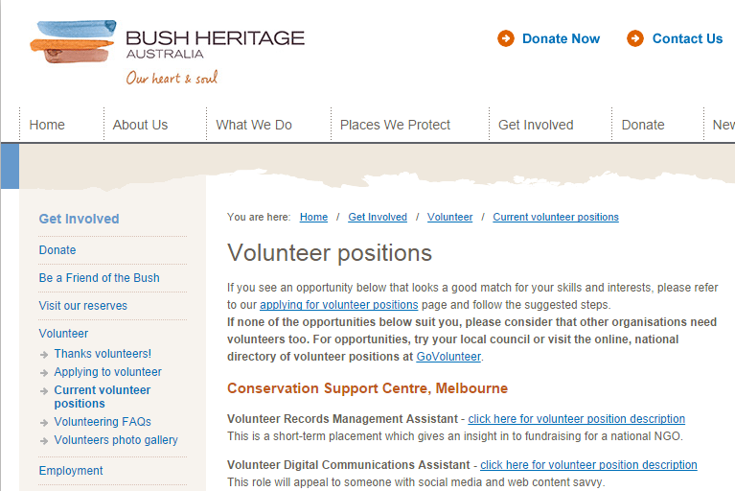
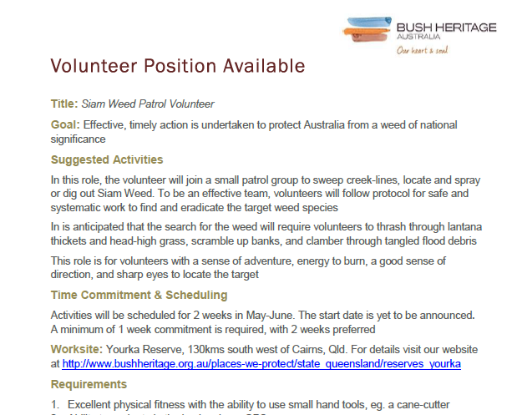
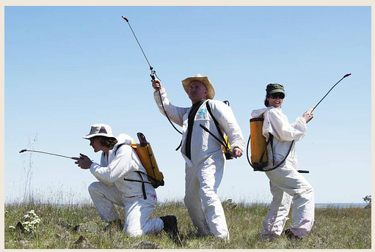
Resourcing the work - volunteers
Notes:
We use the same process to identify opportunities to involve volunteers in our work
Across the portfolio we can see how much volunteer support is being sought,
And see where the exemplars are and try to replicate their efforts on other projects
Because the workplans are built from Results Chains,
its easy to provide good context about why the volunteer help is required,
when, where, the outcomes we expect to achieve, and how we will measure those outcomes
Now we can pull out this information and start to populate Volunteer Position Descriptions
Which then go onto our website
And people put their hands up to help
So we end up being able to do much more than would otherwise be possible

Slide 6
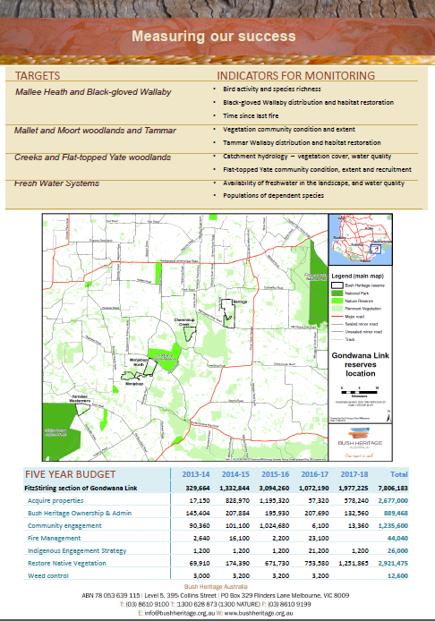
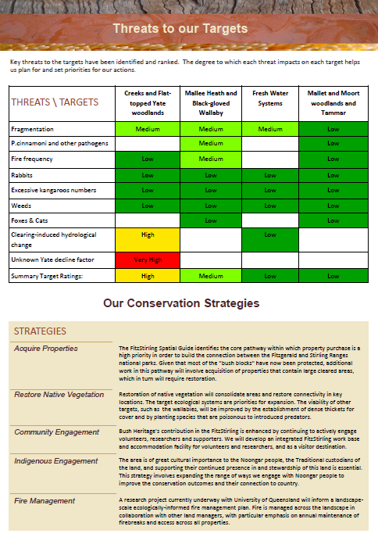
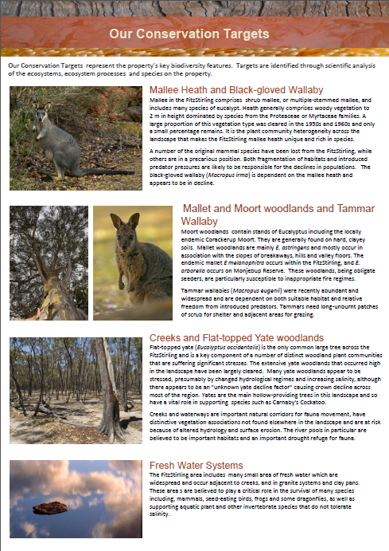
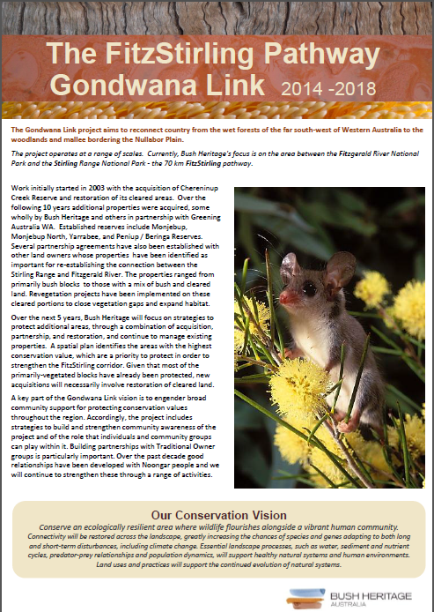
Resourcing the work - $$$s
Notes:
So that’s a quick view about the people side of resourcing a project; the other half of the puzzle is the financial side.
First - bringing money in -
At the project level, we worked with our fundraisers to develop a standard template for a project, that can be used when talking about the project publicly or with funders
Have a similar one for documenting a subset of a project, such as a particular strategy or Results Chian
The template can be filled in by cutting and pasting the words out of Miradi, and adding a few pictures
Aim is to get the words written well once, store it in Miradi where everyone can get at it, then its easy to generate materials like this
there’s often a lot more information required, but this generally serves to start the conversation
So, having consistent, quality information about our projects easily available to our fundraisers helps make their roles more efficient

Slide 7
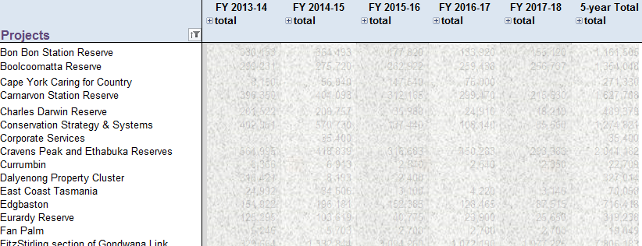
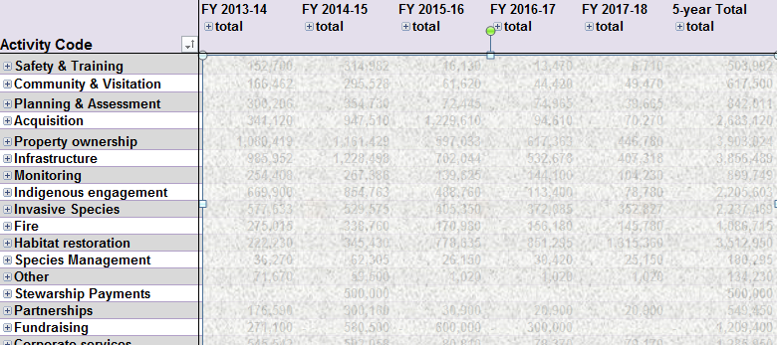
Resourcing the work - $$$s
Notes:
. . . The Portfolio reports also help manage the money going out –
An initial view shows the multi-year budget by project, which helps with comparisons across projects
can see it split by the cost of effort, or direct expenses, or both
or by type of account – operating vs capital expenses for example
or for just a subset of projects, such as within a region
Can also slice it the other way, by type of activity,
so, for example, fire management activities across all projects
This is “activity based costing” that you might hear your finance folks talk about
All this info can lead to adjustments being made in some projects, either in the short-term or progressively thru quarterly forecast updates

Slide 8




Next steps
Miradi database
Finance System
Notes:
So that’s a summary of some of the rather tedious but necessary steps that can be taken to help managers make decisions about individual projects as well as across the portfolio.
We can generate these types of reports because we’ve been very fortunate to have access to a database developed by David Berg, a volunteer with the Nature Conservancy
We’ve recently started using Miradi Share,
So all the data that is in David’s database , is now also in the Miradi share database . . .
And that offers an opportunity to develop this type of reporting into a system that anyone could use
We’re keen to work with others to identify the generic needs, find some funding to pay the programmers,
then build some of these types of capabilities into MS so that any organisation can get access to these types of features
If that’s of interest to you or anyone in your organisation then let’s chat

Slide 9
Managing the Business of Conservation

