Slide 1
Human Wellbeing – What We Have Learned Since 2012 Guidance
CMP Members’ Meeting, October 5-7, 2014

Slide 2
Topics
Overview of HWT concepts
Testing of HWT in field
Reactions to HWT framework
Discussion Questions

Slide 3
How Can Conservation Contribute to Human Wellbeing?
2 Primary Avenues:
Via ecosystem services provided by conservation targets (these are called “human wellbeing targets”)
Directly as part of a conservation strategy (these are called “socially beneficial results”)

Slide 4
Via ecosystem services
Human wellbeing is achieved via ecosystem services provided by functioning conservation targets
Services that intact, functioning ecosystems, species, and habitats provide and that can benefit people

Slide 5
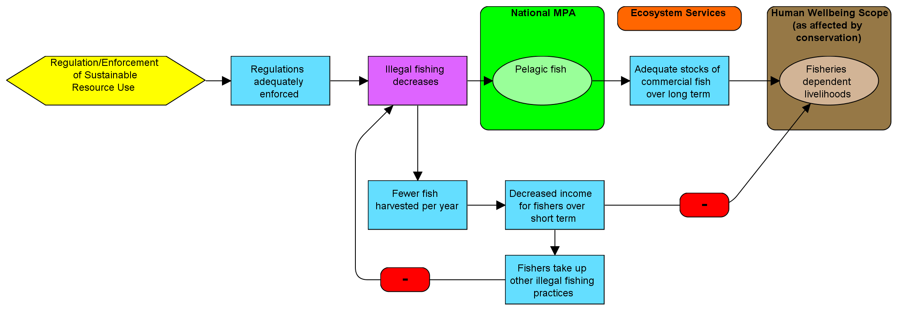
Use Results Chains to Show Trade-offs, Feedback Loops
Enforcement of sustainable fishing regulations
Regulations adequately enforced
Illegal fishing decreases
Pelagic fish status improved
Adequate stocks of commercial fish over long term
Fisheries livelihoods
Fewer fish harvested per year
Decreased income for fisheries over short term
Fishers take up other illegal fishing practices

Slide 6
Directly as part of a conservation strategy
General Relationship
Eco-certification of timber harvesting
Specific Example
Loggers get more money for certified products
Result directly benefiting humans
Ecosystem services
Forest livelihoods
Notes:
Necessary for achieving conservation, but it also has direct social benefits

Slide 7
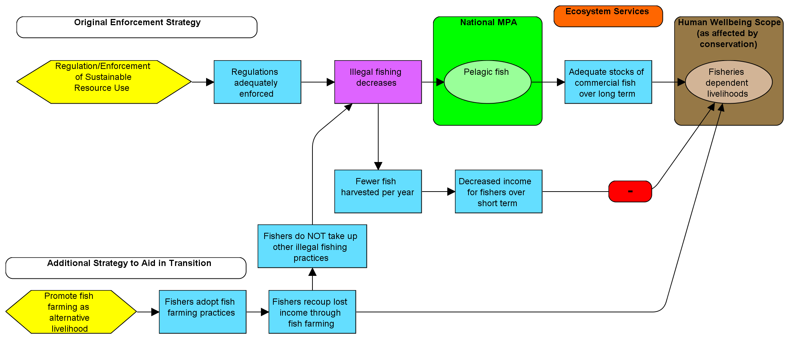
Use Results Chains to Show Trade-offs, Feedback Loops
Enforcement of sustainable fishing regulations
Regulations adequately enforced
Illegal fishing decreases
Pelagic fish status improved
Adequate stocks of commercial fish over long term
Fisheries livelihoods
Fewer fish harvested per year
Decreased income for fisheries over short term
Fishers do NOT take up other illegal fishing practices
Ecosystem service results contributing to human wellbeing
X
Fishers take up other illegal fishing practices
Promote fish farming as alternative livelihood
Fishers adopt fish farming practices
Fishers recoup lost income through fish farming

Slide 8
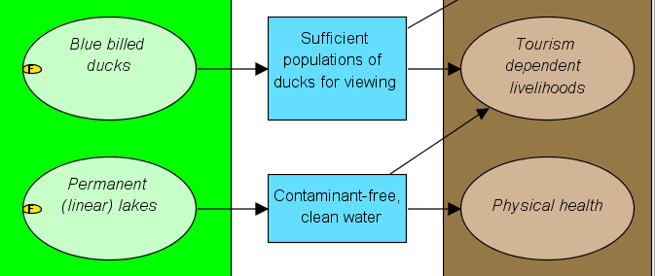
HWB Goals & Indicators
By 2030 and thereafter, damage to homes and farms from drought and flooding has decreased by at least 75%, compared to 2010 levels
Indicator: average daily cubic meters released by dry and wet season
Indicators: Annual $ value of damage to homes from flooding
Annual $ value of damage to farms from drought and flooding
Indicator: Abundance of blue-billed ducks in tourism areas
By 2030 and thereafter, at least 90% of nature tourism companies indicate they have sufficient good quality wildlife and habitat to draw in tourists
Indicator: % nature tourism companies indicating sufficient quality wildlife and habitat
By 2030 and thereafter, fewer than 10 cases of water-borne diseases are recorded annually within the region
Indicator: Fecal coliform concentration (in dry & wet seasons)
Indicator: # cases of water-borne diseases recorded annually within the region

Slide 9
Topics
Overview of HWT concepts
Testing of HWT in field
Reactions to HWT framework
Discussion Questions

Slide 10
Testing in Field
Lots of experience!!
Dissemination: CCNet Europe Webinar 2012, CGBD 2012, CCNet Global Rally 2013, CCNet Europe Rally 2013, ICCB/SCB 2013 - Marcia and Daniel, USAID 2013, WCS brown bags, Dfid, Imperial College symposium, North American CCNet Webinar
Application: TNC New Mexico 2013, CONANP - Mexico 2013, USAID - Philippines, Nepal, Indonesia, Congo 2014; IICA, Uganda 2013, PCRM West Africa 2013, Sweden 2013, WCS-GIZ Colombia 2014, Disney Coral Reef Conservation 2013, NOAA Hawaiian Monk Seals 2013, ABCG Strategic Planning 2013-14, USFWS Refuges Region 8, Rare internal planning, CCNet new coach trainings, TNC - In the Gulf of California / Mexico's Northern Pacific, Bush Heritage work with indigenous communities
Notes:
CCNet Europe Webinar 2012
CGBD 2012
CCNet Global Rally 2013
CCNet Europe Rally 2013
ICCB/SCB 2013 - Marcia and Daniel
USAID 2013
WCS
Brown bags for senior staff
Dfid
International meetings - David to update
Dfid-funded Valuing Nature Network - NERC-Dfid funded project to integrate human-nature needs - big symposium at Imperial College (ESCI grant - looking to see how to capture a state in wellbeing status and then attributing that to conservation - fact that CMP added HWTs into OS is great, but need to get other groups like ESCI, NERC, NORAD to understand that conservation community grasped it)
North American CCNet Webinar 2013 (included sharing guidance material)
Supin W. and Erin/Aaron(?) - shared a measures document on social science (Strengthening the Social Impact of Sustainable Landscape Program)
Application
FOS Facilitations:
TNC New Mexico 2013
CONANP - Mexico 2013
USAID - Philippines, Nepal, Indonesia, Congo 2014; IICA, Uganda 2013
PCRM West Africa 2013
Sweden 2013
WCS-GIZ planning with local governments for dry forest conservation in Colombia (3 files, all in Spanish) 2014
Disney Coral Reef Conservation 2013
NOAA Hawaiian Monk Seals 2013
ABCG Strategic Planning 2013-14
USFWS Refuges, Region 8, Anaho National Wildlife Refuge
Rare’s own planning - used Dfid categories but CMP guidance. Don’t have skill set or people with skills for monitoring HW indicators. In terms of timing, HW results are longer-term results, 6-10 years out, but many projects are shorter-term (socially-beneficial strategies in service of conservation). Attribution also gets tricky.
CCNet new coach trainings. Also, lots of discussion of HWT topic on CCNet listserve. Some concerns expressed by some coaches, feeling that we’re trying to constrain people in the way coaches can present relationships, but these people hadn’t actually read the HWT guidance.
TNC - In the Gulf of California / Mexico's Northern Pacific TNC has identified measures and are refining them. We aligned our measures to How is your MPA doing, which includes a pretty complete list of governance & socio-economic indicatrors
USAID CARPE Central Africa has adopted a standard set of metrics across all its partners. David will share details of this.
Bush Heritage - Stuart Cowell does a lot of work with indigenous communities - using it but not following it exactly. Their experience is that ES model doesn’t work with indigenous communities. Guidance has been very beneficial but want some more freedom on how to use/ interpret guidance. This issue came up during 2013 CCNet Rally.

Slide 11
Reactions
Generally, very positive
Changed the way OS users (and much of conservation community) are thinking about and addressing nature-human linkages
Main criticism – not adequate for use in indigenous cultures

Slide 12
Topics
Overview of HWT concepts
Testing of HWT in field
Reactions to HWT framework
Discussion Questions

Slide 13
Discussion Questions
Have you used HWT Guidance? What has been your experience? Reactions, suggestions…
Have you used guidance to just show relationships or have you also established goals/indicators?
How can we help teams identify relevant indicators for connections between conservation & human wellbeing?
Methodologies for easily/ affordably measuring human wellbeing

