Slide 1
5 measures
A dashboard
to record and report
conservation impacts

Slide 2
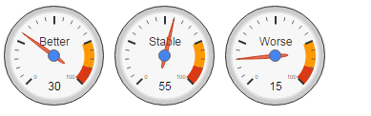
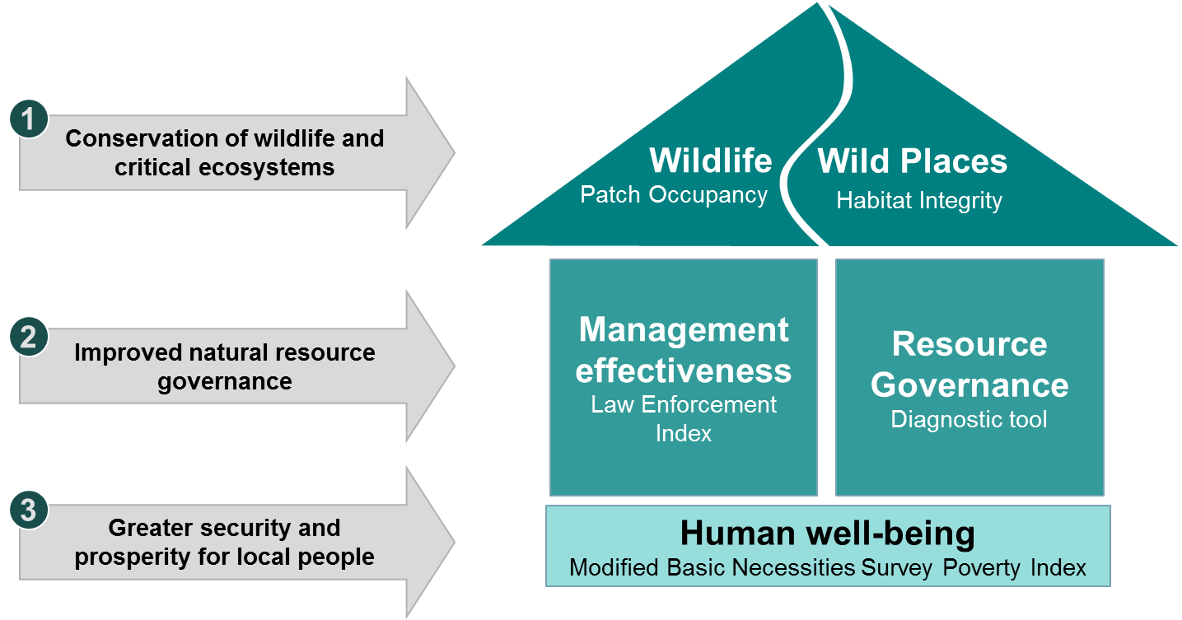
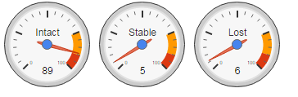
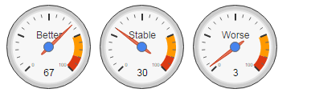
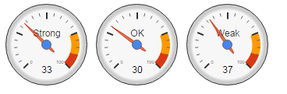
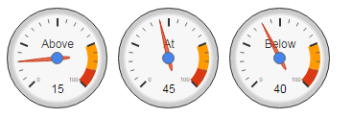
WCS 5 Measure Dashboard
State of conservation in 45 landscape and seascapes covering 6 million square miles
Indicator species
Habitat quality
Illegal resource use
Resource governance
Local livelihoods
Click a gauge for more information

Slide 3
Built on a clear theory of change
Measure 4
Governance index
Measure 1
Species Patch Occupancy
Measure 3
SMART law enforcement index
Strategic actions and investments
Resource governance systems are strengthened
Species
Targets
Resource management is more effective
Direct threats are reduced or abated
Economic incentives for sustainable resource management are increased
Habitat
Targets
Measure 2
Cover Change
Measure 5
Local livelihood index
Notes:
So building on what we are already monitoring and focusing on the general and broadly applicable approach that we take to effect conservation and save wildlife and wildplaces – it makes sense for our organization to measure 5 things.
The species that are our conservation targets. Their habitat. The threats to our conservation targets and whether their management in improving over time. The governance systems that we investing time and effort to strengthen and the livelihoods of local people who are typically our strongest constituents for conservation.

Slide 4
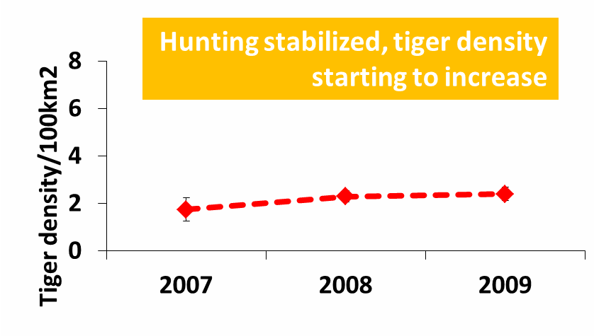
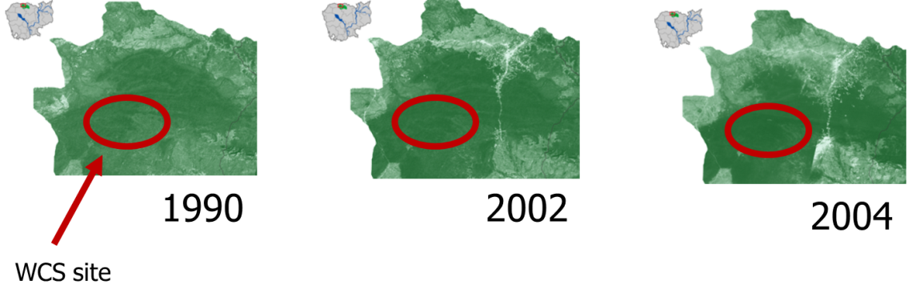
Both impact & effectiveness
Impact measures
  Do we see positive trends in the status of the things we care about?
Effectiveness measures
  Can we attribute observed status trends to WCS actions and investments?
  Can we better understand what works and what does not?
Notes:
Measuring complex outcomes of environment and development interventions - 500,000 pound 3 year grant from the Economic and Social Research Council/DFID

Slide 5
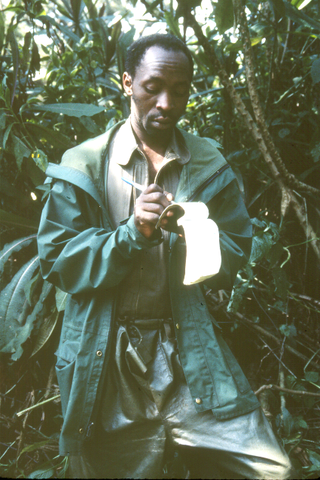
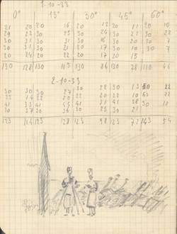
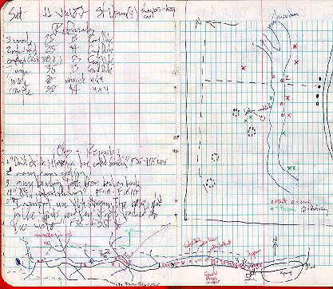
Power of 5 measures
Affordable
1
Flexible
2
Scalable
3
Repeatable
4
5
Good enough
Uses industry standard methods

Slide 6
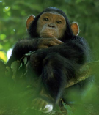
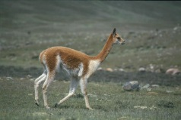
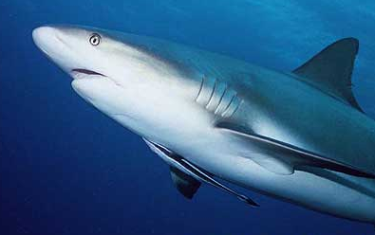
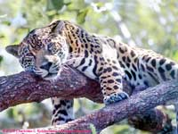
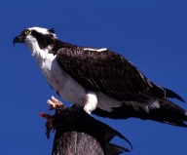
Species – patch occupancy
Target Results | Measures
Conservation of wildlife and critical ecosystems | Wildlife patch occupancy
 | Habitat and ecological integrity
Improved natural resource governance | Management effectiveness
 | Resource governance
Greater security and prosperity for local people | Human well-being
Time 0
Time 1
Time 2

Slide 7
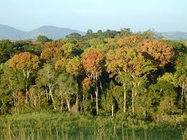
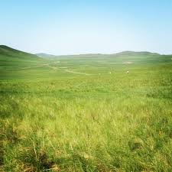
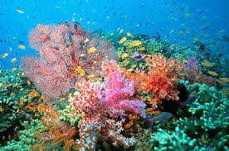
Habitat - Cover
Target Results | Measures
Conservation of wildlife and critical ecosystems | Wildlife patch occupancy
 | Habitat and ecological integrity
Improved natural resource governance | Management effectiveness
 | Resource governance
Greater security and prosperity for local people | Human well-being
Time 0
Time 1
Time 2

Slide 8
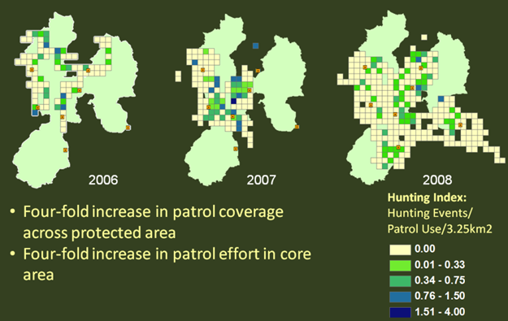
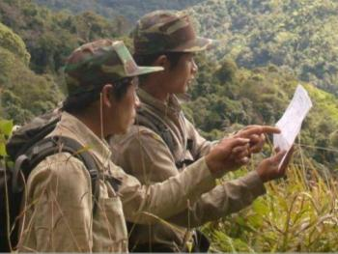
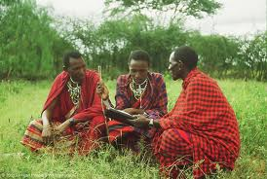
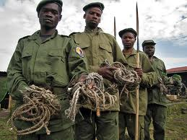
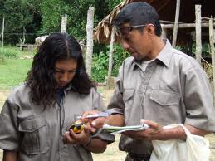
Threats – SMART LEM
Target Results | Measures
Conservation of wildlife and critical ecosystems | Wildlife patch occupancy
 | Habitat and ecological integrity
Improved natural resource governance | Management effectiveness
 | Resource governance
Greater security and prosperity for local people | Human well-being

Slide 9

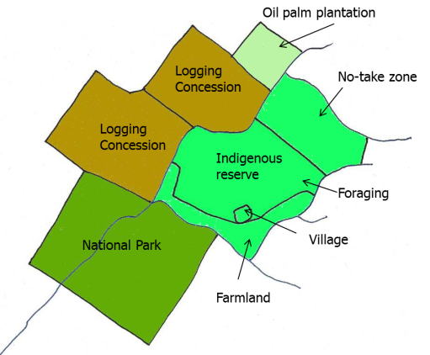
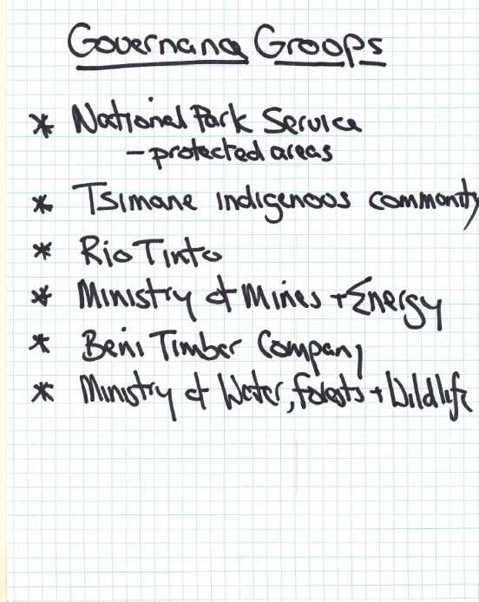

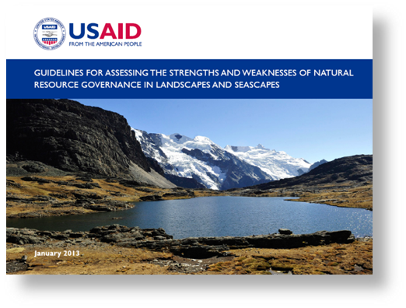
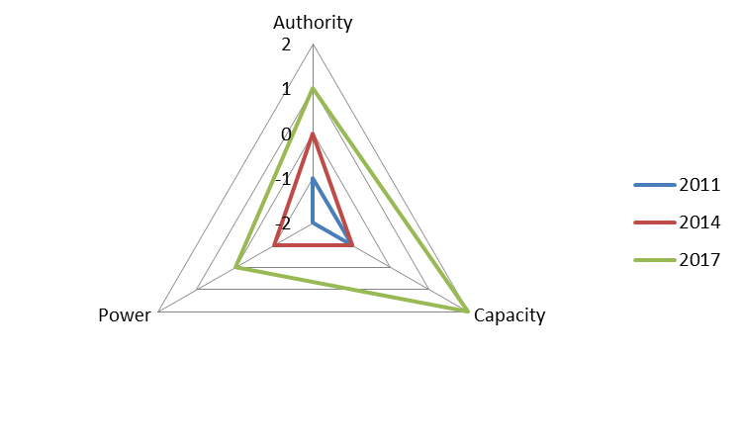
Governance
Target Results | Measures
Conservation of wildlife and critical ecosystems | Wildlife patch occupancy
 | Habitat and ecological integrity
Improved natural resource governance | Management effectiveness
 | Resource governance
Greater security and prosperity for local people | Human well-being
Evaluating authority, capacity and power to govern

Slide 10
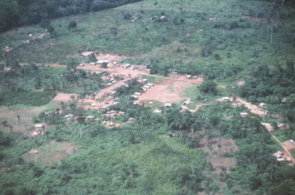
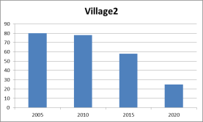
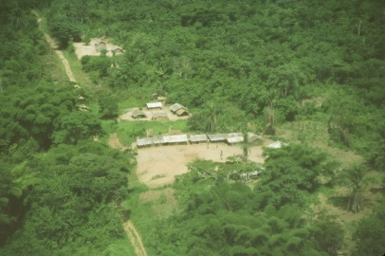
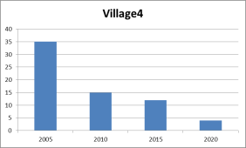
Local livelihoods
UN
“Poverty is a lack of
basic necessities”
Target Results | Measures
Conservation of wildlife and critical ecosystems | Wildlife patch occupancy
 | Habitat and ecological integrity
Improved natural resource governance | Management effectiveness
 | Resource governance
Greater security and prosperity for local people | Human well-being
Basic Necessities Survey
Locally defined
Easy to measure
Maps onto World Bank metrics

Slide 11
5 Measures
“Imperfect but good enough”

